Slide 1
Vista Park Remediation project FOURTH update meeting
OCTOBER 8, 2019

Slide 2
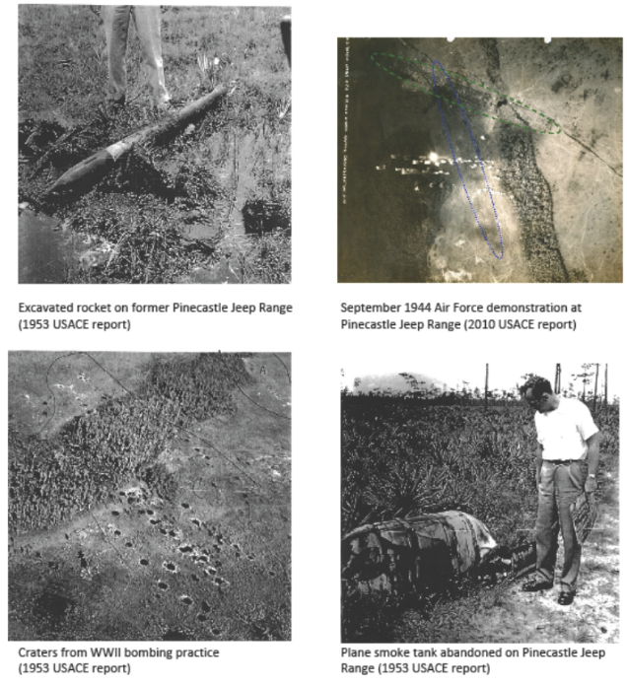
Historical images of munitions use on former pinecastle jeep range

Slide 3
VISTA PARK REMEDIATION: RESOLVING WWII-ERA ENVIRONMENTAL CONTAMINATION AND PUBLIC SAFETY RISKS

Slide 4
HOW WE GOT HERE
The contamination stems from military use of the property, part of the former Pinecastle Jeep Range, for a variety of munitions training and demonstration exercises during World War II.
In 2007, investigation and studies conducted by the U.S. Army Corps of Engineers (ACOE) identified hazards including bomb craters, munitions debris, and soils contaminated with explosive compounds.
The ACOE studied the site in 2008, but has not implemented any specific plan to remediate the full site. The ACOE has not committed to a date for remediation of any portion of Vista Park in the foreseeable future.
The Florida Department of Environmental Protection (FDEP) approved the Voluntary Cleanup Order (VCO) following the owner’s submittal of a detailed plan for the clearance process.

Slide 5
What you can expect
Neighbors will be fully informed on each primary phase of cleanup activity, so they know what to expect from the clearance process.
State government oversight of the Unexploded Ordnance (UXO) Remediation project. The FDEP, through its VCO, prescribes strict guidelines for the remediation and restoration process.
Neighbors will see equipment brought in to clear the land, as well as deliveries of scanning devices used to detect subsurface anomalies (potential Munitions and Explosives of Concern [MEC]).
Future meetings, so the community can receive updates and provide input on the progress of the remediation efforts.

Slide 6
Vista Park Site Marked With Munitions Remediation Sectors

Slide 7
SITE WIDE PRE-REMEDIATION

Slide 8
SITE WIDE POST-REMEDIATION

Slide 9
Preliminary Wetland Evaluations Used in Developing the FDEP Voluntary Cleanup Order - completed
Researched historical databases including aerial photography; published wetland maps; U.S. Geological Survey topographic surveys
Field delineated all wetlands and located by Global Positioning System
Conducted preliminary functional wetland assessments
Researched listed species databases for potential occurrence of Threatened and/or Endangered wildlife species or Species of Special Concern
Coordinated with Project Team on techniques for UXO (munitions) sampling in wetlands, and post remediation
Evaluated potential wetland restoration approaches
Coordinated wetlands evaluations and procedures with FDEP

Slide 10
Vista Park Site Marked With Munitions Remediation Sectors
Completed (FDEP accepted & NFA)
ASCR Completed
Work On-going

Slide 11
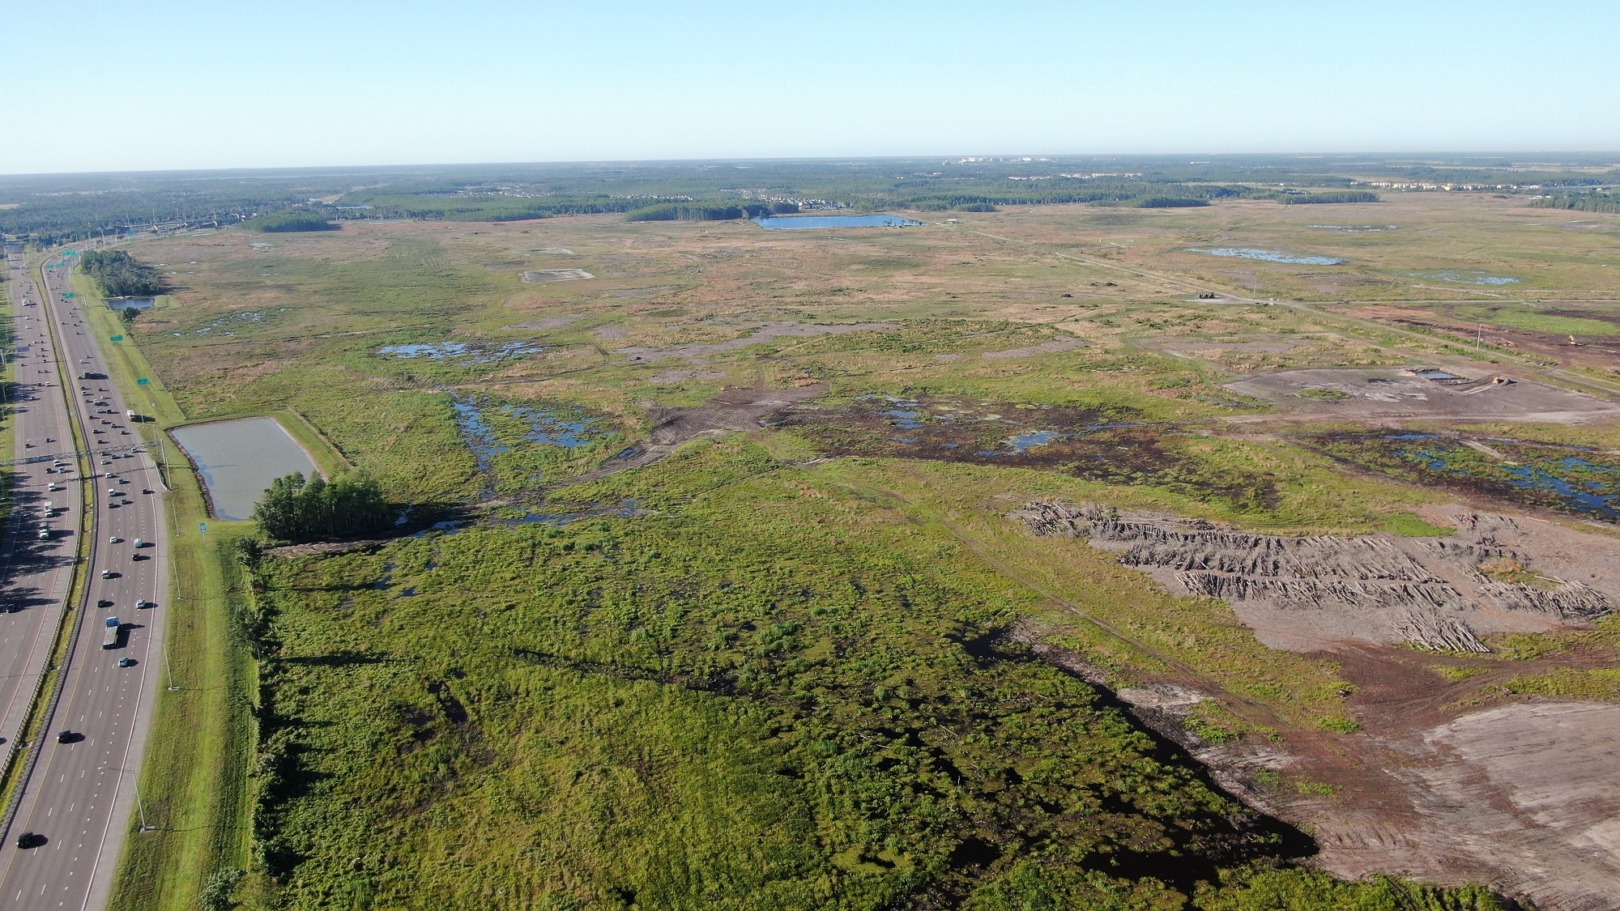

Slide 12
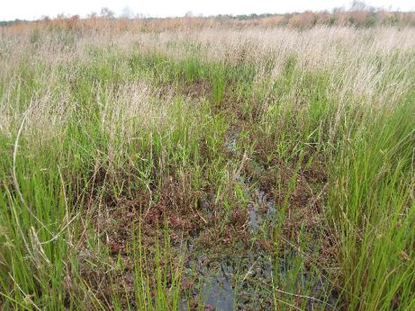

Slide 13
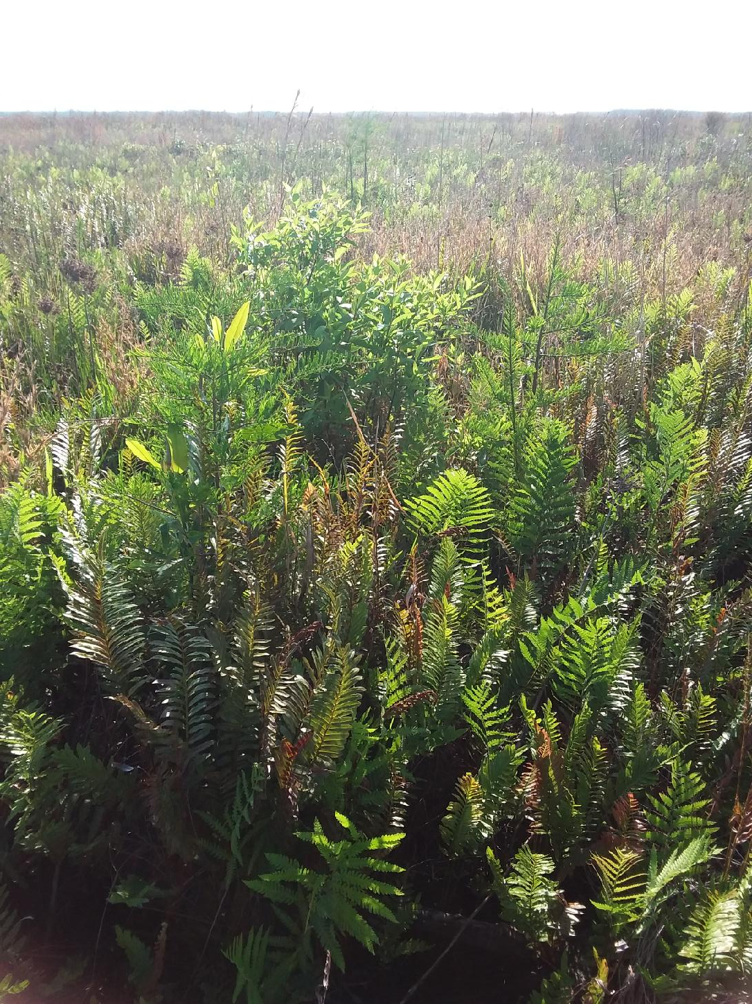

Slide 16
Wetland Requirements associated with the FDEP Voluntary Cleanup Order
FDEP site review completed site-wide prior to initiation of work
Baseline Uniform Mitigation Assessment Method Evaluation (UMAM) & FDEP review completed site-wide prior to initiation of work
UMAM analysis of proposed wetland impact area completed site-wide prior to initiation of work
100% gopher tortoise survey to be completed by sector and any gopher tortoises will be relocated following Florida Fish and Wildlife Conservation Commission permitting criteria [100% surveys completed for all sectors; relocation permits issued for all sectors]

Slide 17
Wetland Requirements associated with the FDEP Voluntary Cleanup Order (Continued)
Water bird nesting colony survey to be completed by sector [completed for all sectors]
Florida sandhill crane survey to be completed by sector [completed for all sectors]
VCO site work completed by sector (Sectors A, B, and C – completed and accepted by FDEP and No Further Action [NFA] Issued; Sectors D and E – Area Specific Completion Reports submitted to FDEP and pending review; Sectors F and G – remediation activities are on-going)
FDEP post-remediation review and mitigation debit analysis to be completed by sector [completed for Sectors A, B, C, D, and E]
Upon issuance of the FINAL NFA determination, all necessary submittals will be made to obtain issuance of the Site Rehabilitation Completion Order

Slide 18
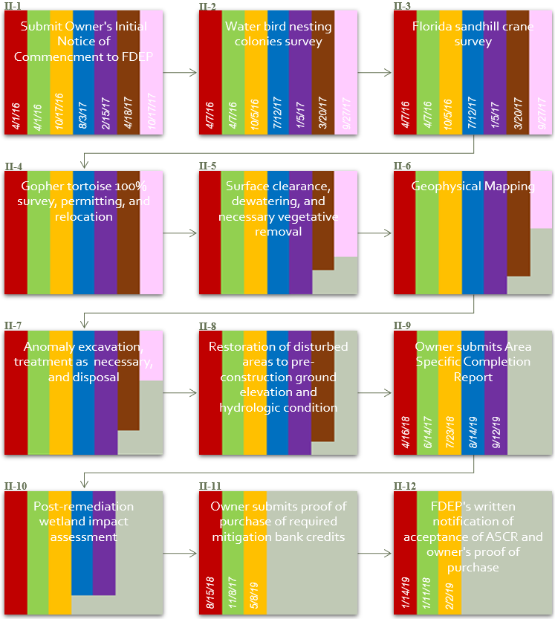
SITE WIDE REMEDIATION PROCESS SECTOR BY SECTOR

Slide 19
Vista Park UXO Remediation Process

Slide 20
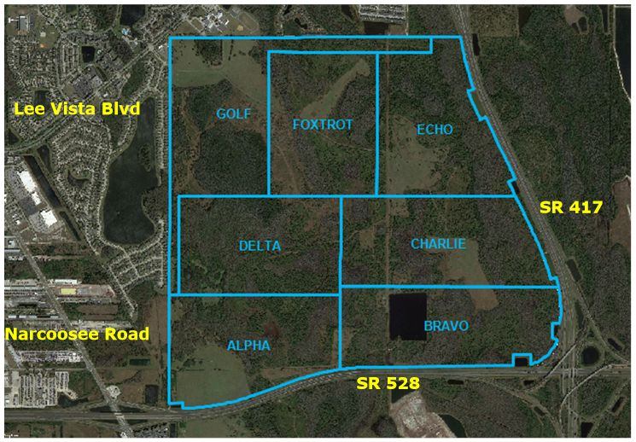
Notes:
Site Description - describe the location compared to known roads and describe the Sectors we are working in

Slide 21
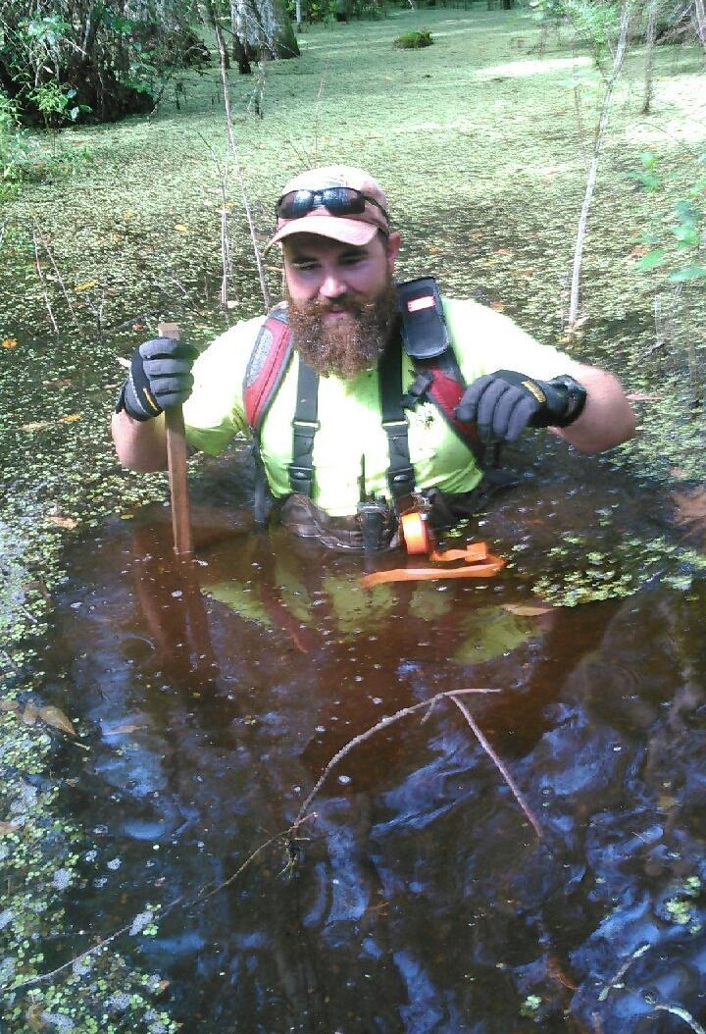
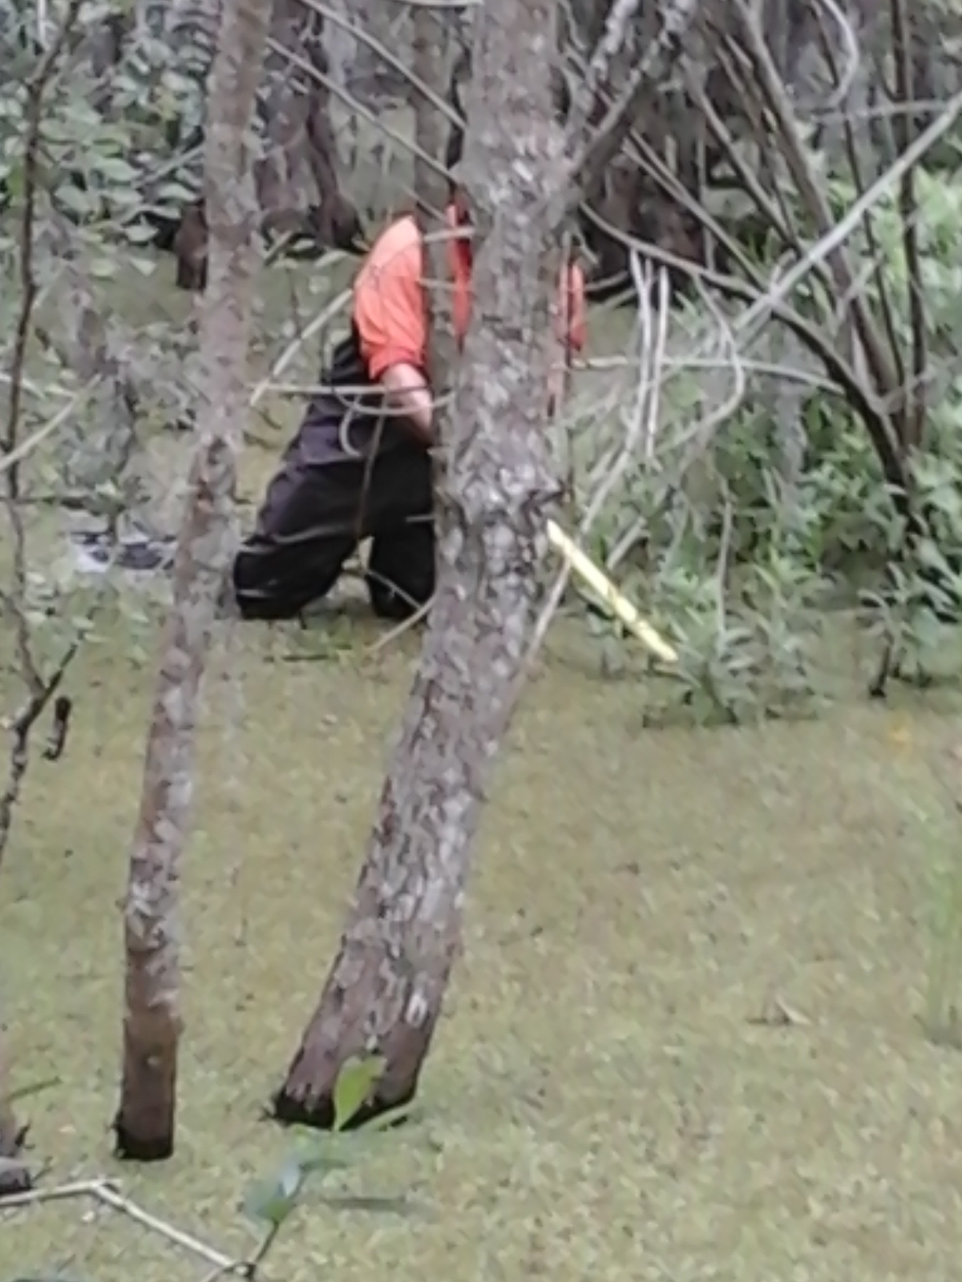
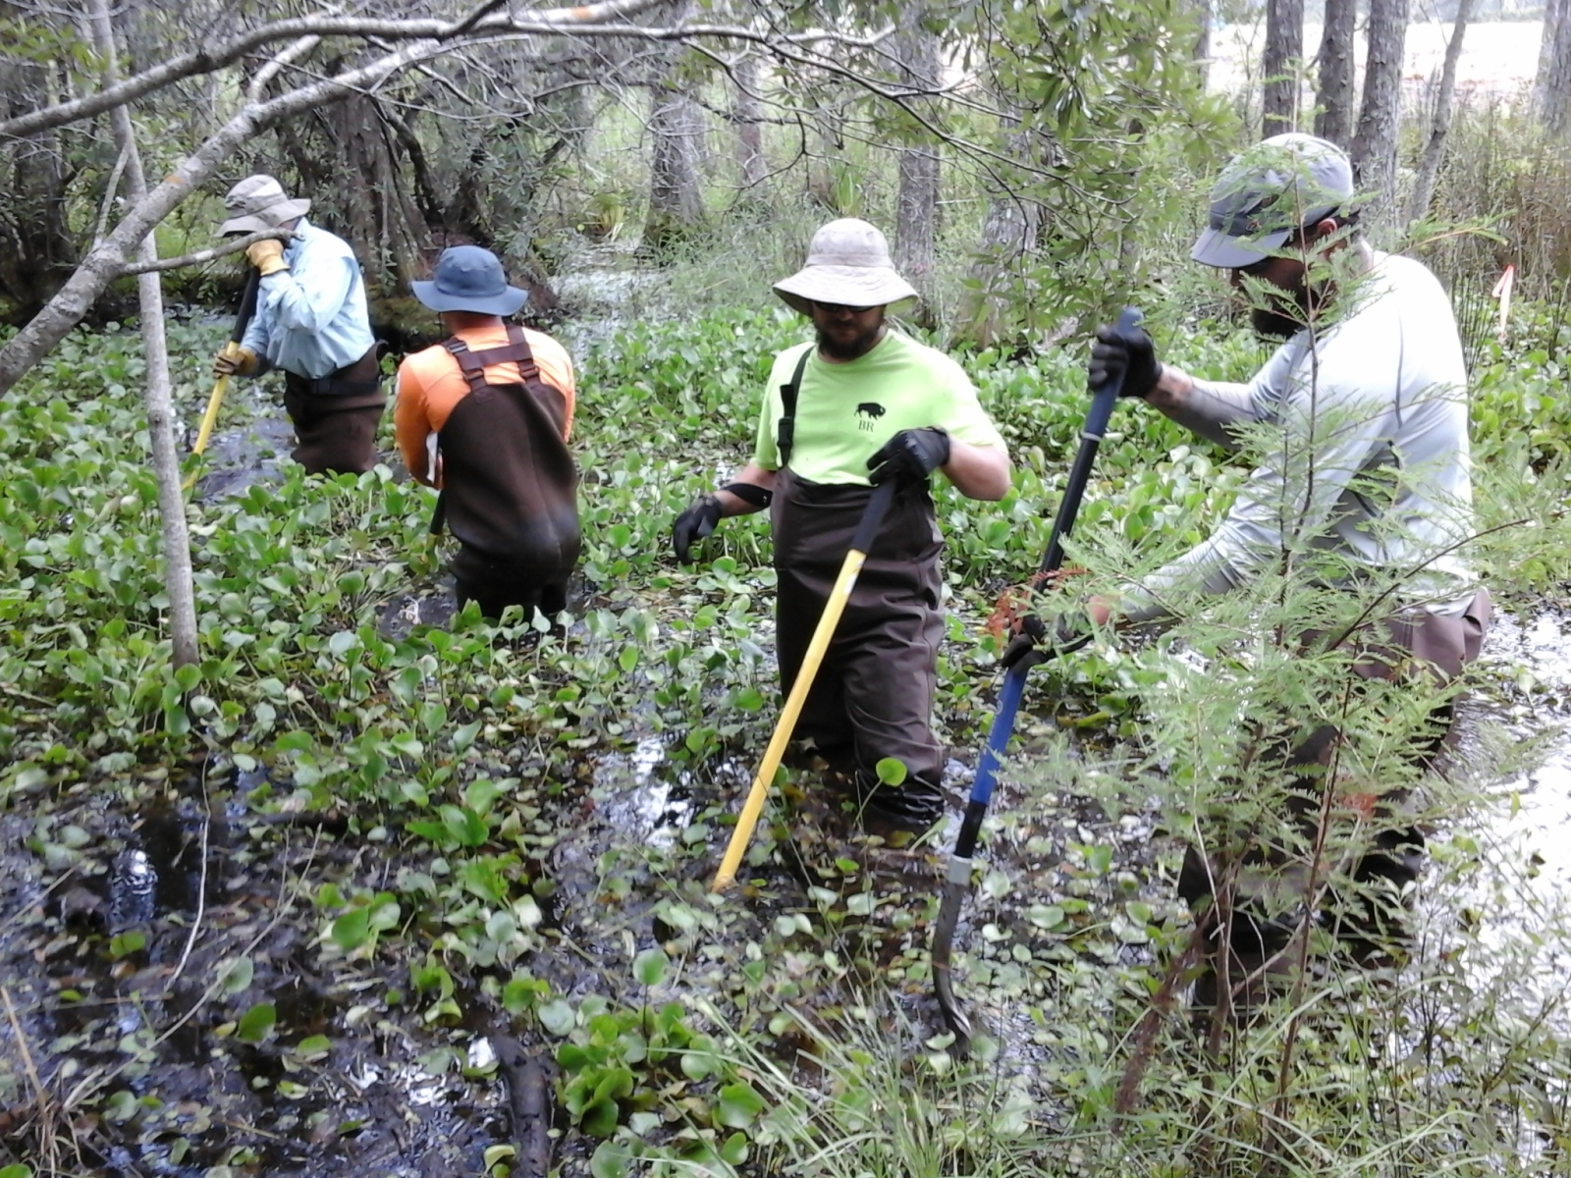
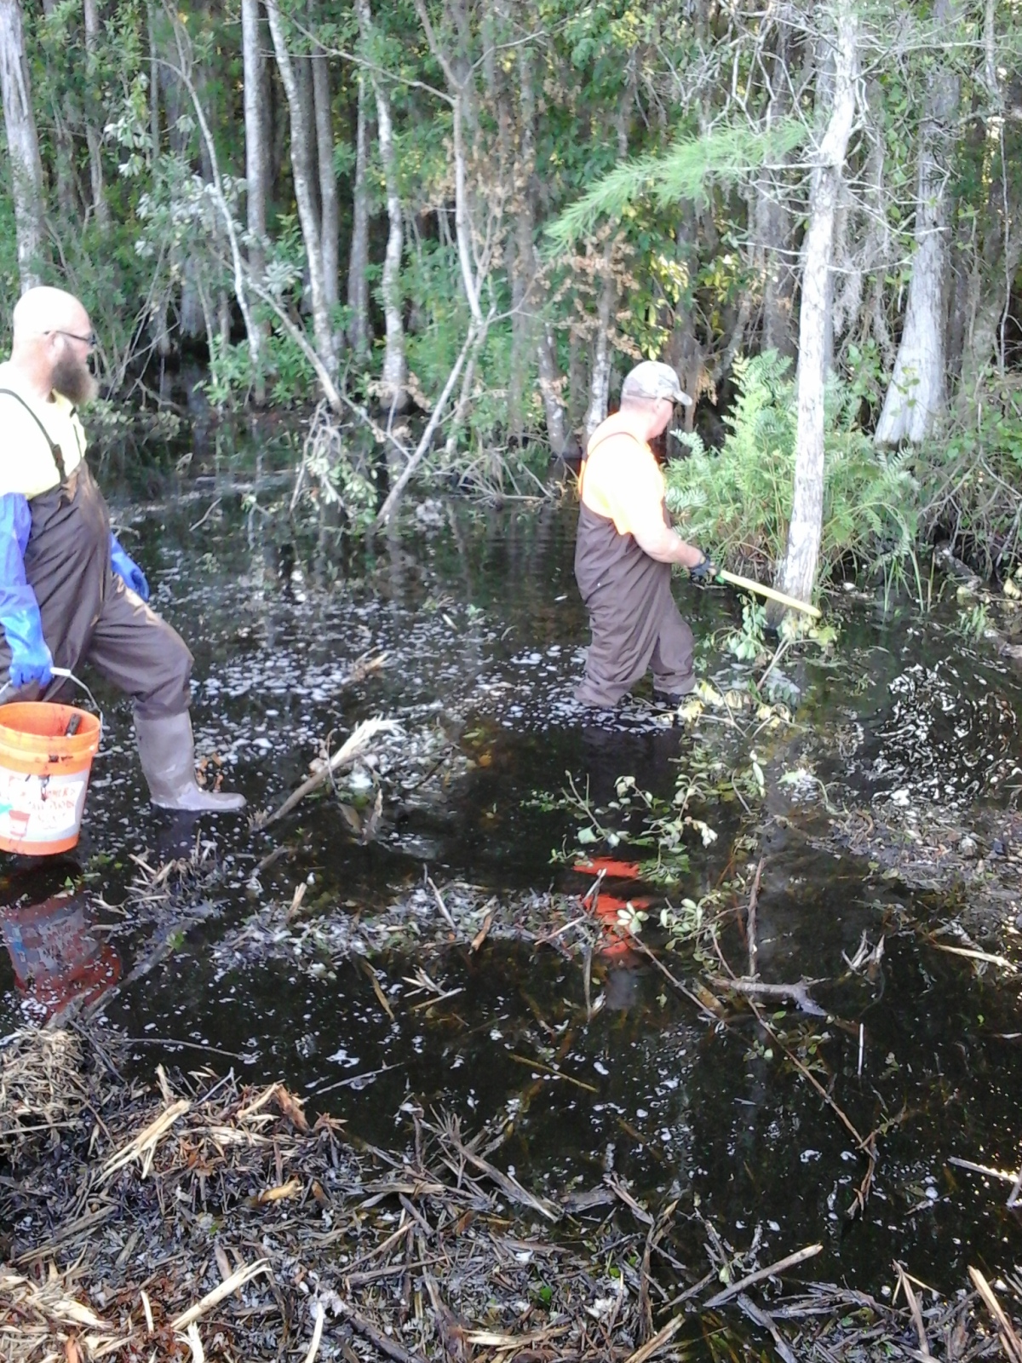
Notes:
These are some examples of Site Conditions

Slide 22
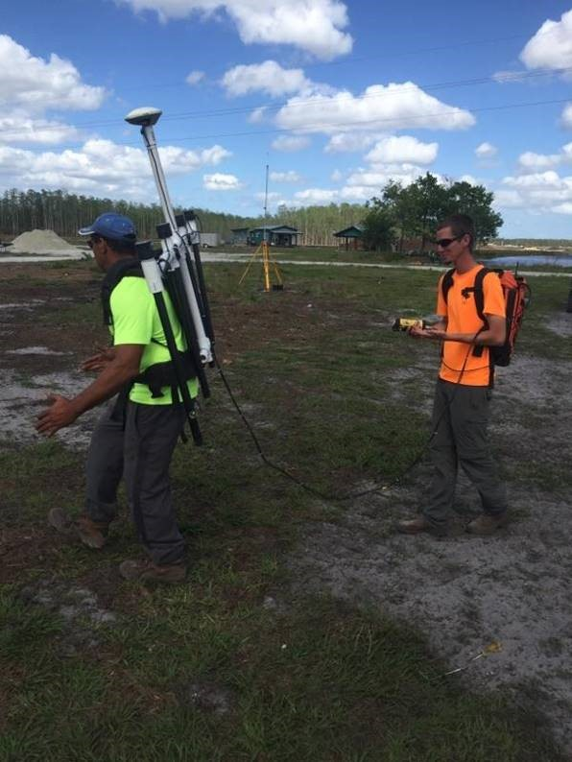
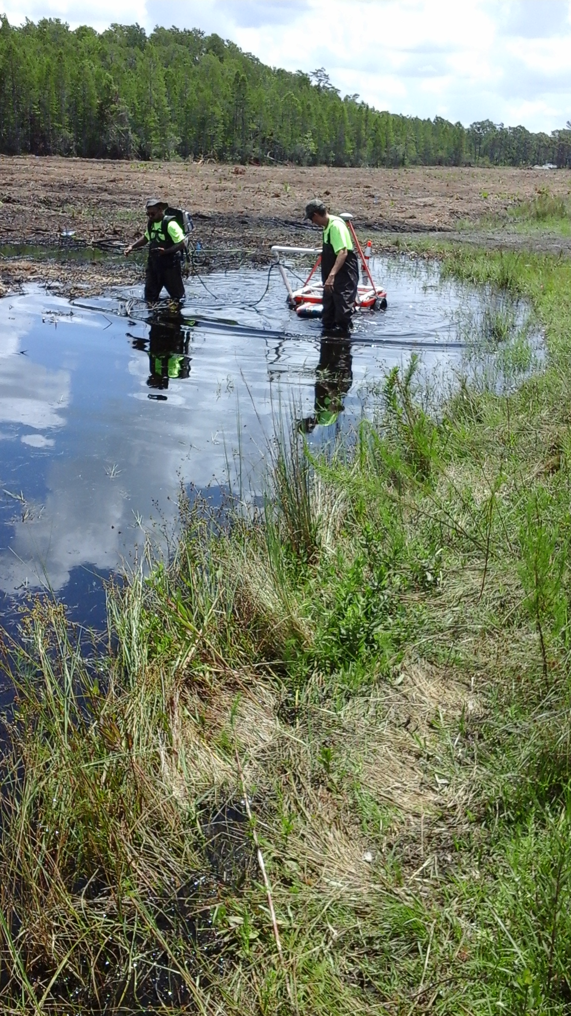
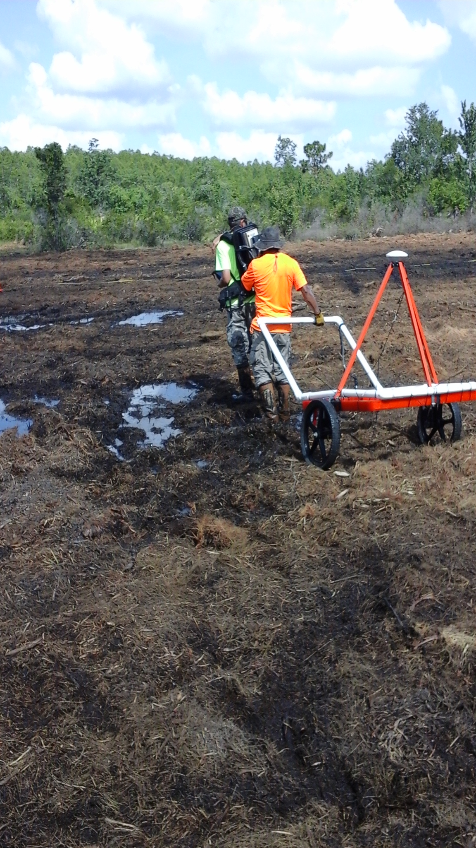
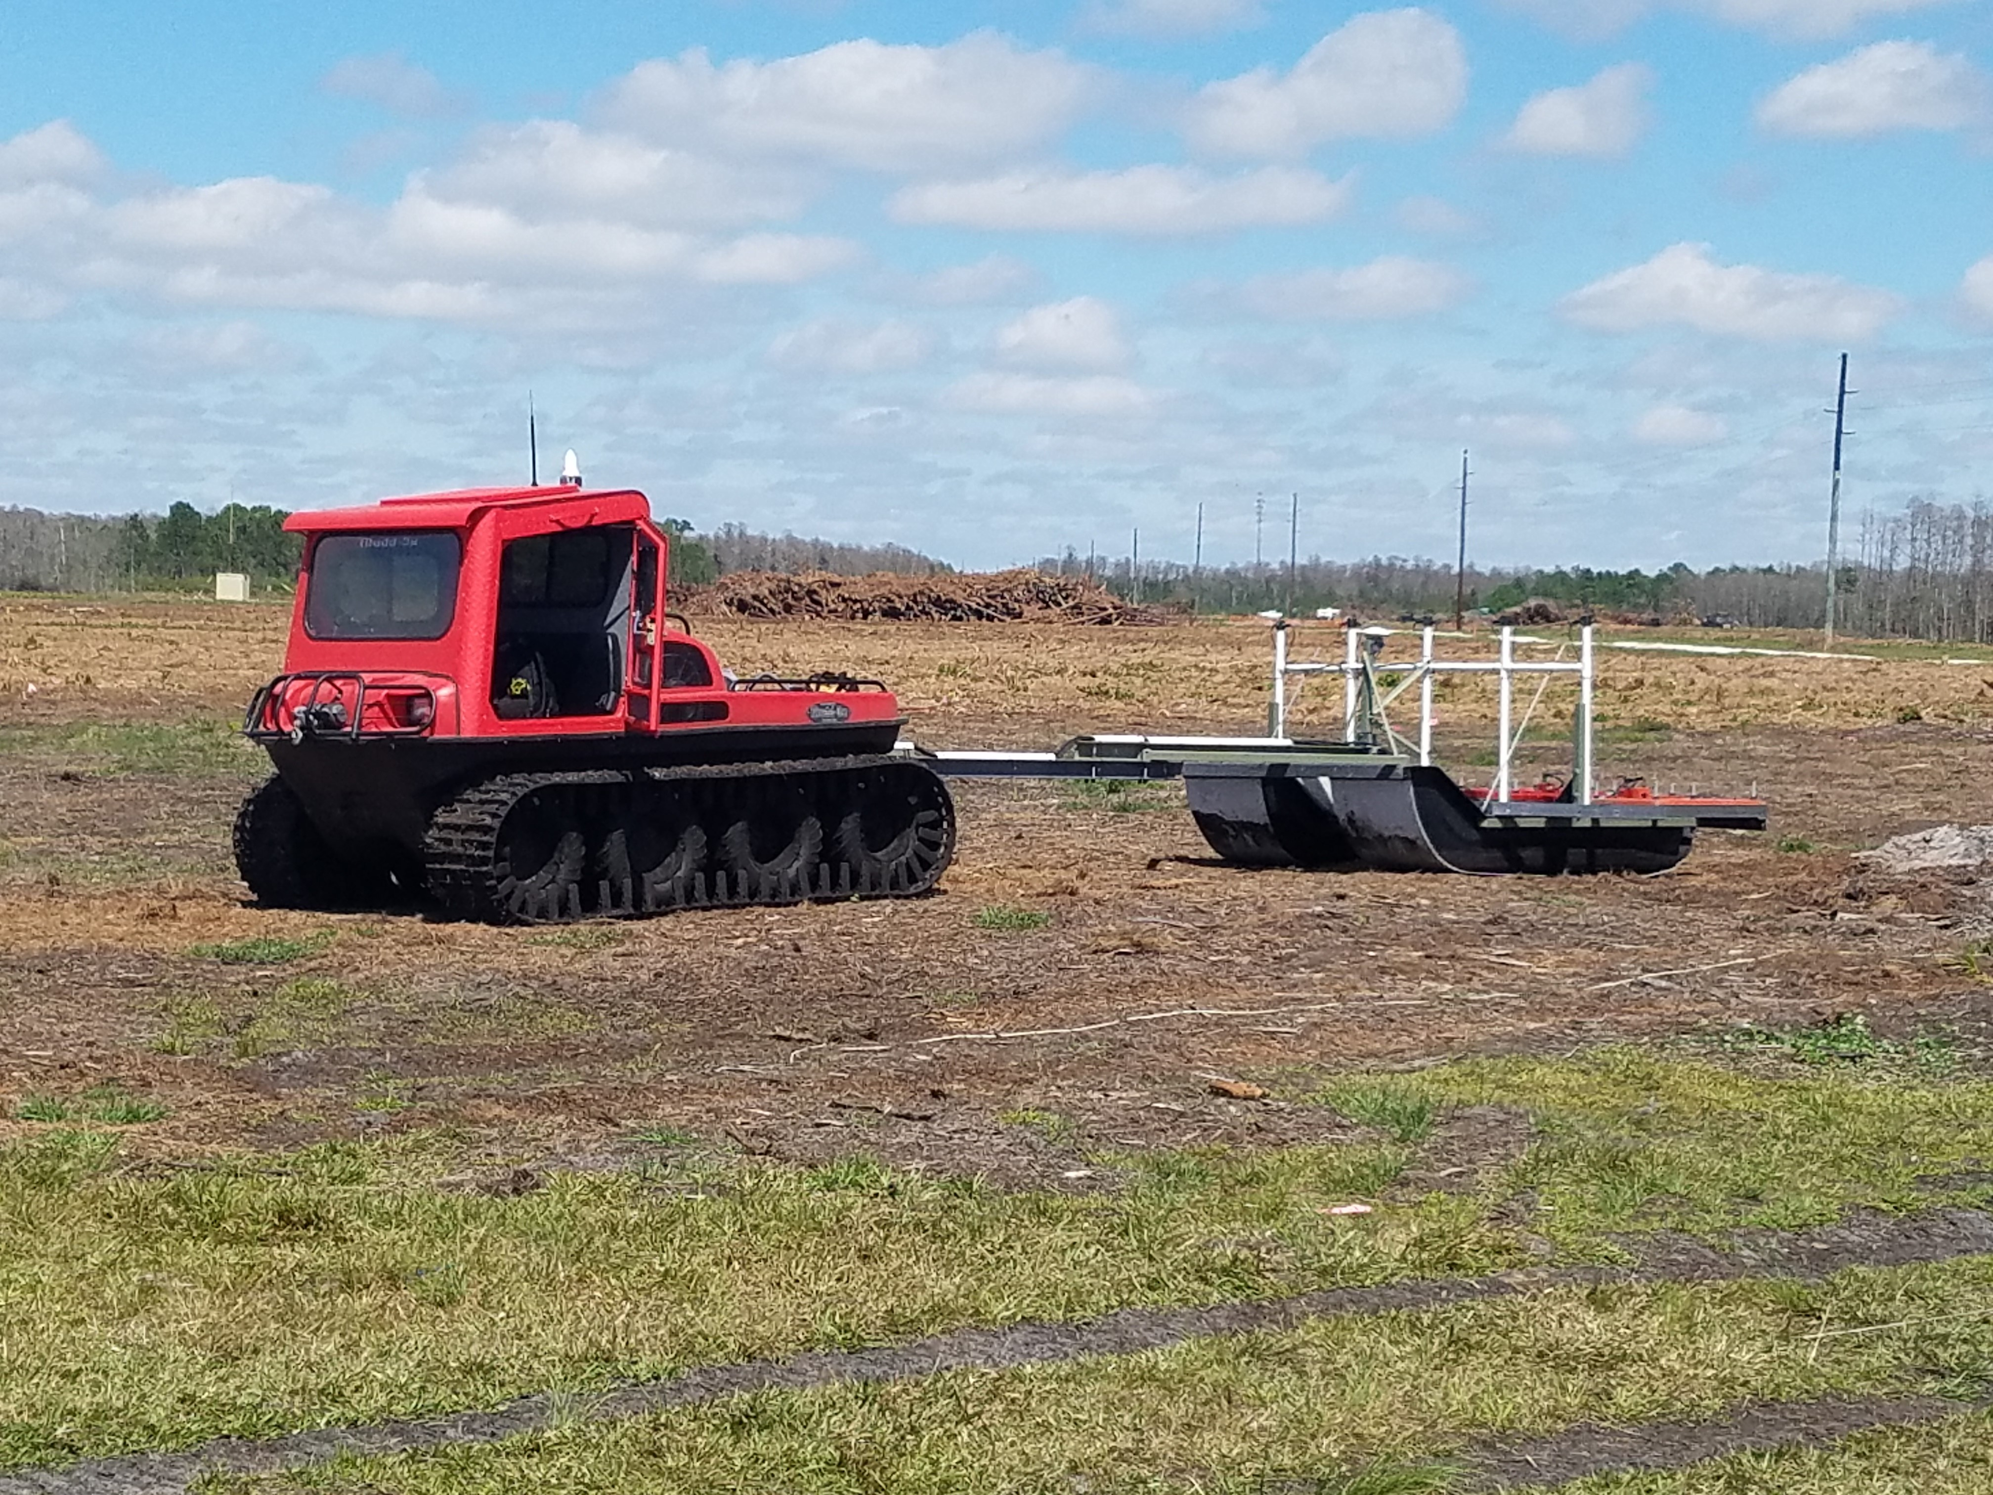
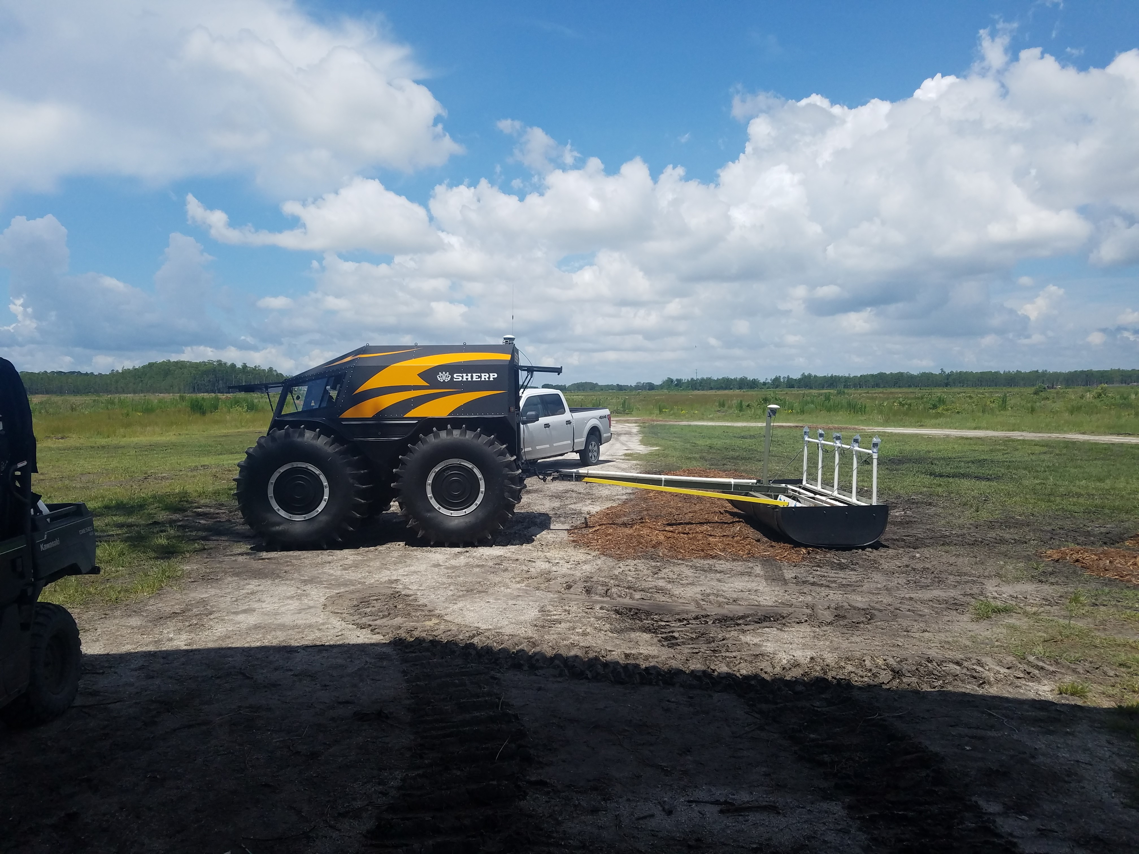
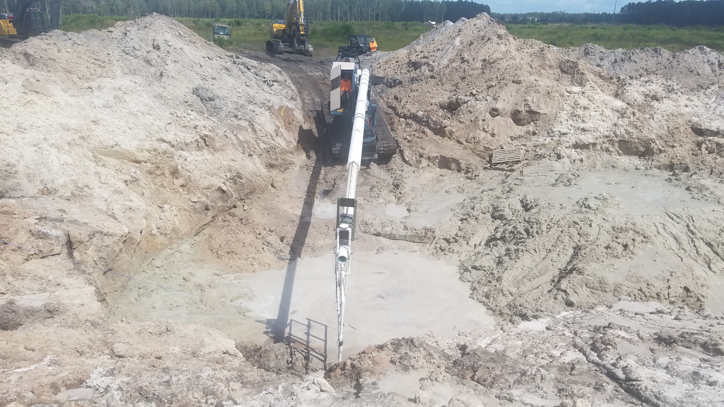

Slide 23
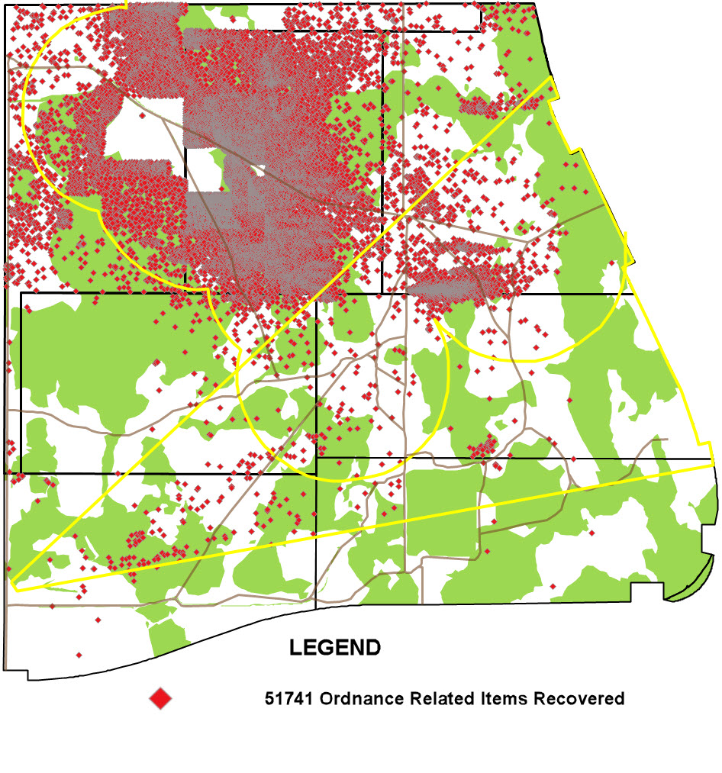

Slide 24
UXO/MD FOUND IN SECTORS A, B, C, D, E, AND F
2.36-inch Rockets (Bazooka)/2-in/3-in/4-in/4.5-in rockets
3.5-inch rocket warhead (aircraft fired)
4.2-inch mortar
5-inch rockets and fuzes (aircraft fired)
4lb fragmentation submunitions
20lb fragmentation bombs
20lb practice bombs
60lb infantry training bombs
20mm/37mm/57mm projectiles
60mm mortars
75mm HE/WP/HEAT projectiles
4lb/500lb incendiary bombs
100lb target identification bombs
Total of 3,333 UXO items
AN-M166 VT fuze
Aircraft explosive actuator cartridges
Fire bomb components and filler residue.
Bomb nose and tail fuzes and components
Bulk explosives
General Purpose Bomb base fuzes and fragmentation
Illumination candle
Projectile and rocket nose and tail fuzes
Rifle grenades
Rocket nose and tail fuzes
Signal flares
White phosphorous bursters and components

Slide 25
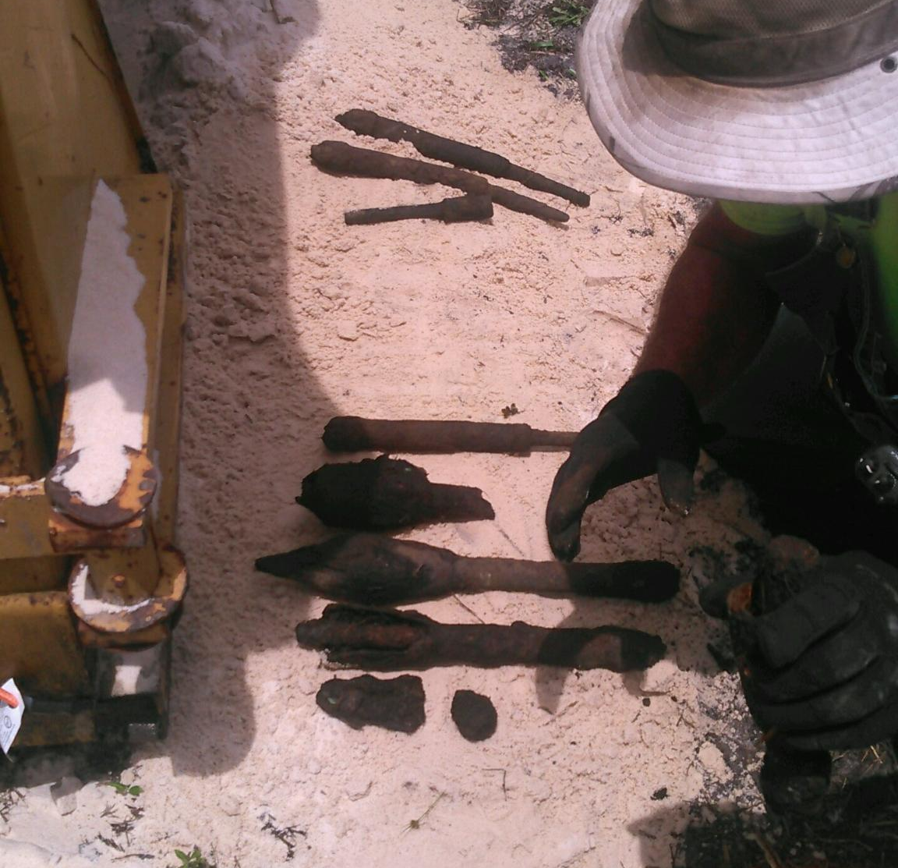
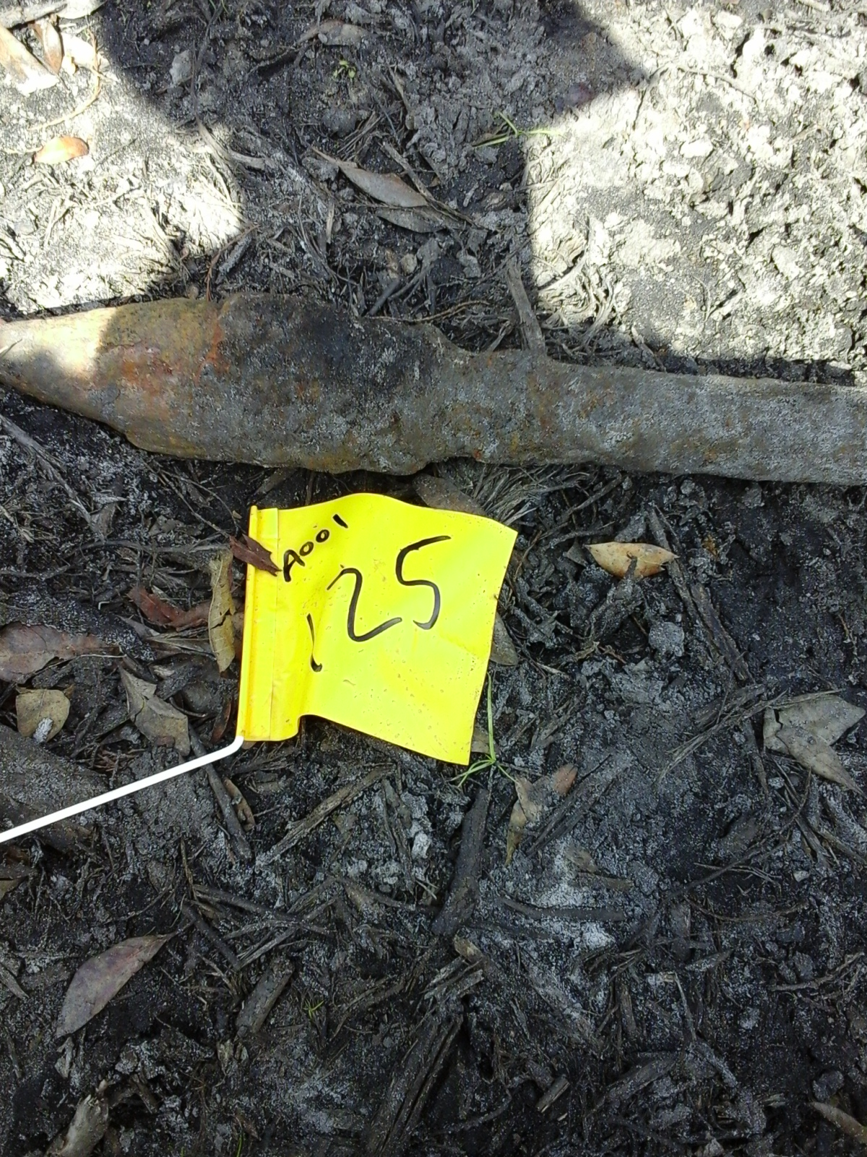
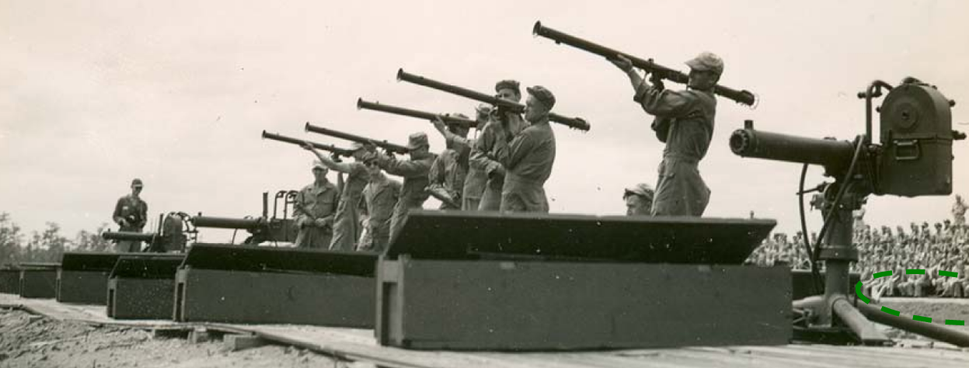
2.36-inch Rockets
(Bazooka)

Slide 26
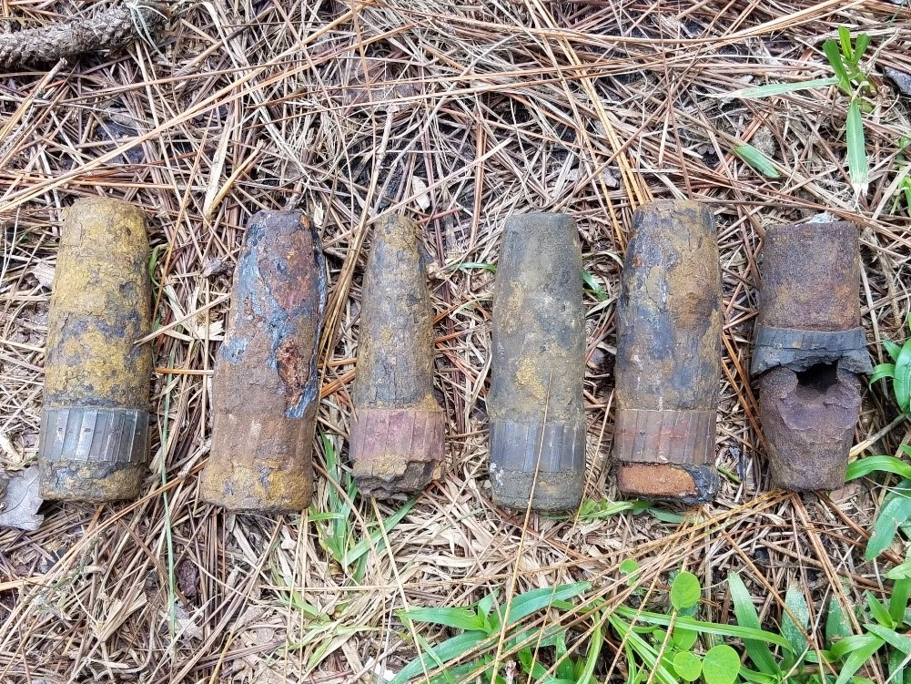
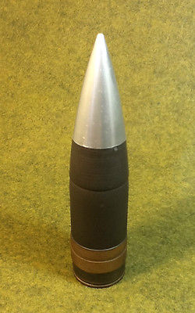
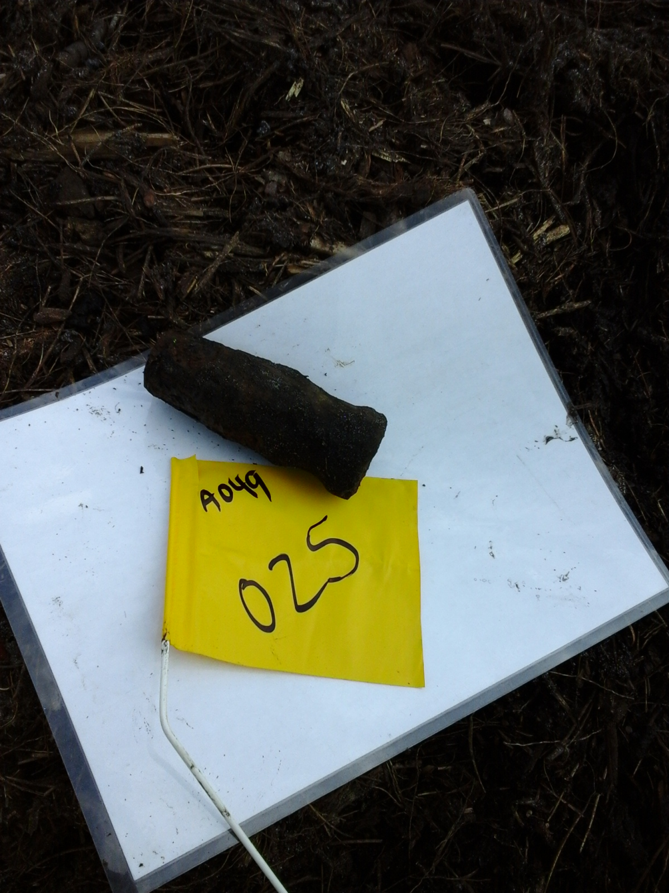
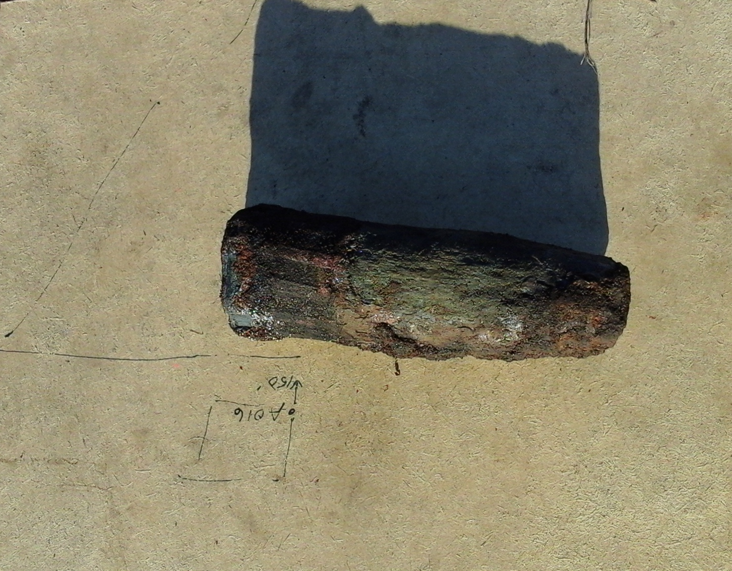
37mm Projectiles

Slide 27
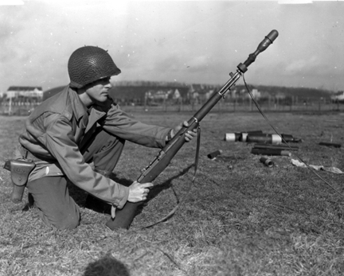
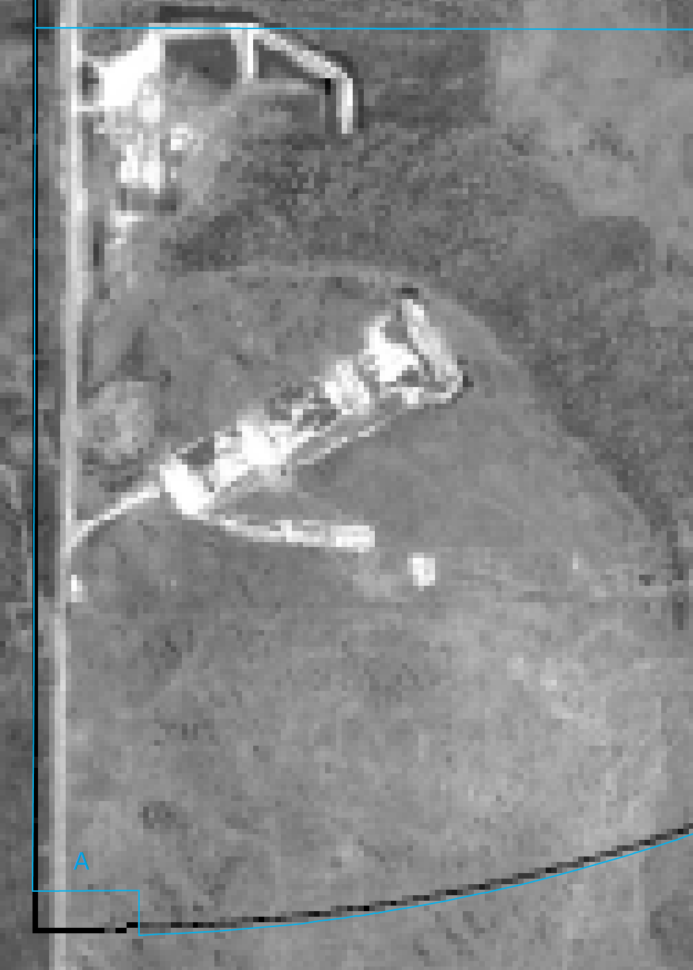
Rifle Grenades
Alpha Sector Rifle Ranges

Slide 28
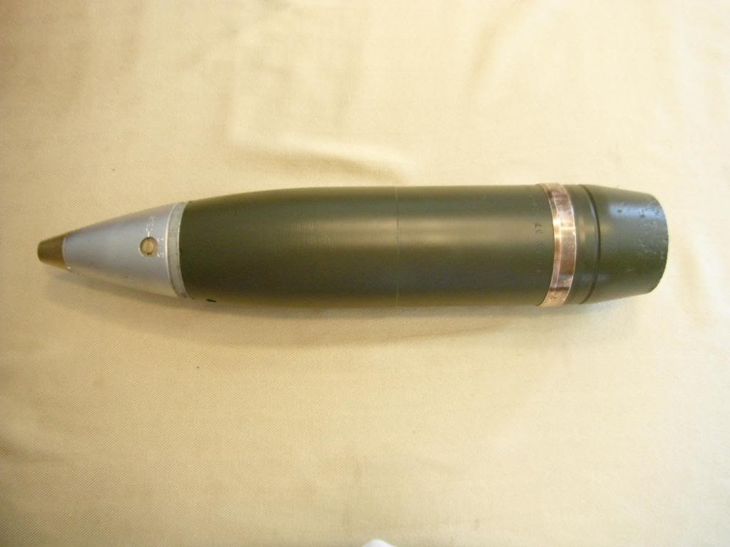
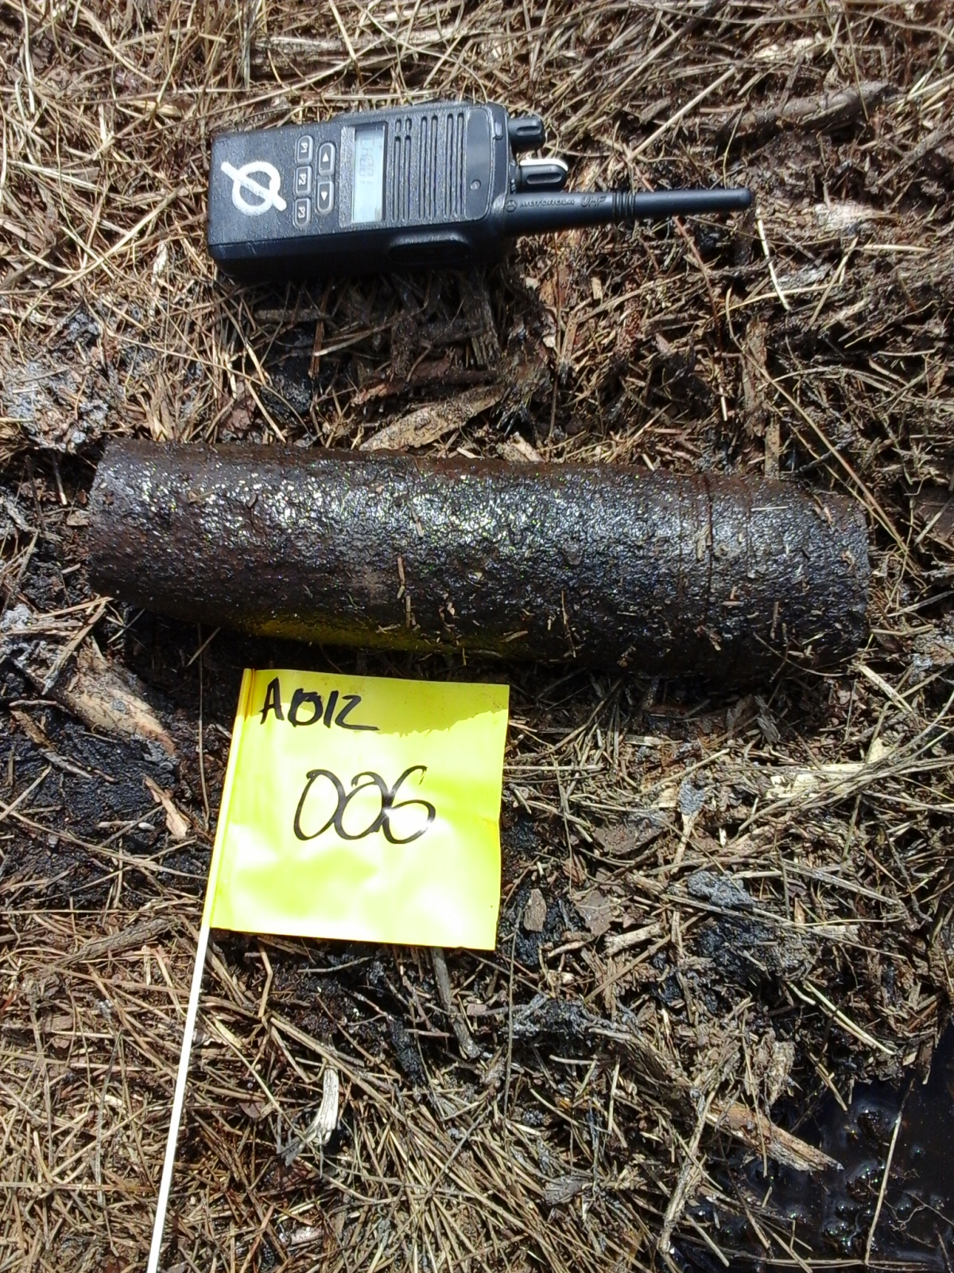
75mm Projectile
Fuze

Slide 29
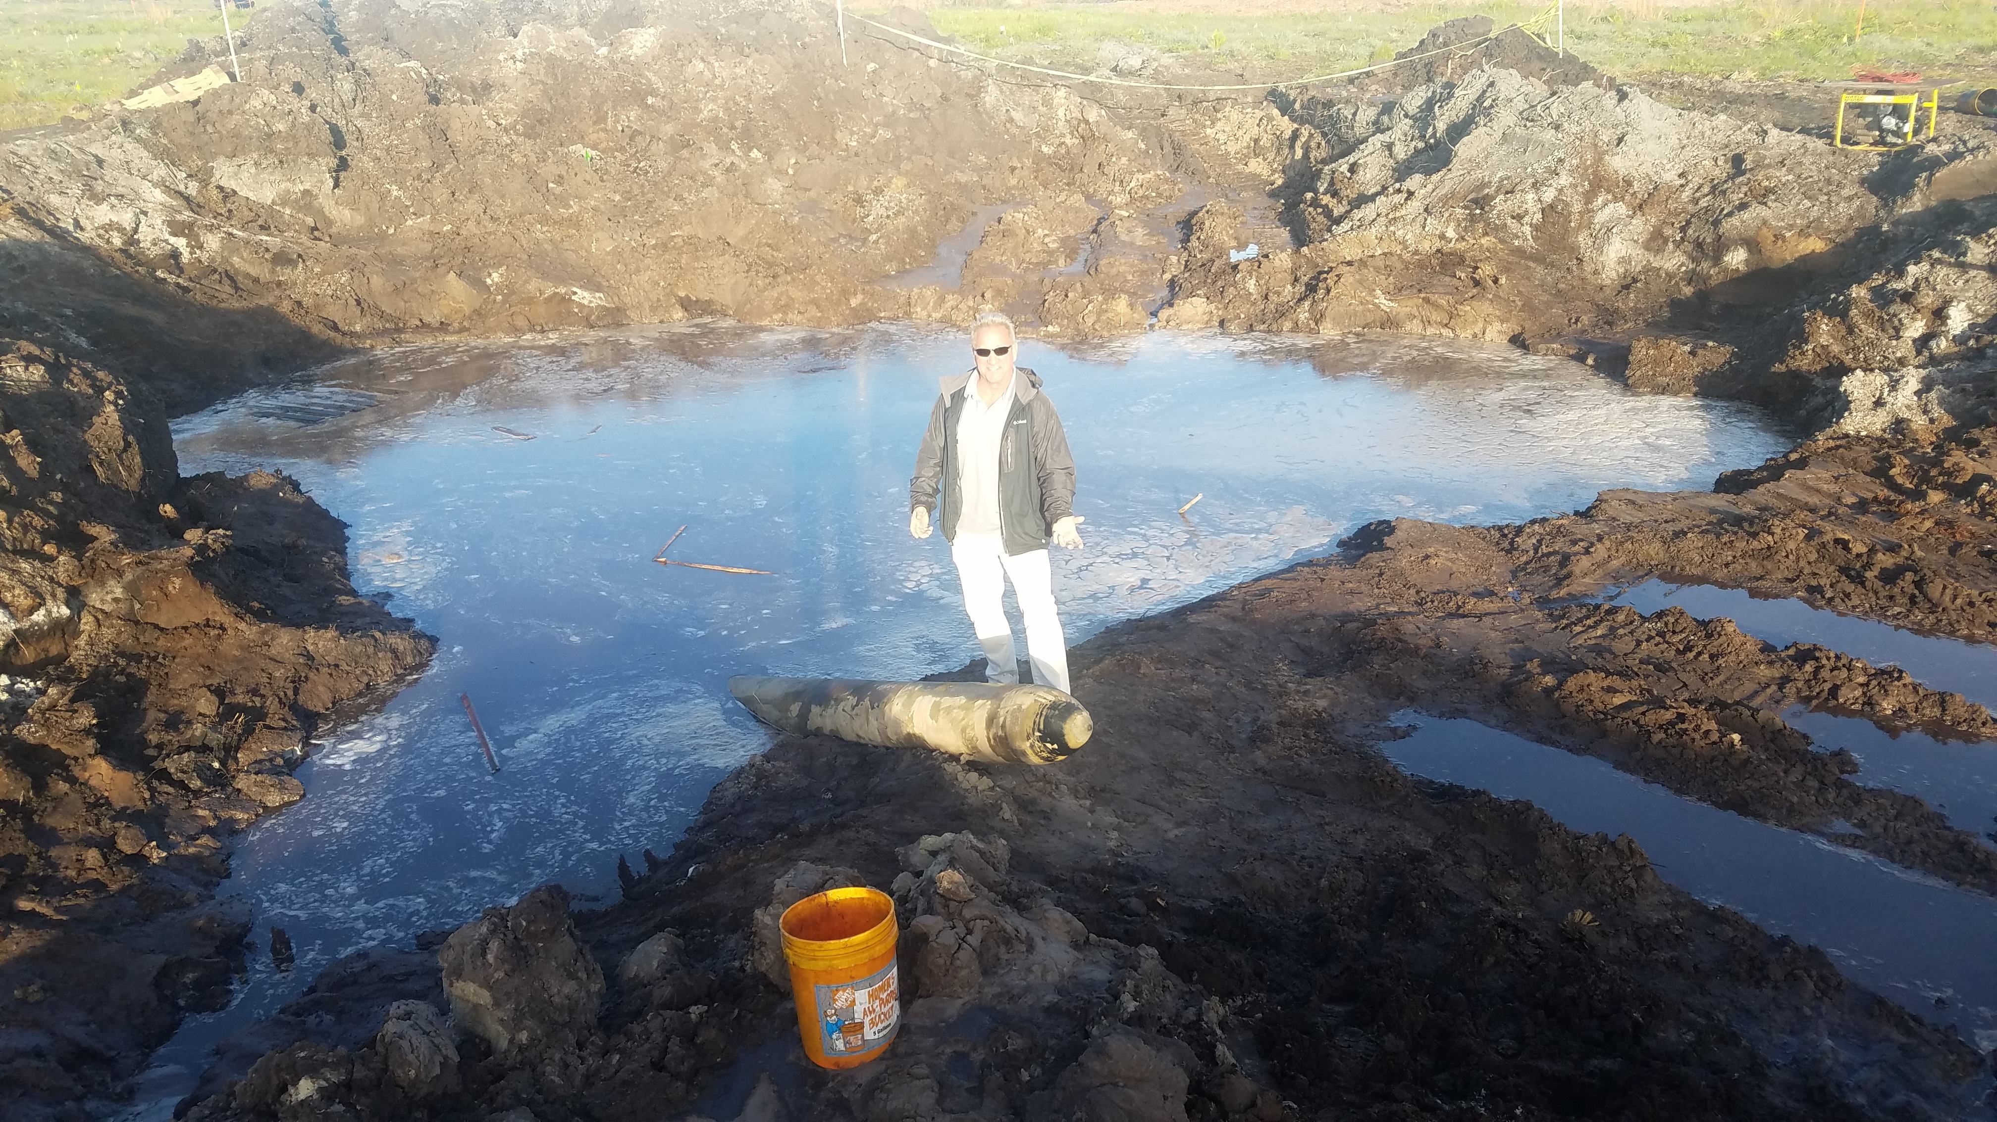
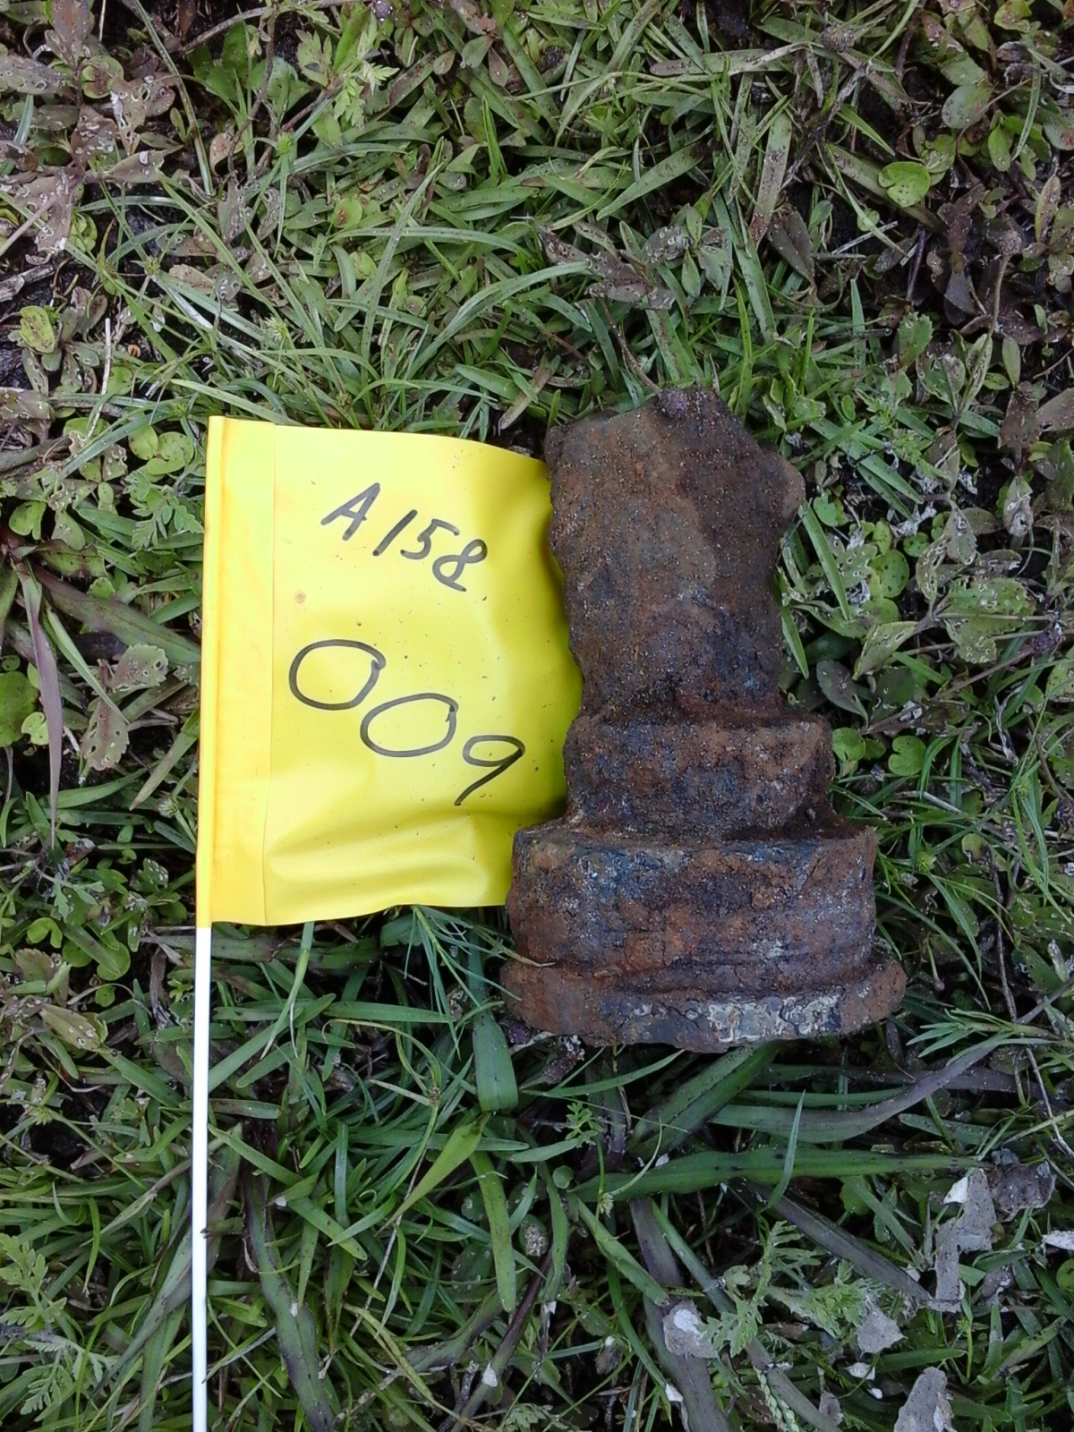
Aircraft Rockets

Slide 30
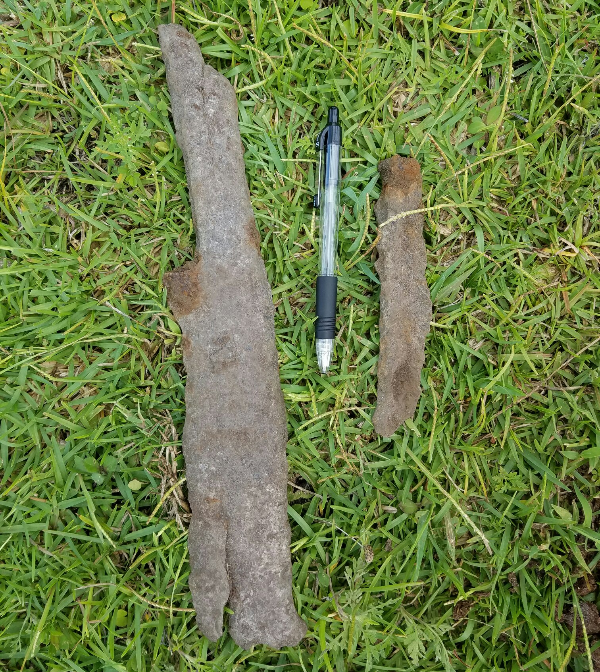
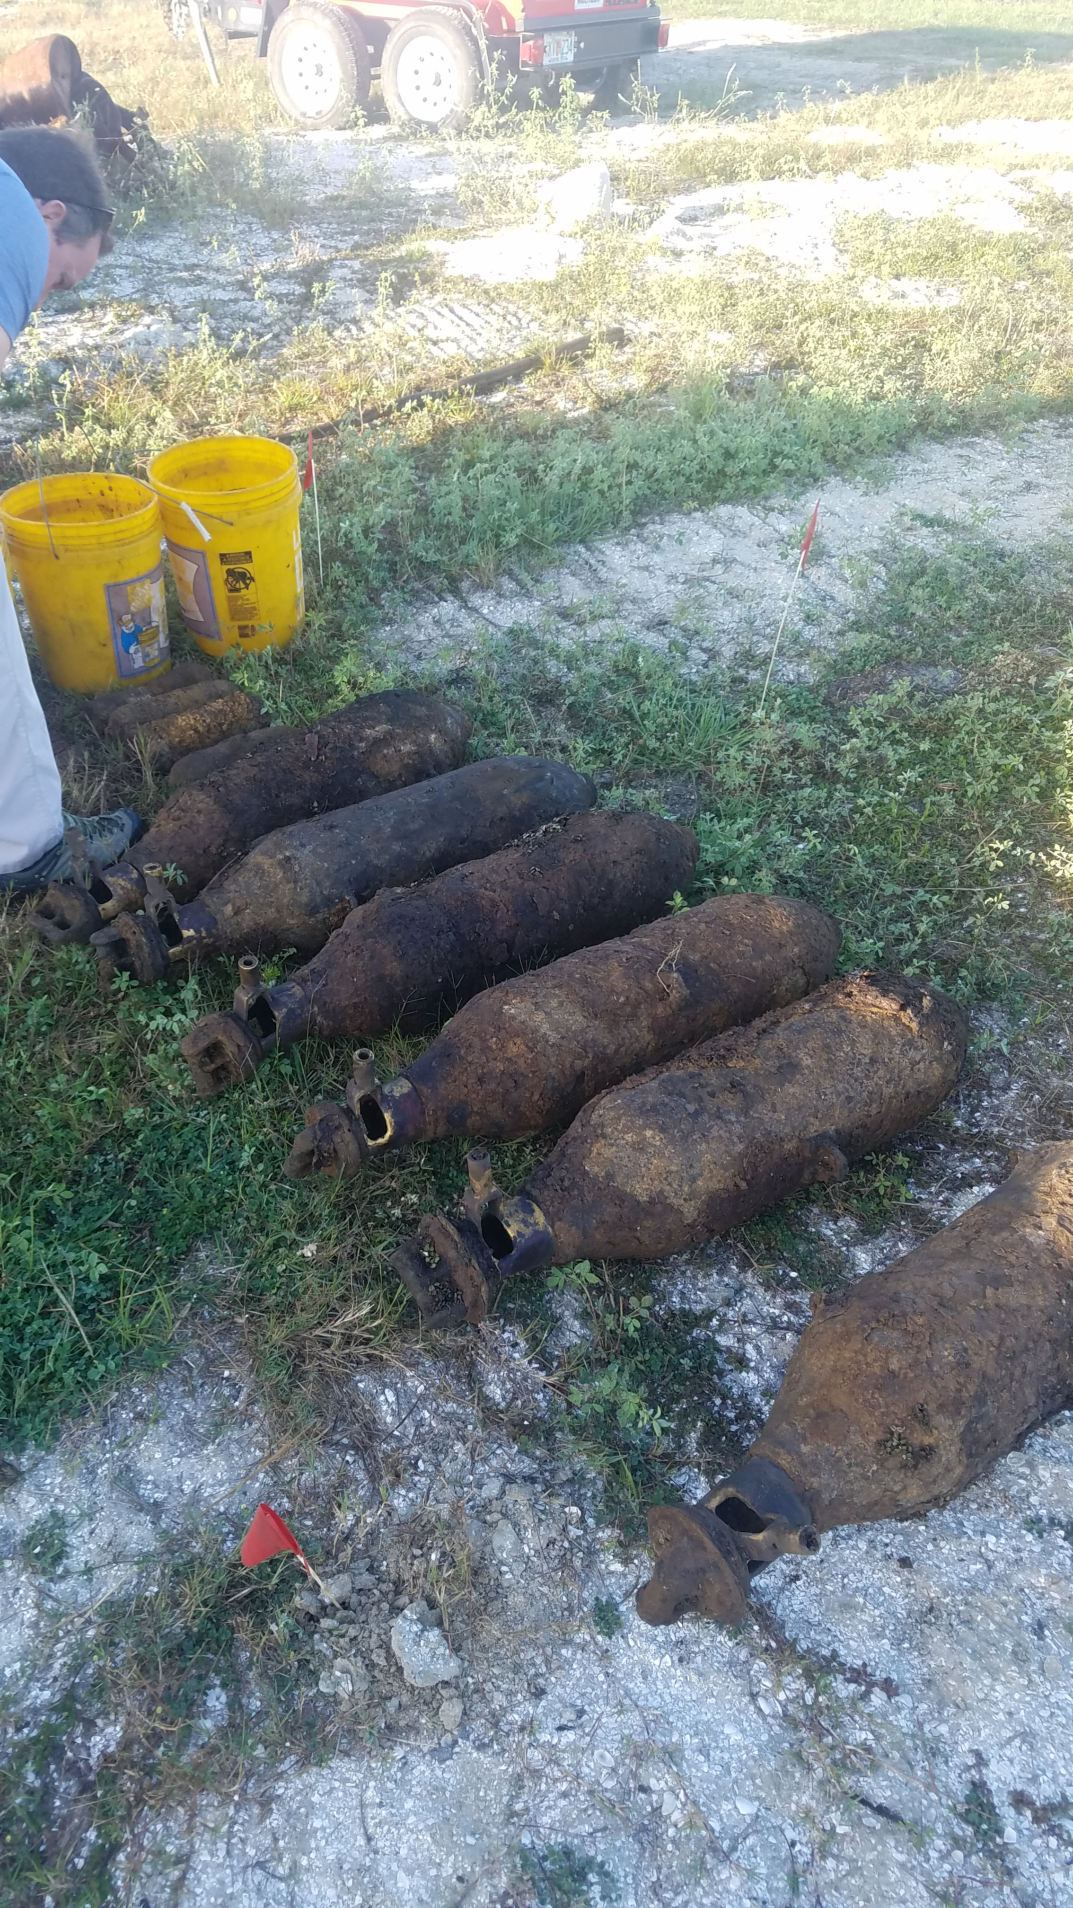
General Purpose Bomb Base Fuzes and Fragmentation
100 series Base Fuze
Practice Bombs
Fragmentation
250lb General Purpose Bomb

Slide 31
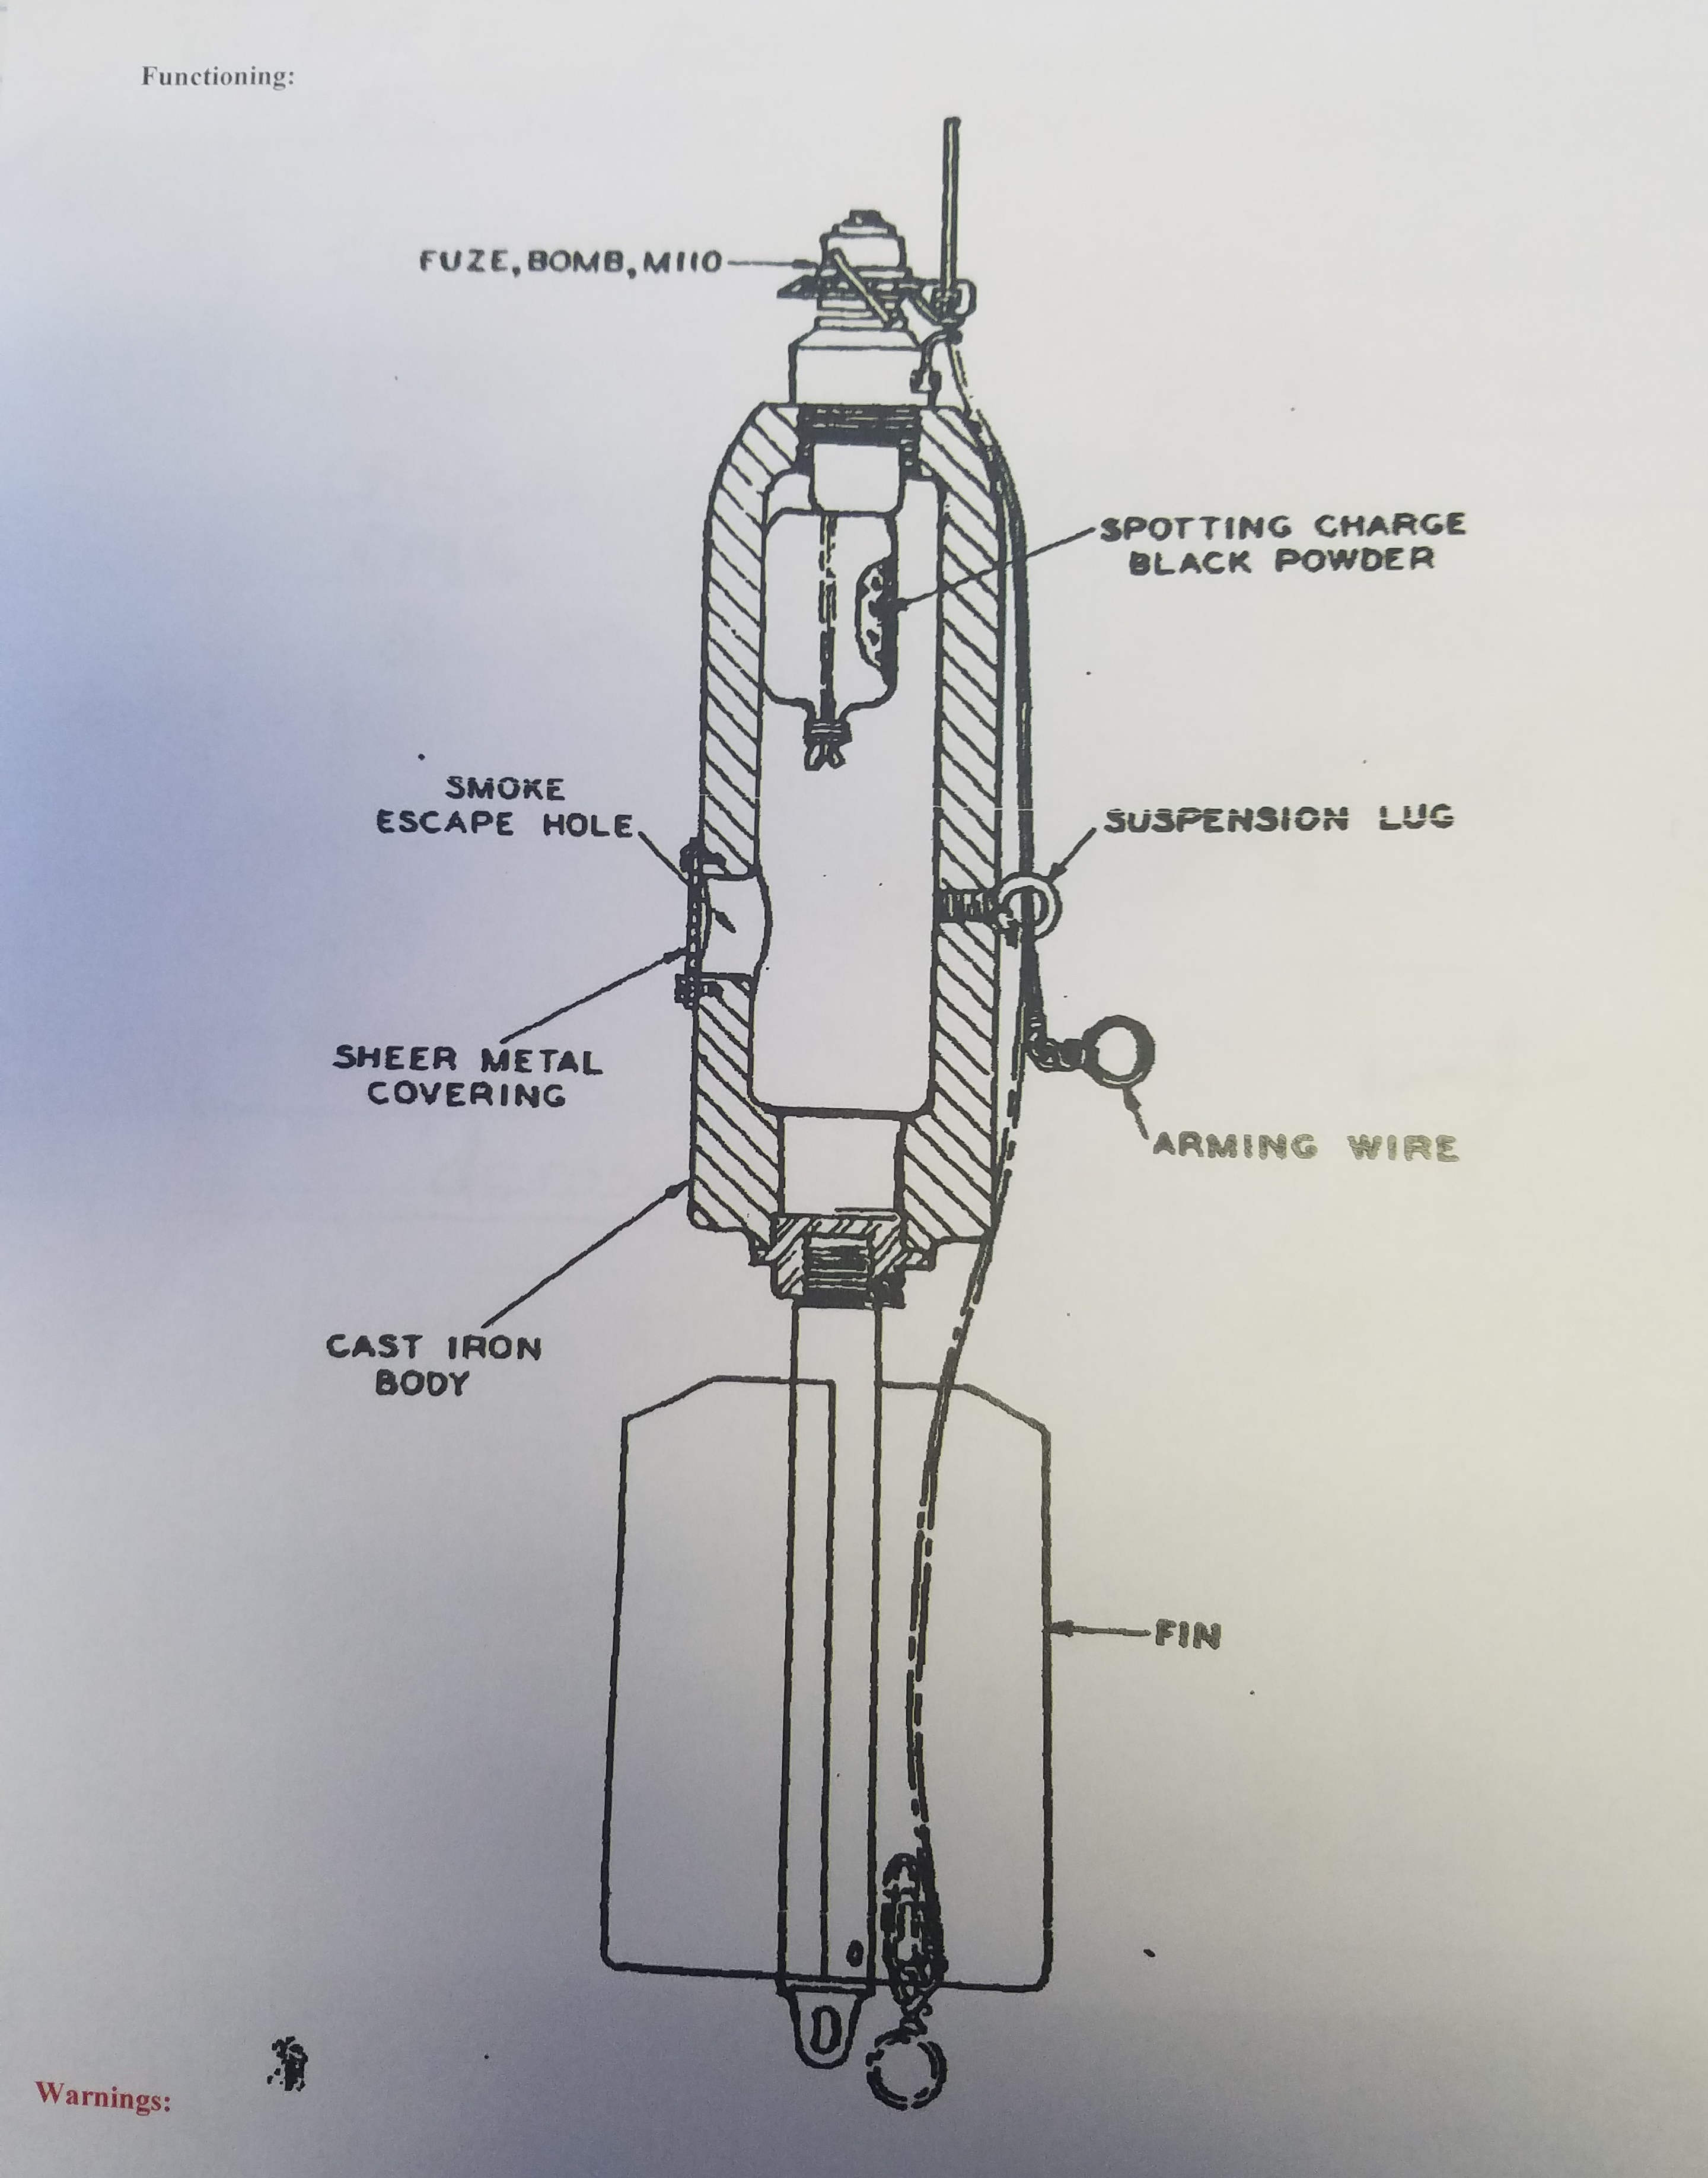
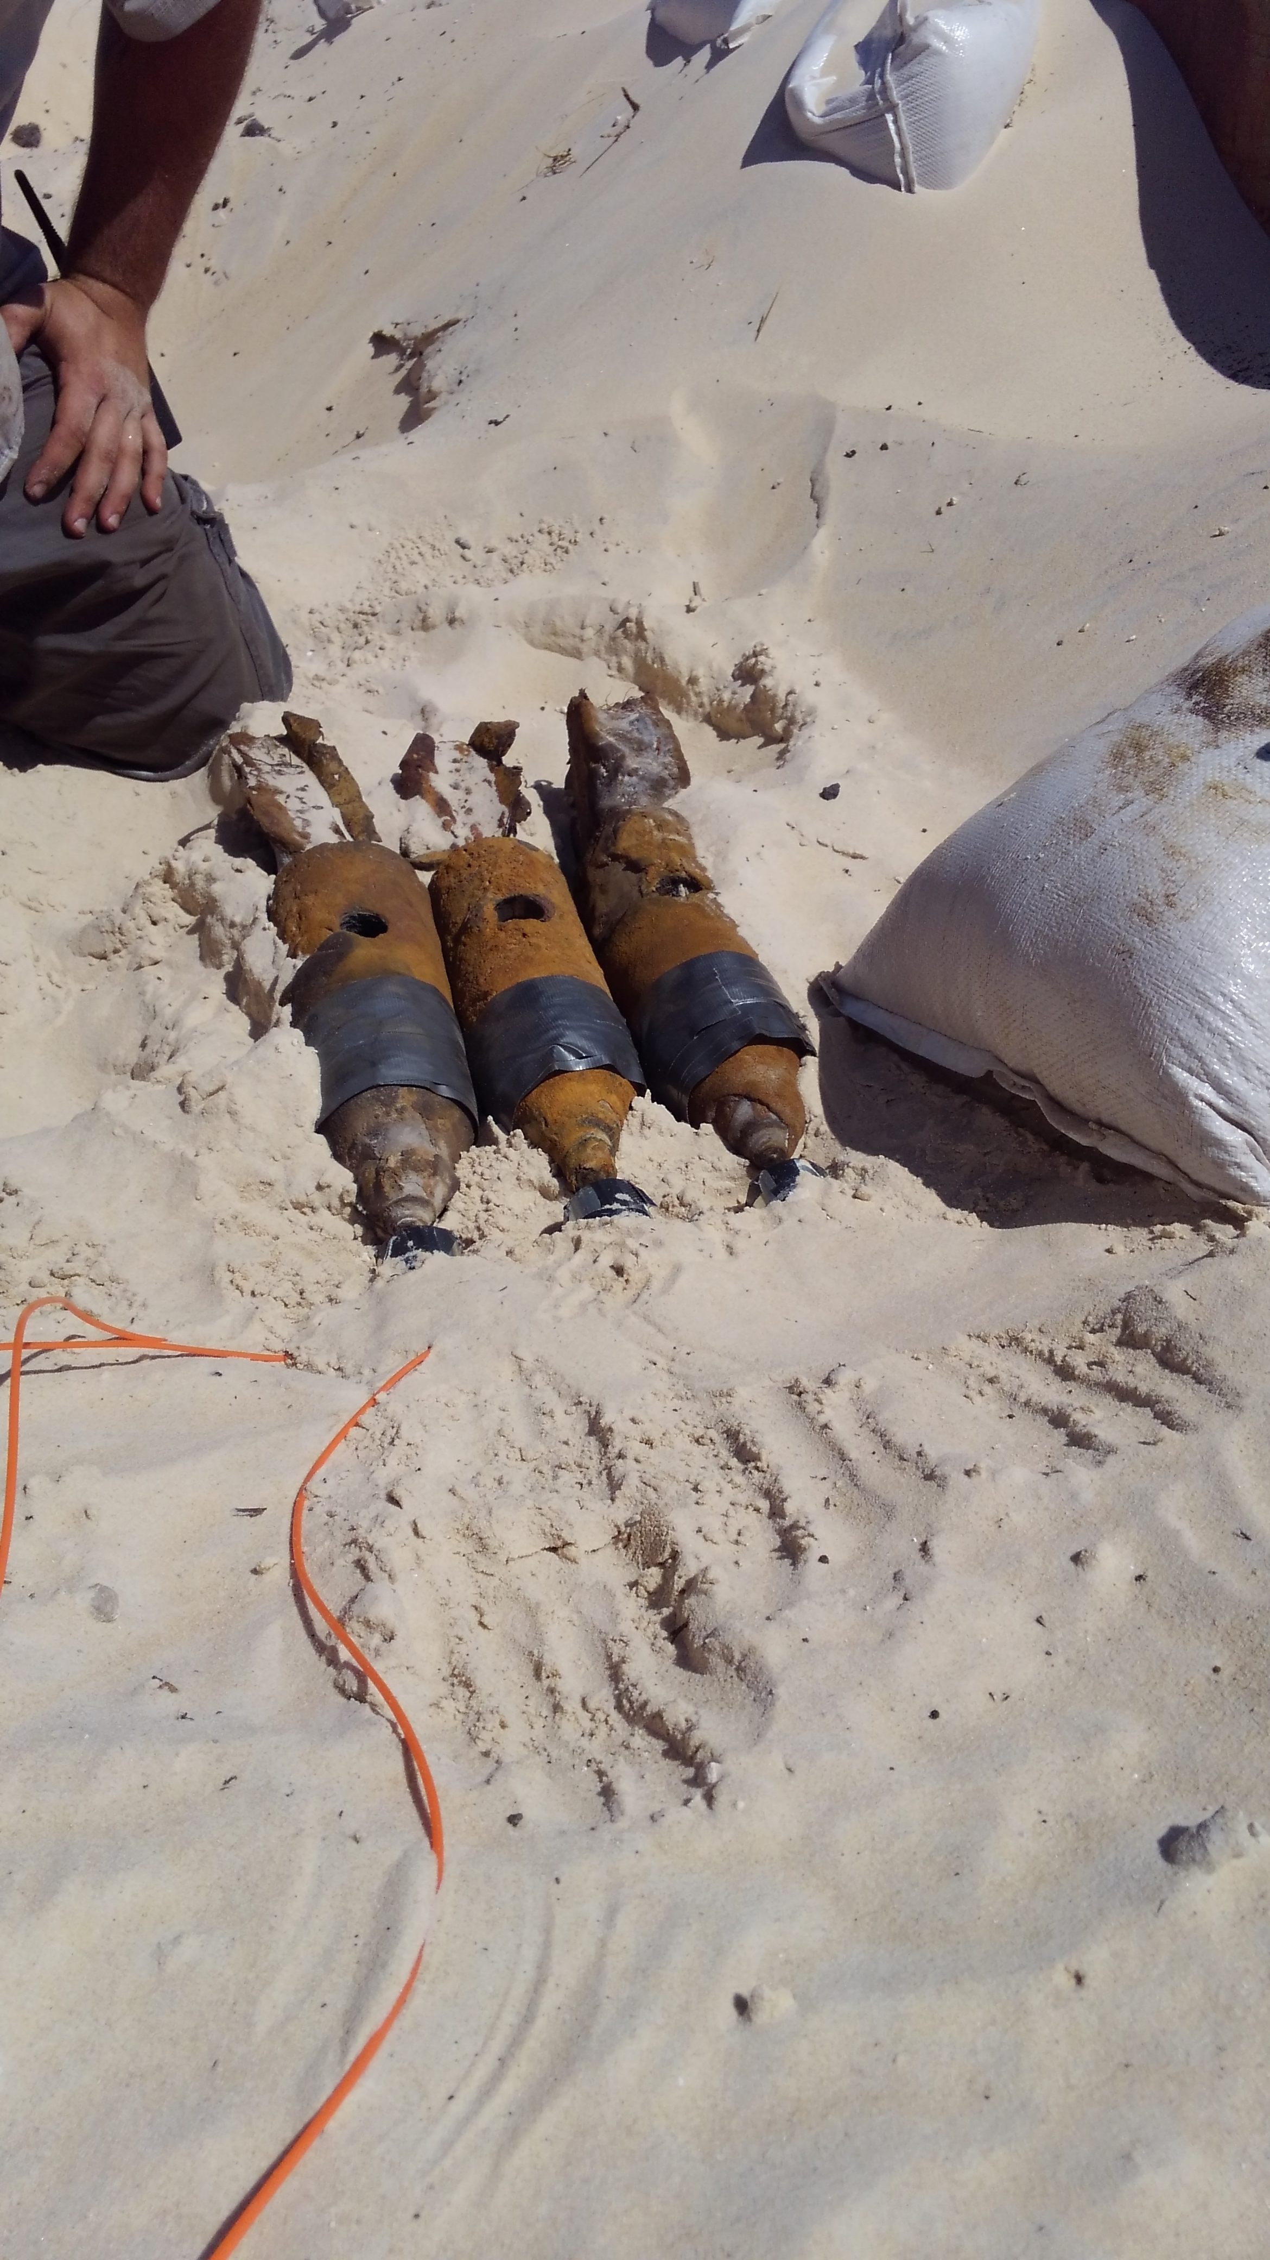
20lb Practice Bomb M48

Slide 32
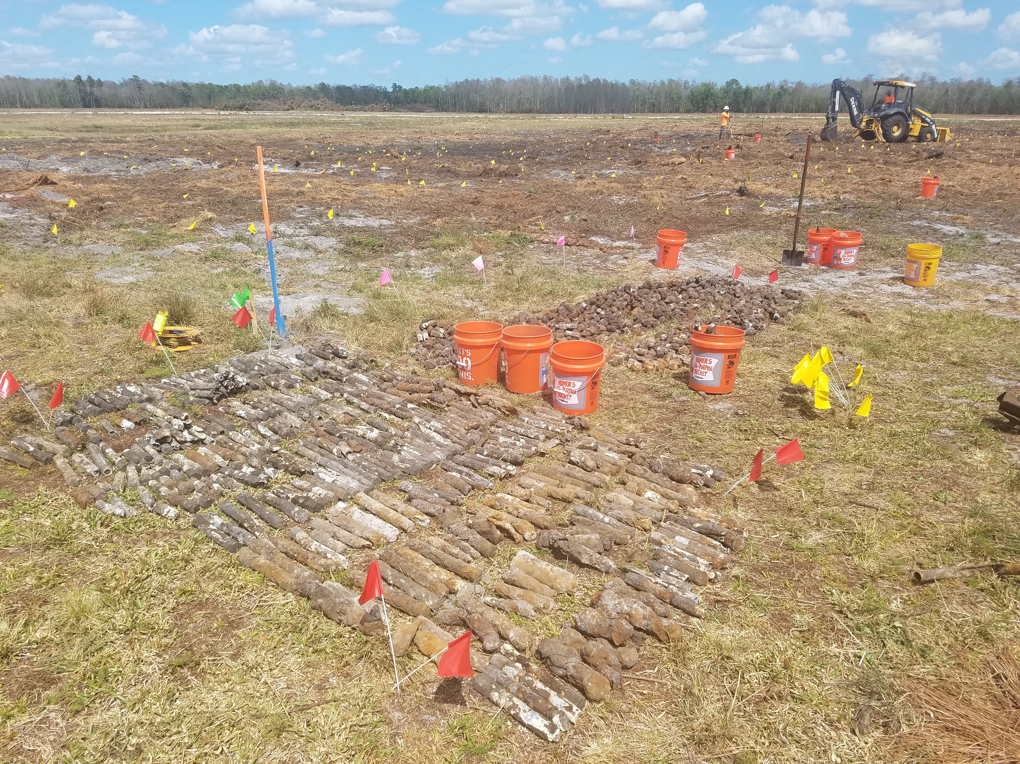
Incendiary Bomb

Slide 33
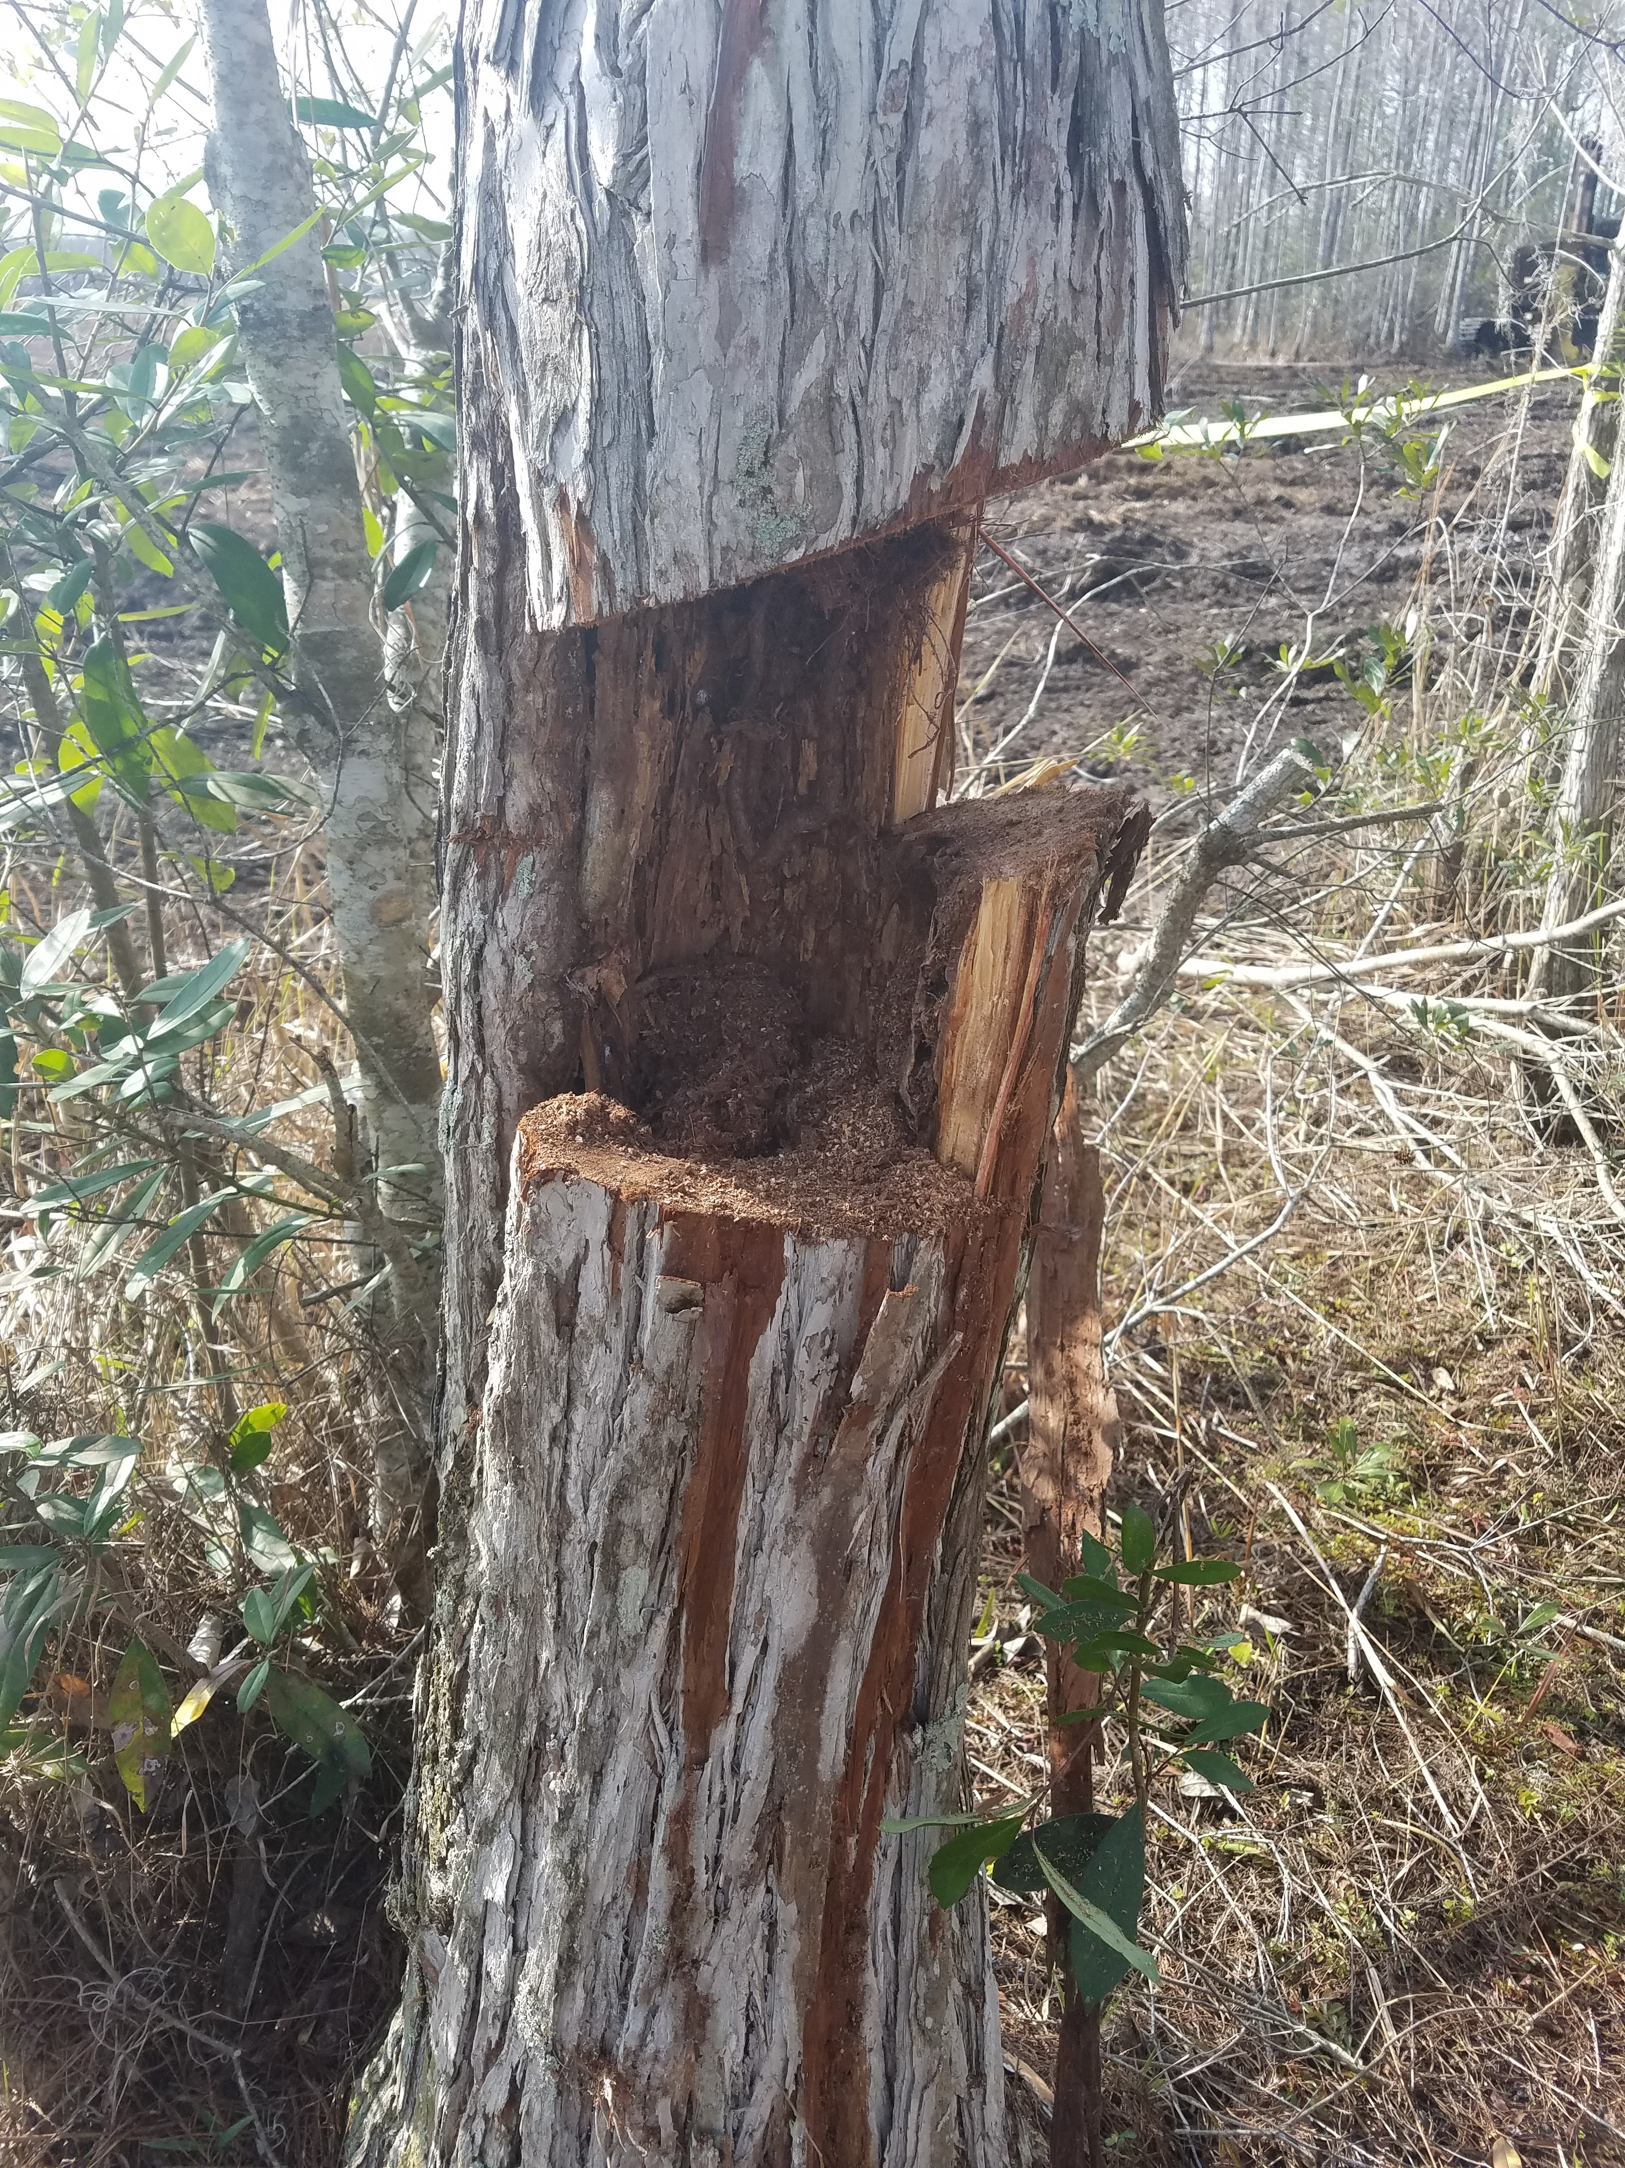
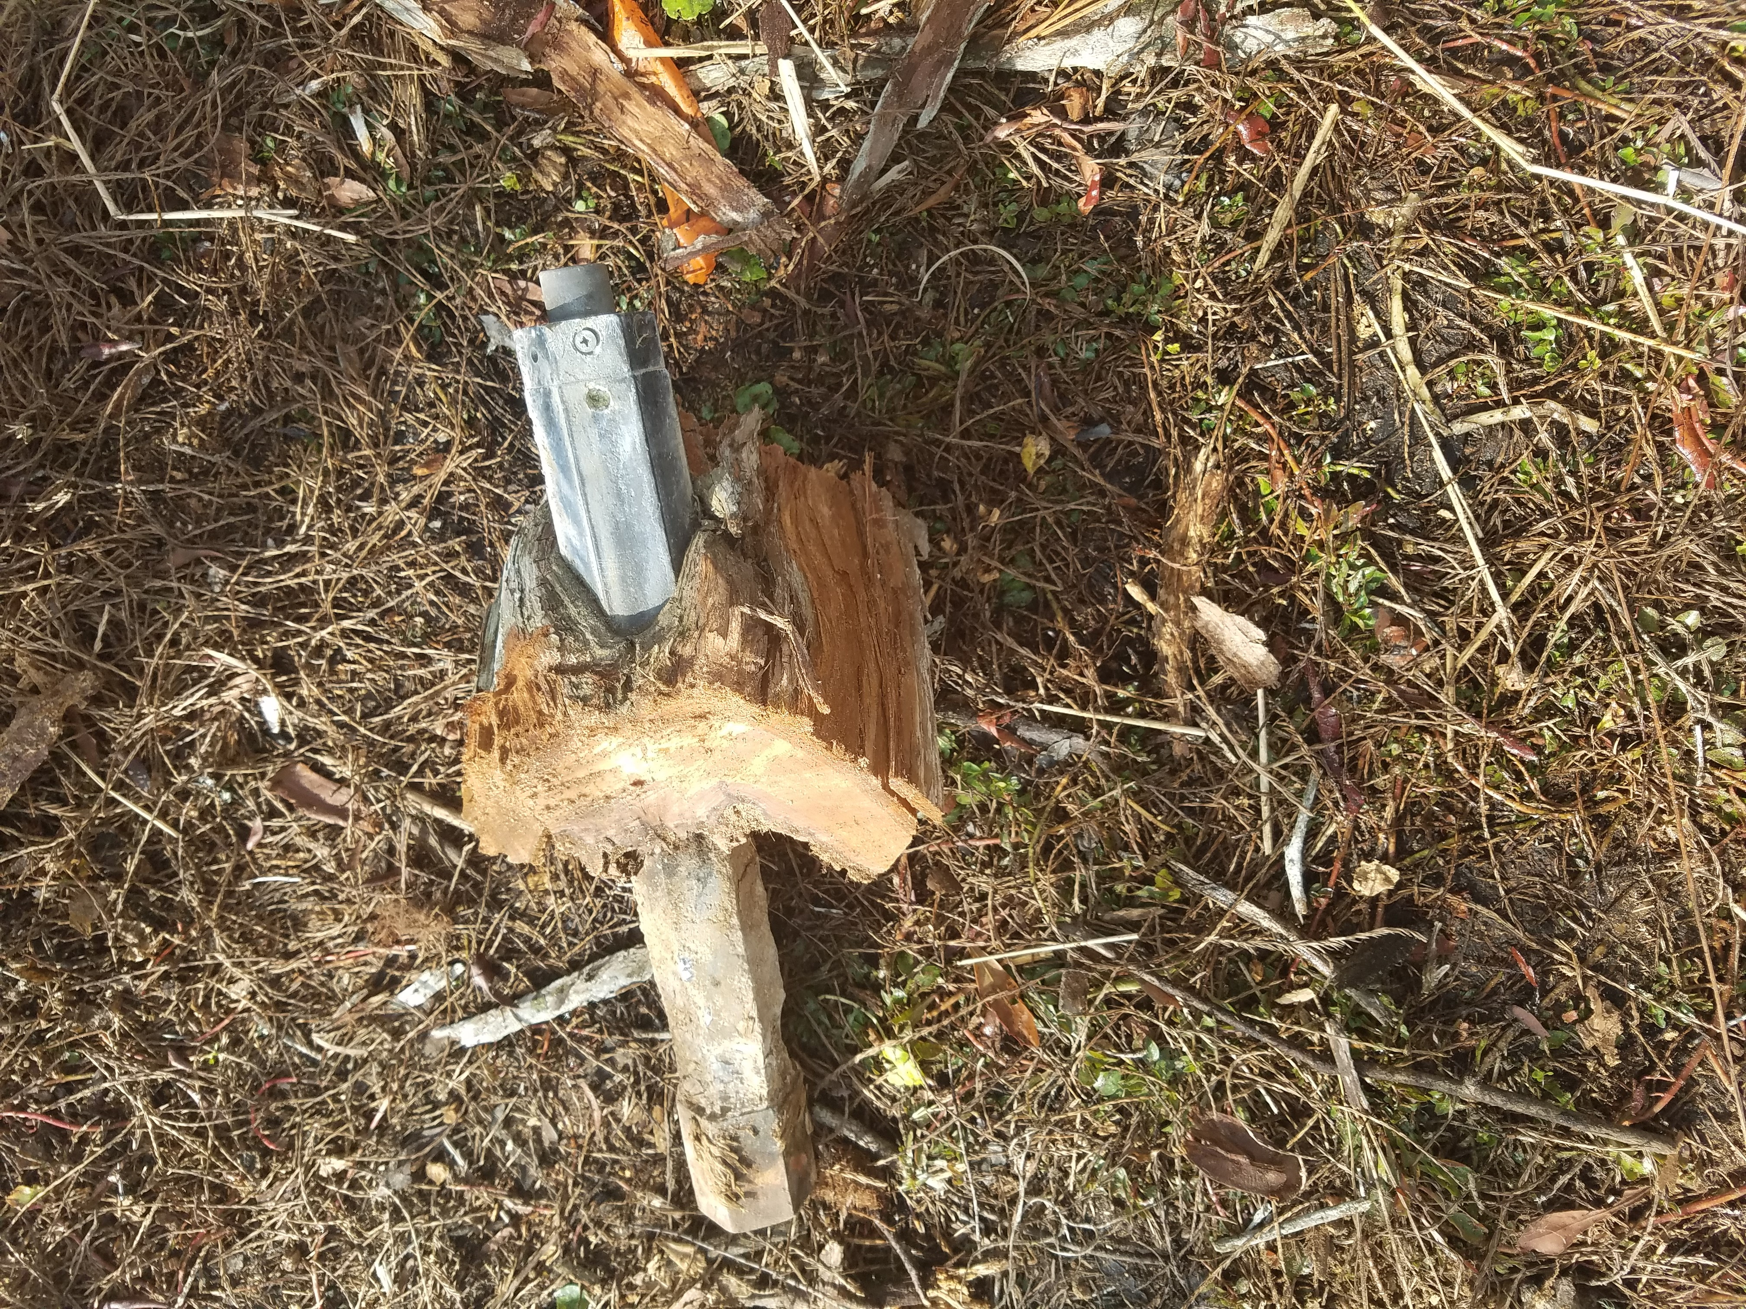
Incendiary Bomb Cut from Cypress

Slide 34
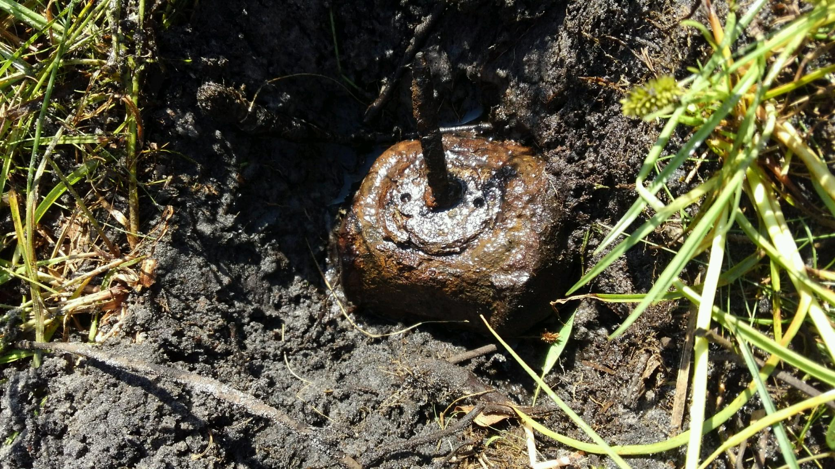
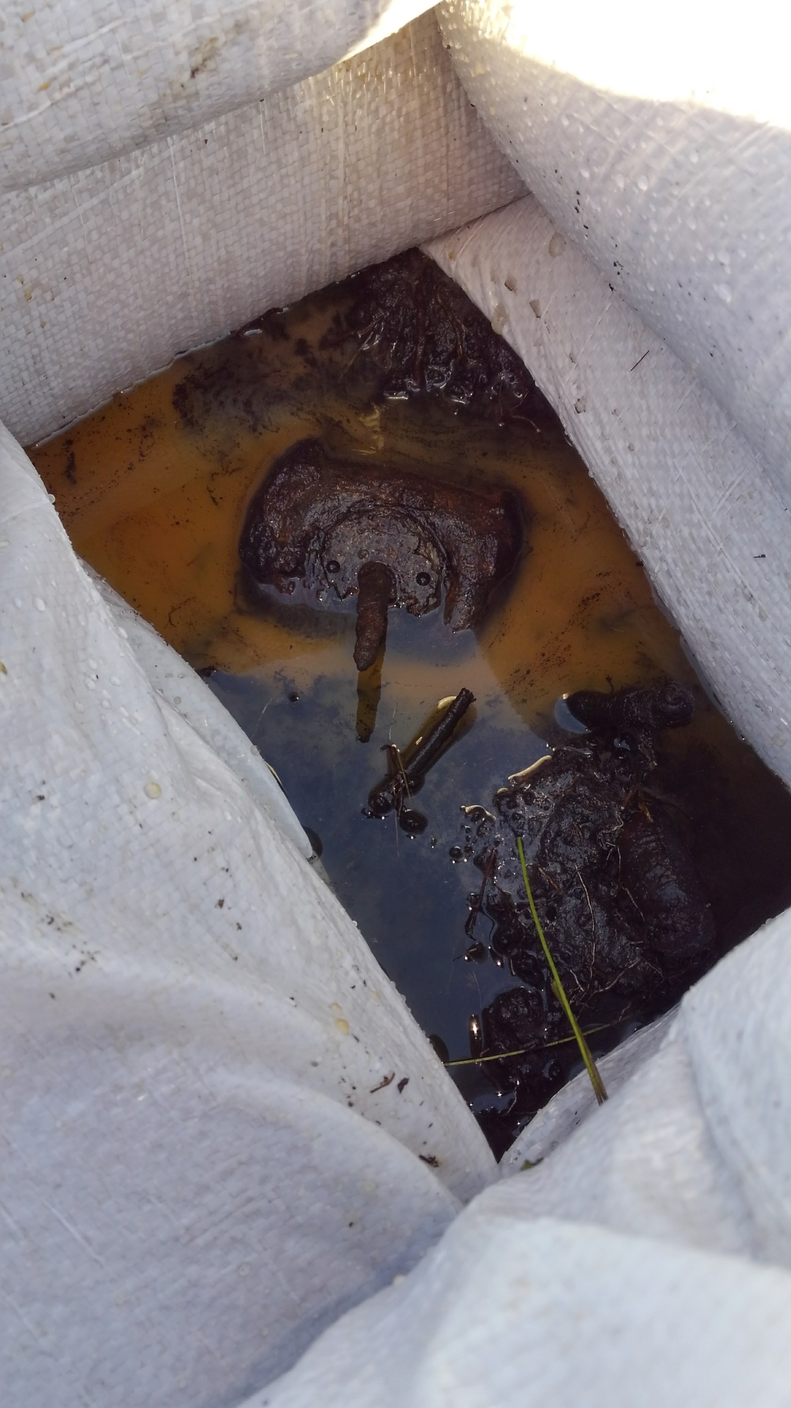
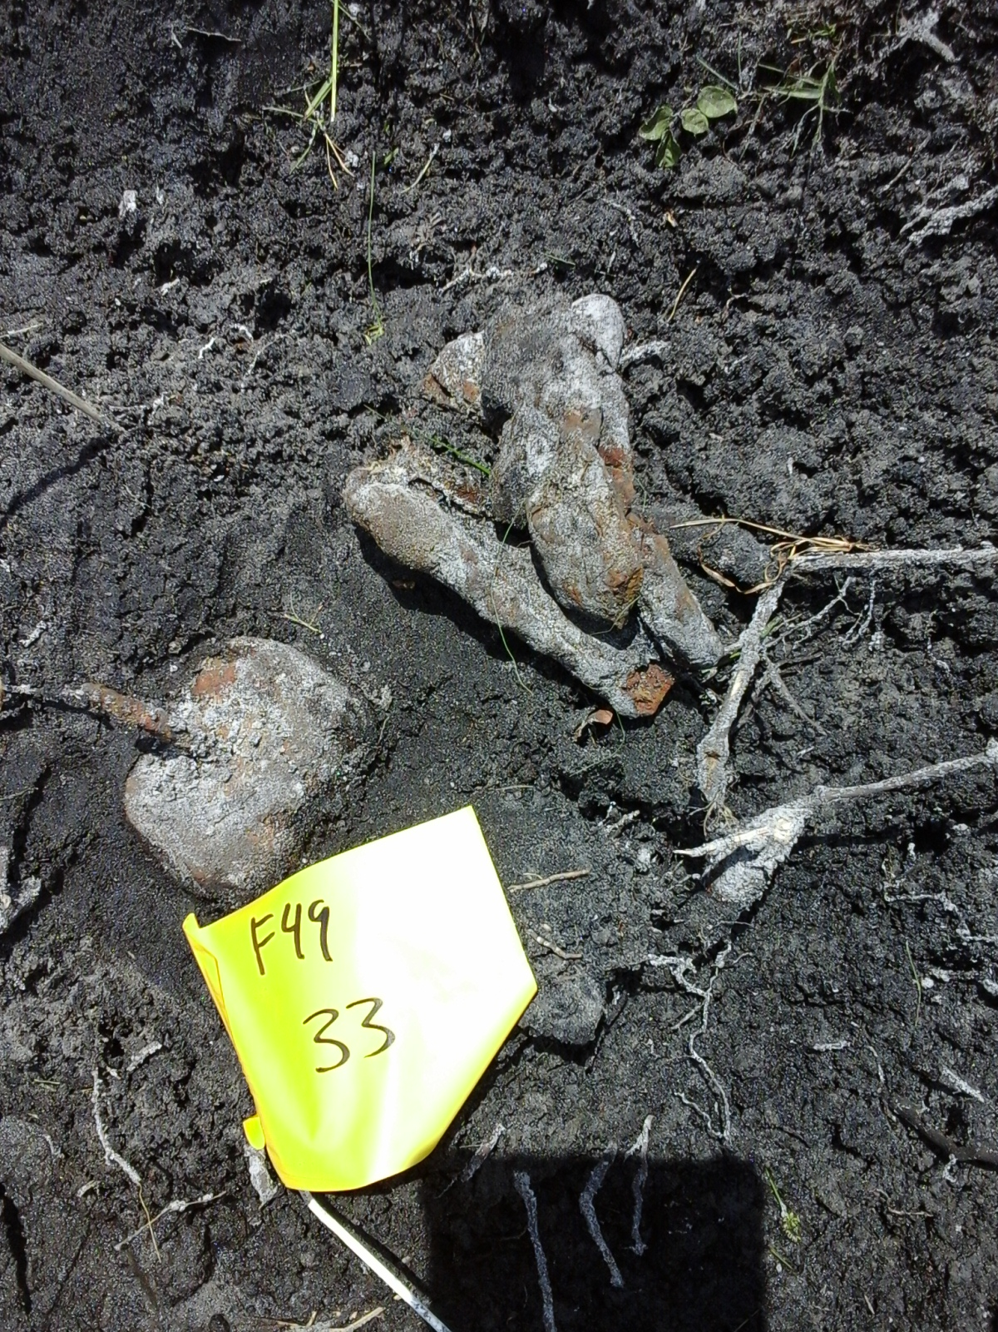
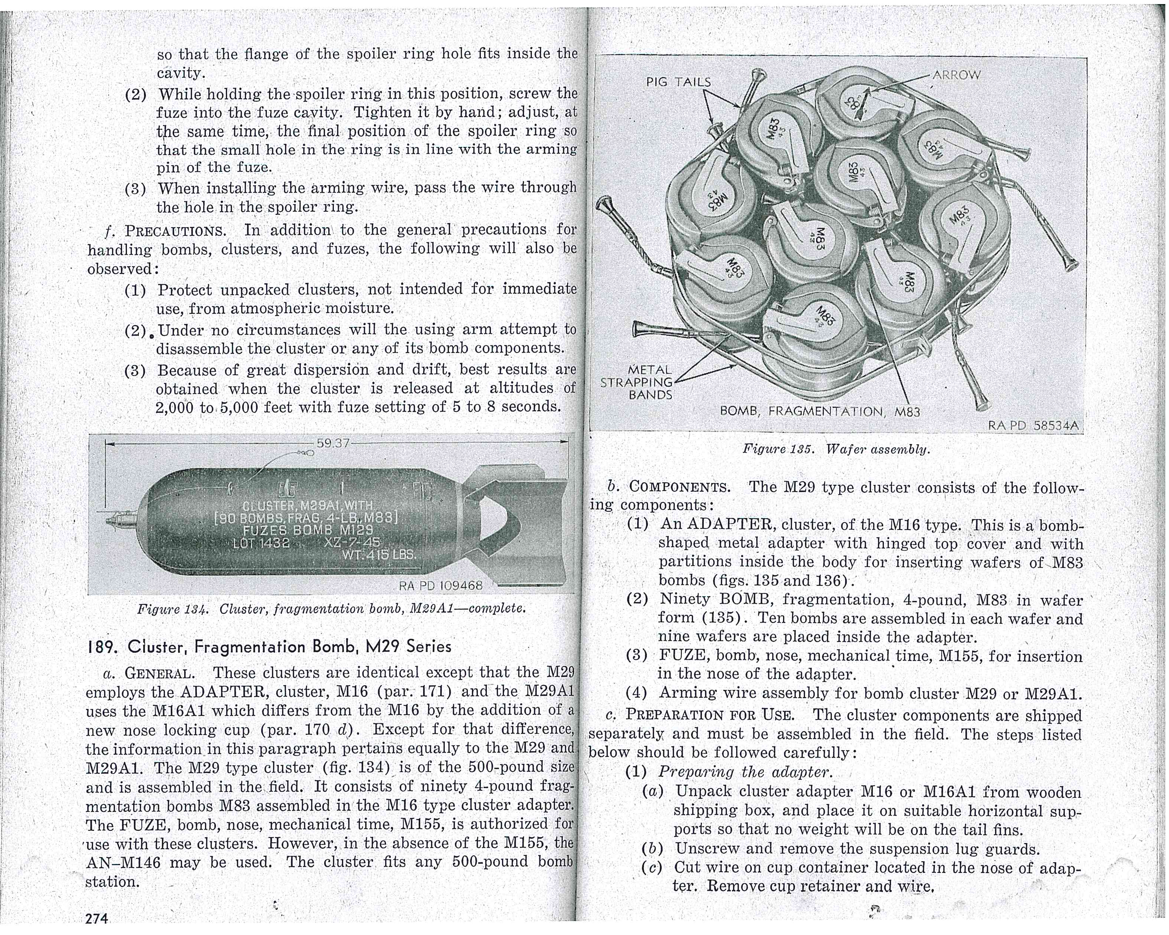
M83 Sub Munition (Butterfly Bomb)

Slide 35
BLOW IN PLACE DETONATION GUIDELINES
Most ordnance items can be moved to a safe distance and destroyed
State of Florida Administrative Code 62-730.320 explosive regulations require a calculated safe distance be utilized for explosive operations
Buffalo’s SOP No. 7 establishes the methodology for the Blow in Place (BIP) detonation process based on federal and state guidelines
There is a chance, during final excavations, BIP items may be encountered in Sectors F and G
In the event that a BIP detonation event is required and an exclusion zone is calculated that may impact any area outside the Site:
Engineering controls will be utilized to minimize the impact of blast effects
Buffalo Restoration will give reasonable prior notice as required by the Integrated Corrective Action Plan (ICAP)
Orlando Bomb Squad will determine what other notifications may be required

Slide 36
Vista Park Site Marked With Munitions Remediation Sectors
Completed (FDEP accepted & NFA)
ASCR Completed
Work On-going

Slide 37
FOR PROJECT INFORMATION AND UPDATES VISIT WWW.VISTAPARK.INFO Thank you for your interest and participation

