Slide 1
Vista Park Remediation project third update meeting
May 24, 2017

Slide 2
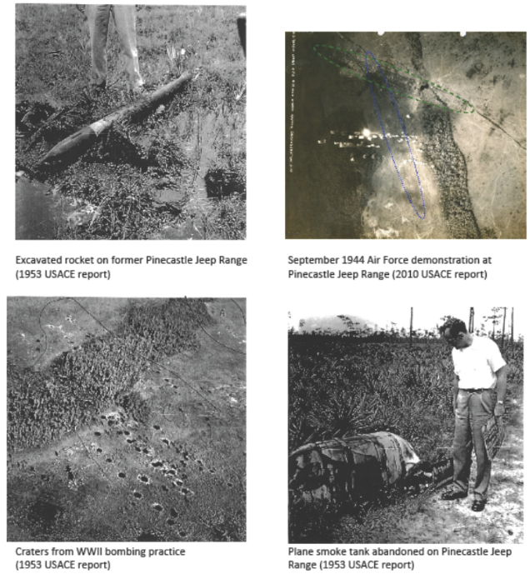
Historical images of munitions use on former pinecastle jeep range

Slide 3
VISTA PARK REMEDIATION: RESOLVING WWII-ERA ENVIRONMENTAL CONTAMINATION AND PUBLIC SAFETY RISKS

Slide 4
HOW WE GOT HERE
The contamination stems from military use of the property, part of the former Pinecastle Jeep Range, for a variety of munitions training and demonstration exercises during World War II.
In 2007, investigation and studies conducted by the U.S. Army Corps of Engineers (ACOE) identified hazards including bomb craters, munitions debris, and soils contaminated with explosive compounds.
The ACOE studied the site in 2008, but has not implemented any specific plan to remediate the full site. The ACOE has not committed to a date for remediation of any portion of Vista Park in the foreseeable future.
The Florida Department of Environmental Protection (FDEP) approved the Voluntary Cleanup Order (VCO) following the owner’s submittal of a detailed plan for the clearance process.

Slide 5
What you can expect
Neighbors will be fully informed on each primary phase of cleanup activity, so they know what to expect from the clearance process.
State government oversight of the UXO Remediation project. The FDEP, through its VCO, prescribes strict guidelines for the remediation and restoration process.
Neighbors will see equipment brought in to clear the land, as well as deliveries of scanning devices used to detect subsurface anomalies (potential MEC).
Future meetings, so the community can receive updates and provide input on the progress of the remediation efforts.

Slide 6
Vista Park Site Marked With Munitions Remediation Sectors

Slide 7
SITE WIDE PRE-REMEDIATION

Slide 8
SITE WIDE POST-REMEDIATION

Slide 9
Vista Park Site Marked With Munitions Remediation Sectors

Slide 10
Preliminary Wetland Evaluations Used in Developing the FDEP Voluntary Cleanup Order - completed
Researched historical databases including aerial photography; published wetland maps; USGS topographic surveys
Field delineated all wetlands and located by Global Positioning System
Conducted preliminary functional wetland assessments
Researched listed species databases for potential occurrence of Threatened and/or Endangered wildlife species or Species of Special Concern
Coordinated with Project Team on techniques for UXO (munitions) sampling in wetlands, and post remediation
Evaluated potential wetland restoration approaches
Coordinated wetlands evaluations and procedures with Florida Department of Environmental Protection (FDEP)

Slide 16
Wetland Requirements associated with the FDEP Voluntary Cleanup Order
FDEP site review completed site-wide prior to initiation of work
Baseline Uniform Mitigation Assessment Method Evaluation (UMAM) & FDEP review completed site-wide prior to initiation of work
UMAM analysis of proposed wetland impact area completed site-wide prior to initiation of work
100% gopher tortoise survey to be completed by sector and any gopher tortoises will be relocated following Florida Fish and Wildlife Conservation Commission permitting criteria [completed for Sectors A, B, C, E, and F – (Relocation Permit issued for Sectors A, B, C, E, and F)]
Water bird nesting colony survey to be completed by sector [completed for Sectors A, B, C, E, and F]
Florida sandhill crane survey to be completed by sector [completed for Sectors A, B, C, E, and F]
FDEP site reviews completed by sector
FDEP post-remediation review and mitigation debit analysis to be completed by sector [Sector B in process]
Upon issuance of the NFA determination, all necessary submittals will be made to obtain issuance of the Site Rehabilitation Completion Order

Slide 17
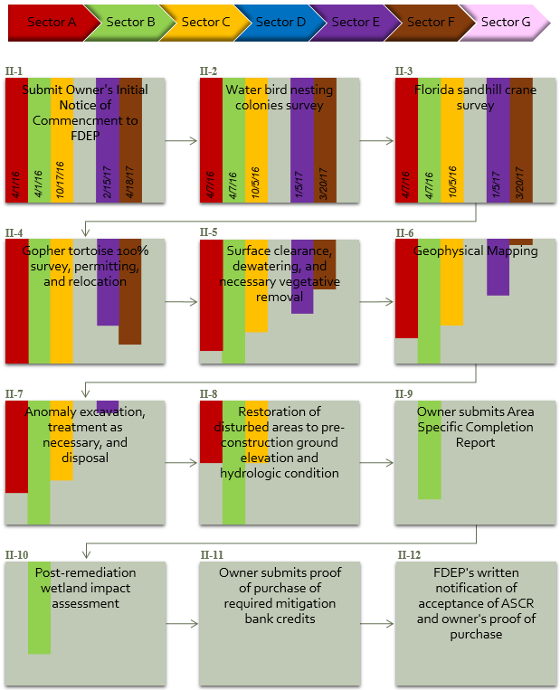
SITE WIDE REMEDIATION PROCESS SECTOR BY SECTOR

Slide 18
Vista Park UXO Remediation Process

Slide 19
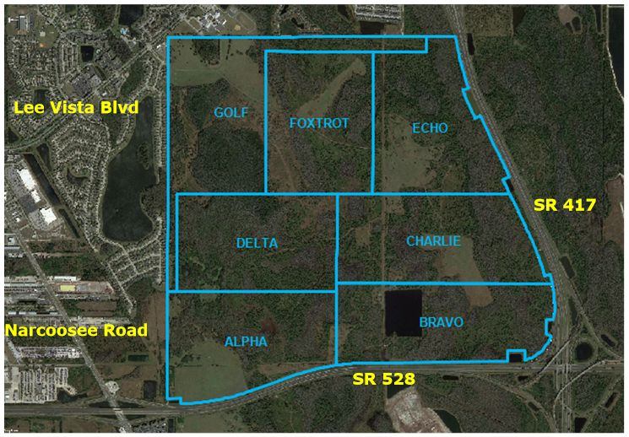
Notes:
Site Description - describe the location compared to known roads and describe the Sectors we are working in

Slide 20
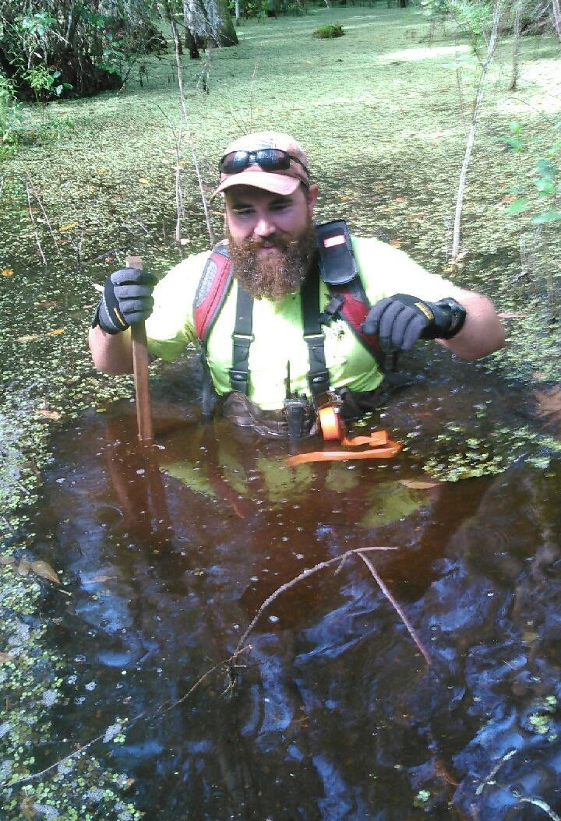
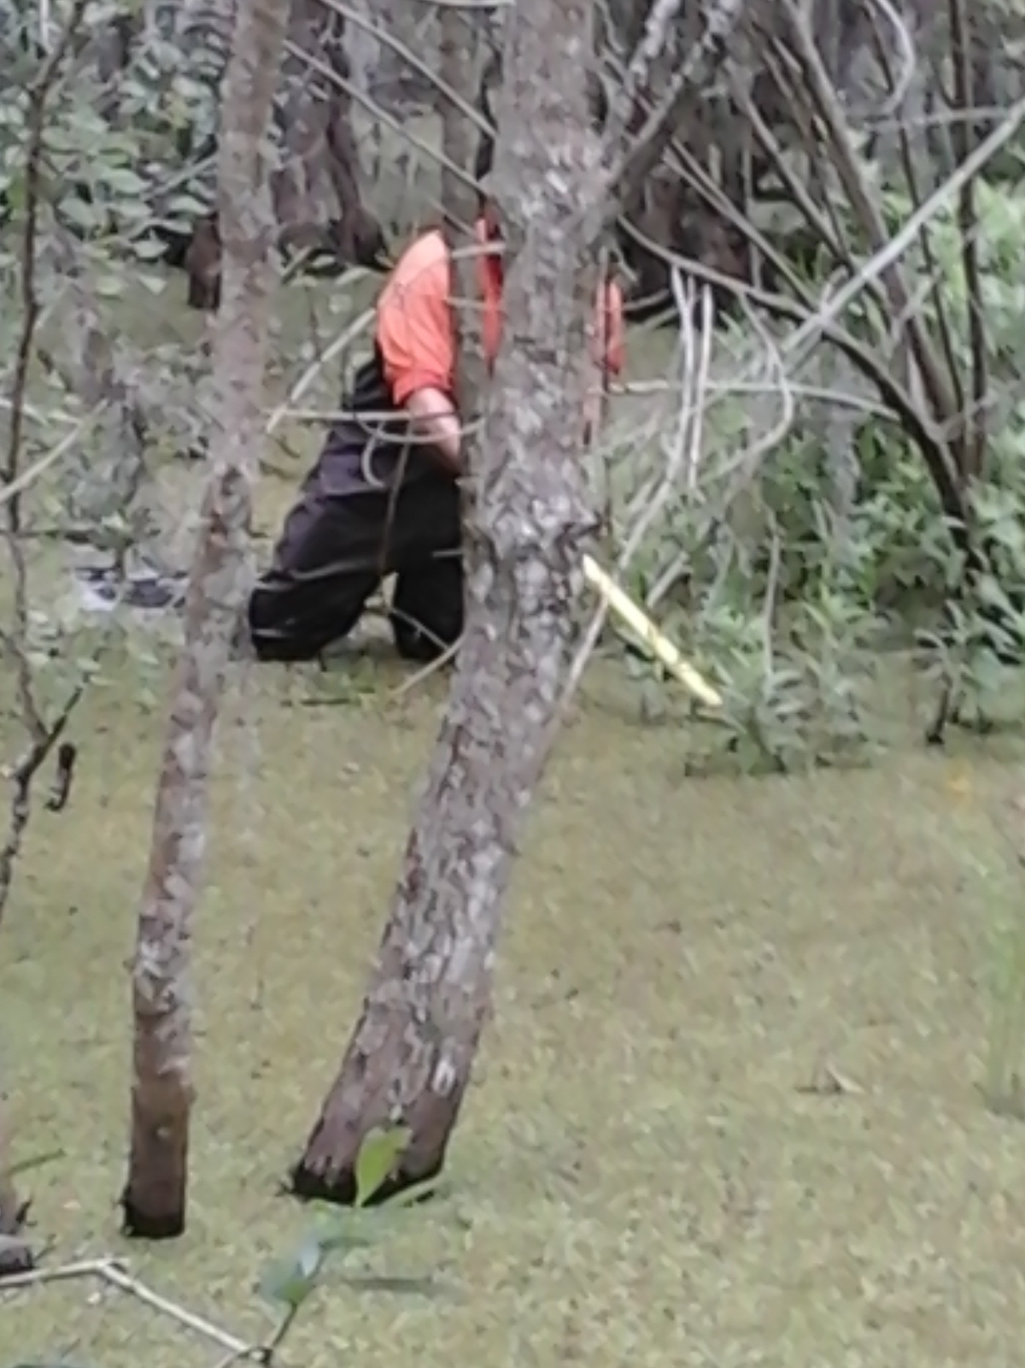
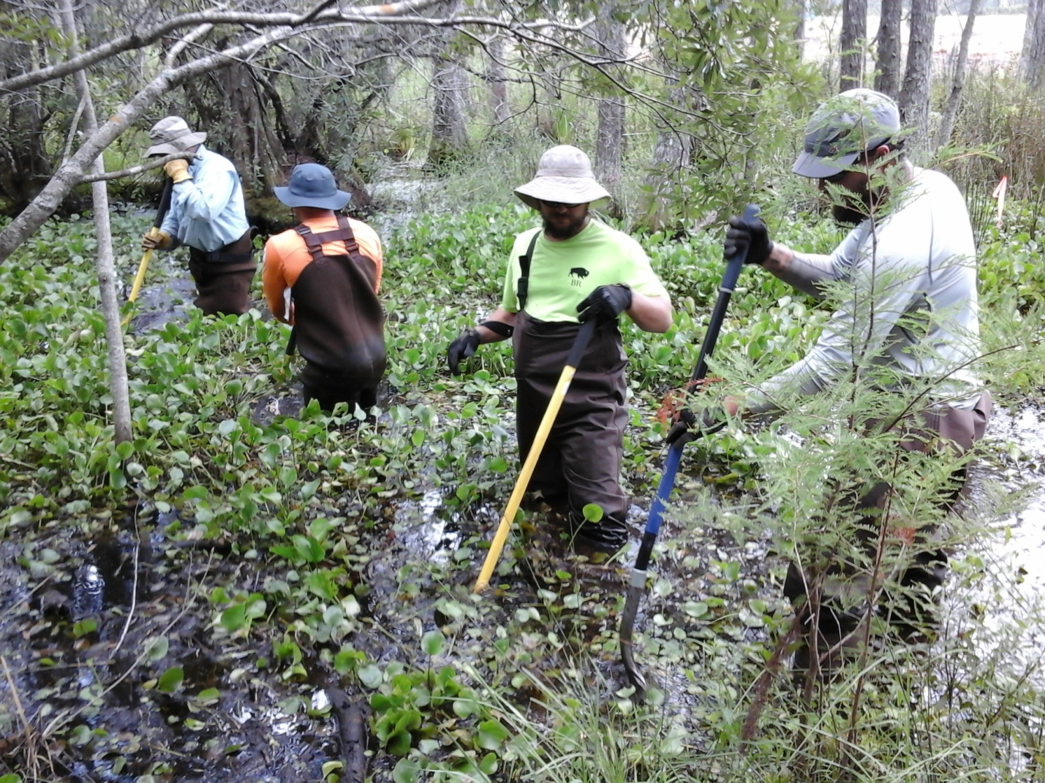
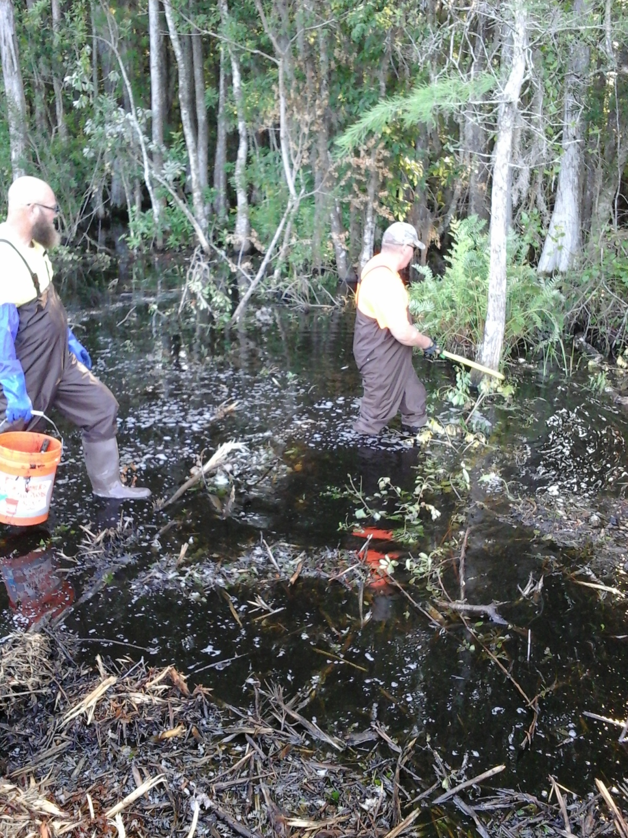
Notes:
These are some examples of Site Conditions

Slide 21
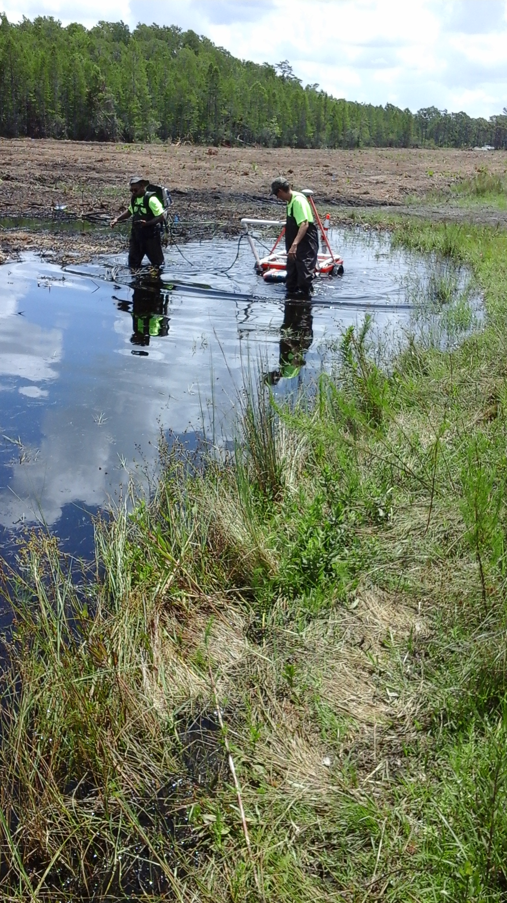
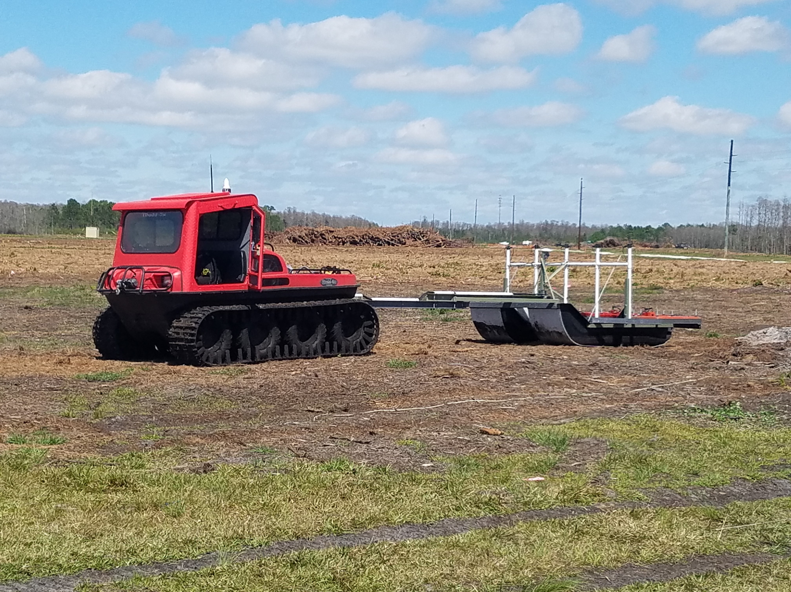
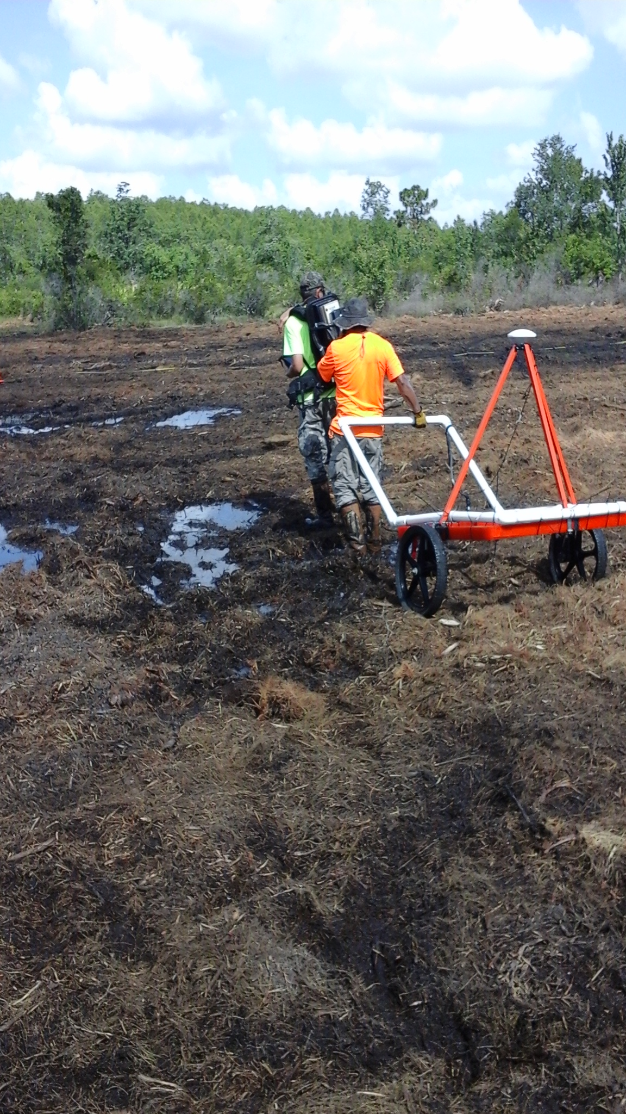

Slide 22
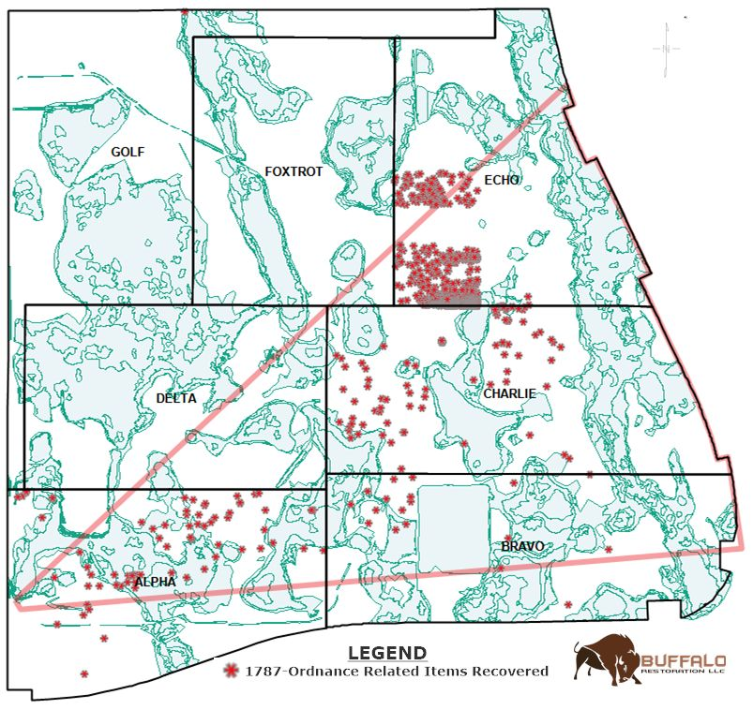

Slide 23
UXO/MD Found in Sectors A, B, C, and E
2.36 inch Rockets (Bazooka)
75mm HE/WP/HEAT projectiles
37mm projectiles
Rifle Grenades
3.5 inch Rocket warhead (aircraft fired)
5 inch Rockets and fuzes (aircraft fired)
General Purpose Bomb base fuzes and fragmentation
4lb incendiary bombs
20lb practice bombs
Total of 658 UXO items

Slide 24
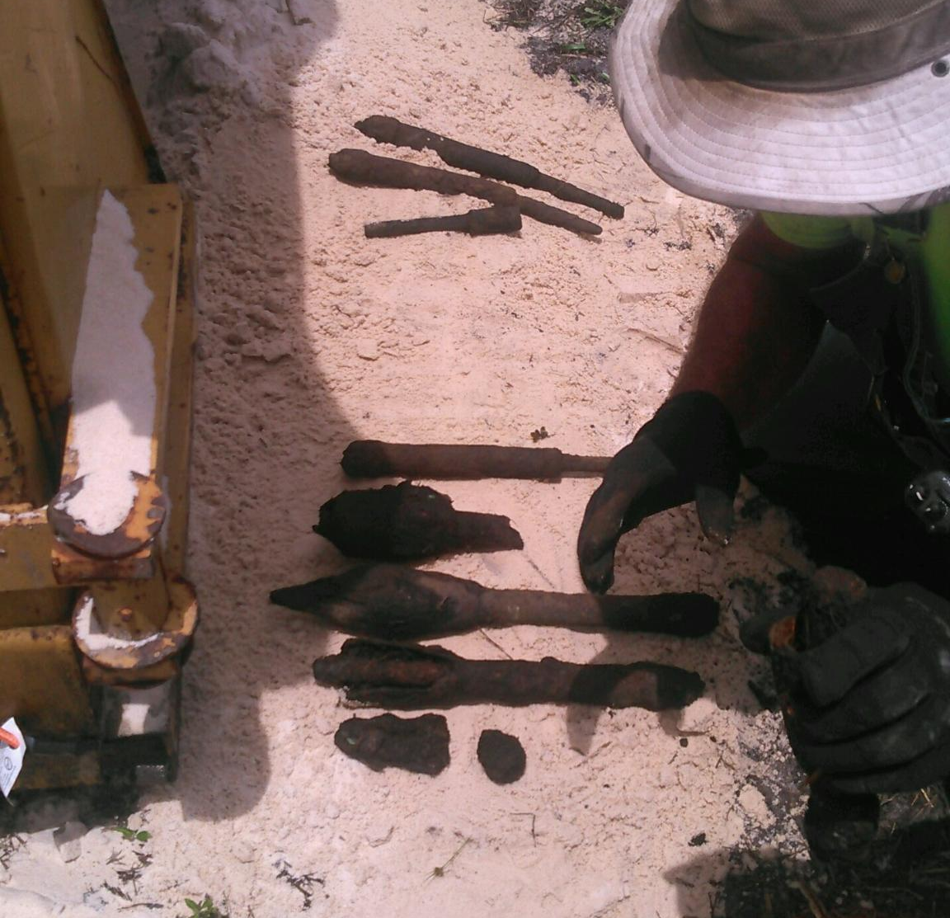
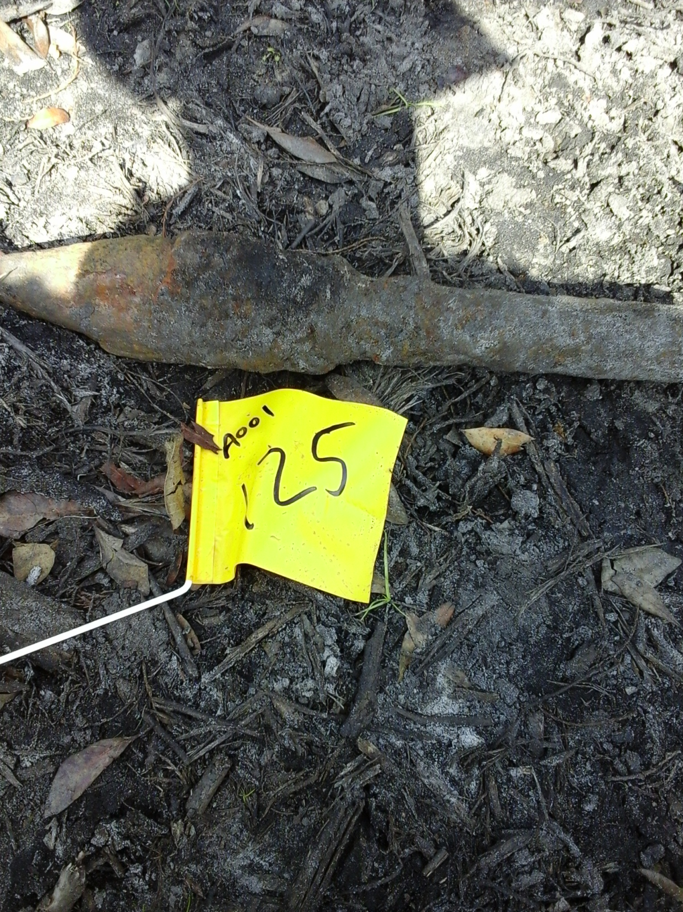
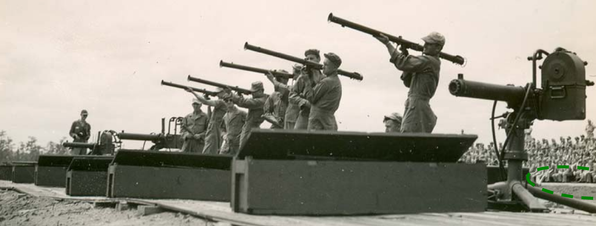
2.36 inch Rockets
(Bazooka)

Slide 25
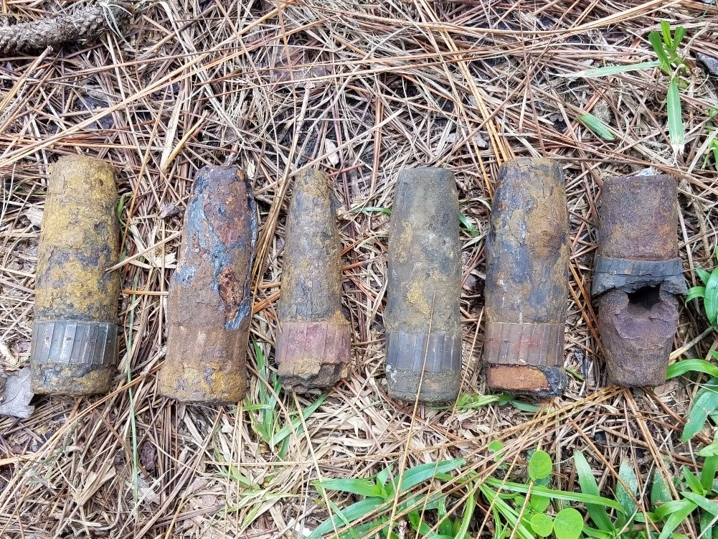
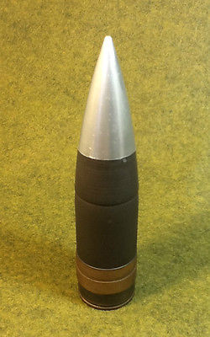
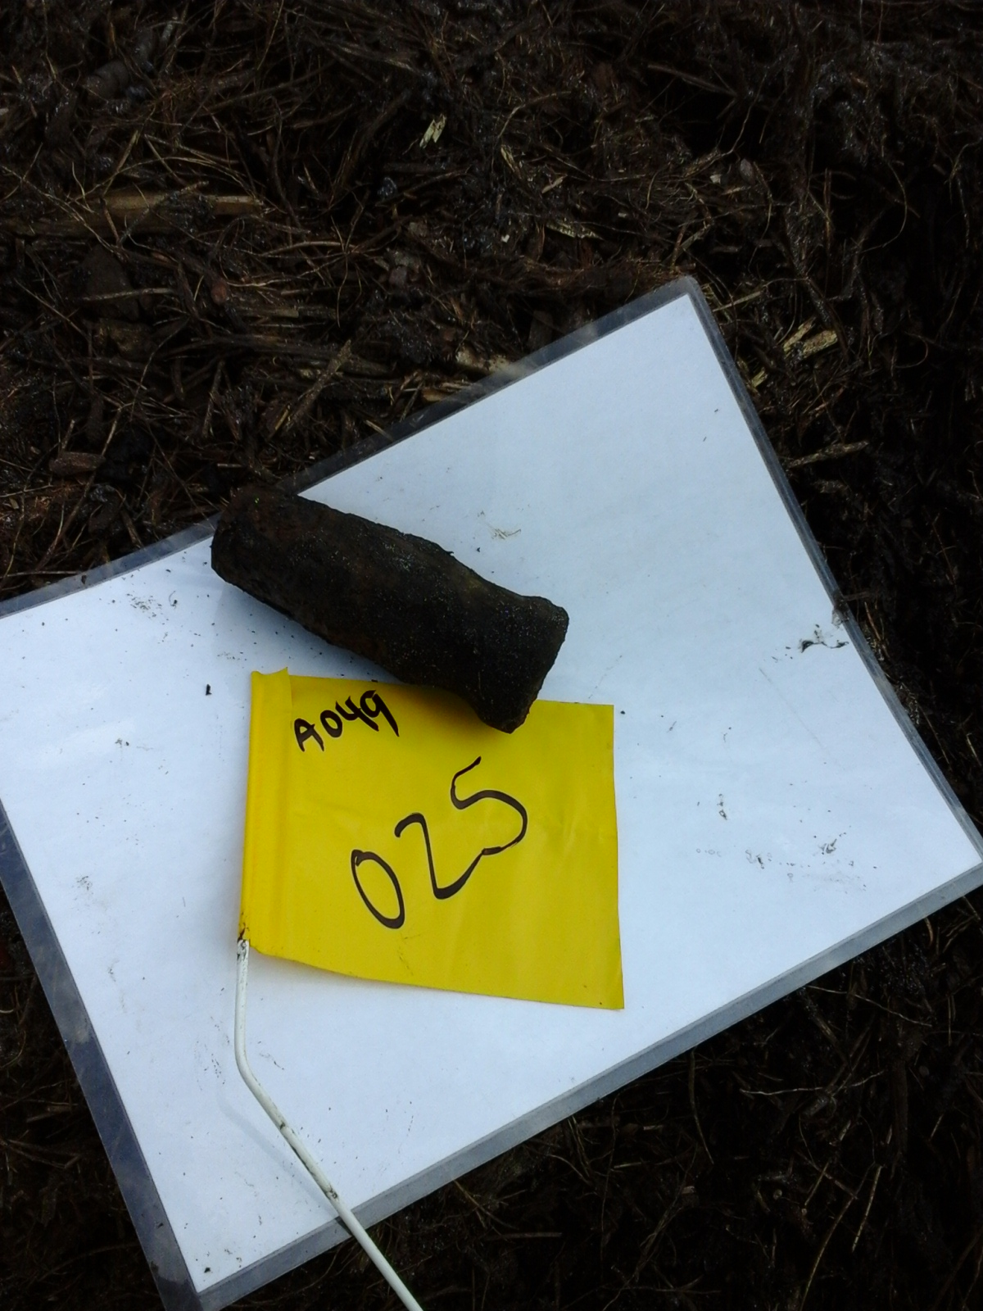
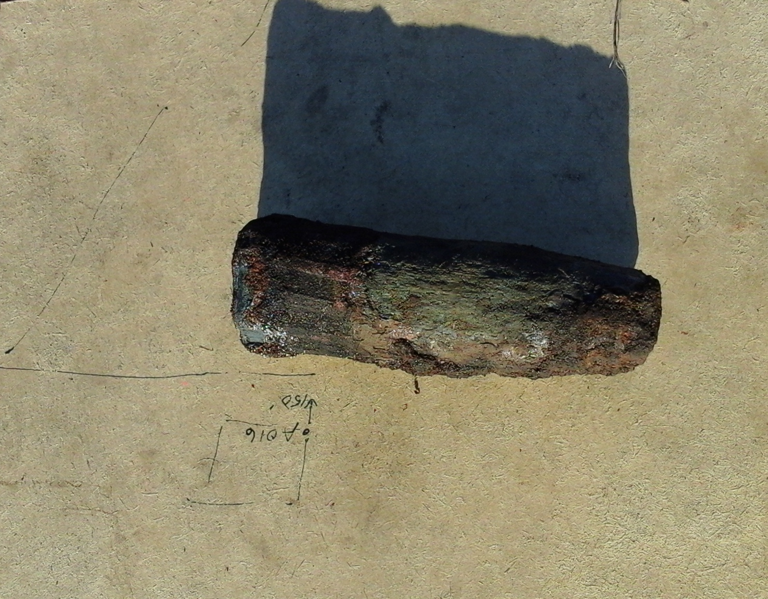
37mm Projectiles

Slide 26
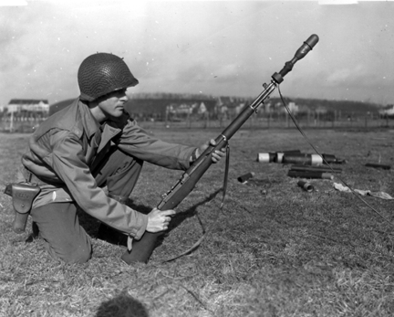
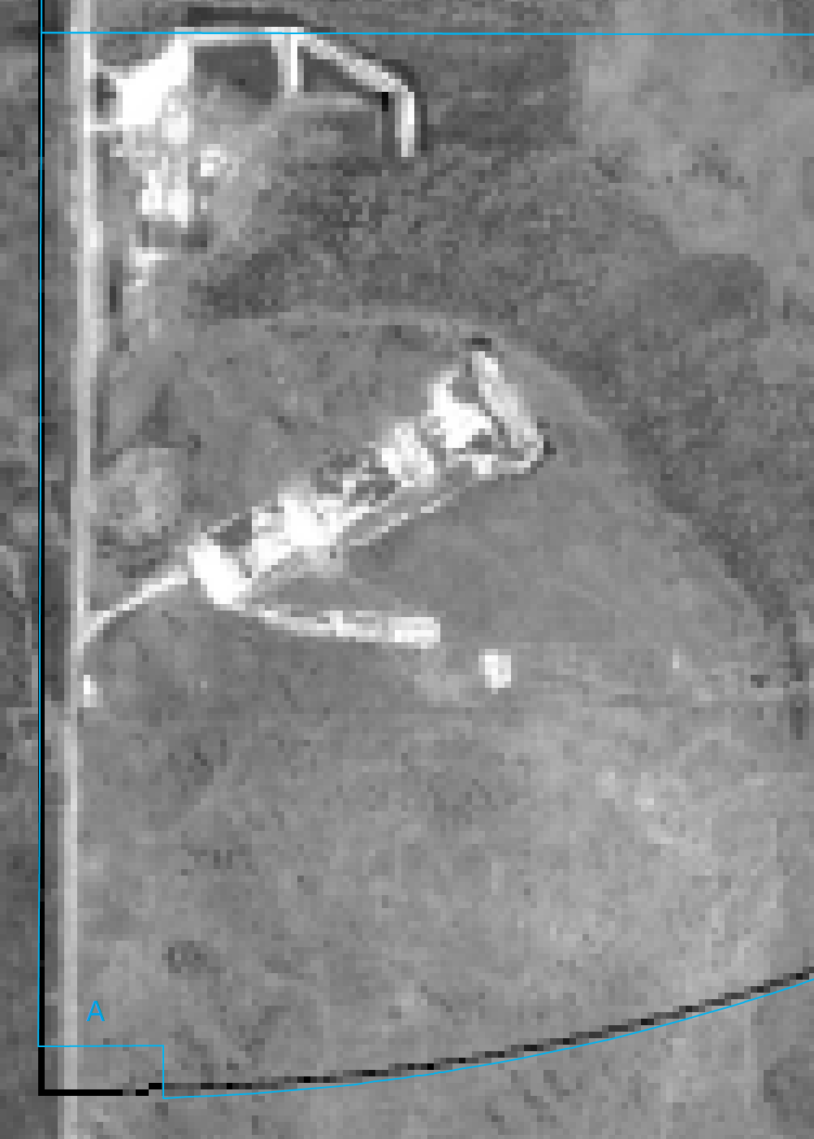
Rifle Grenades
Alpha Sector Rifle Ranges

Slide 27
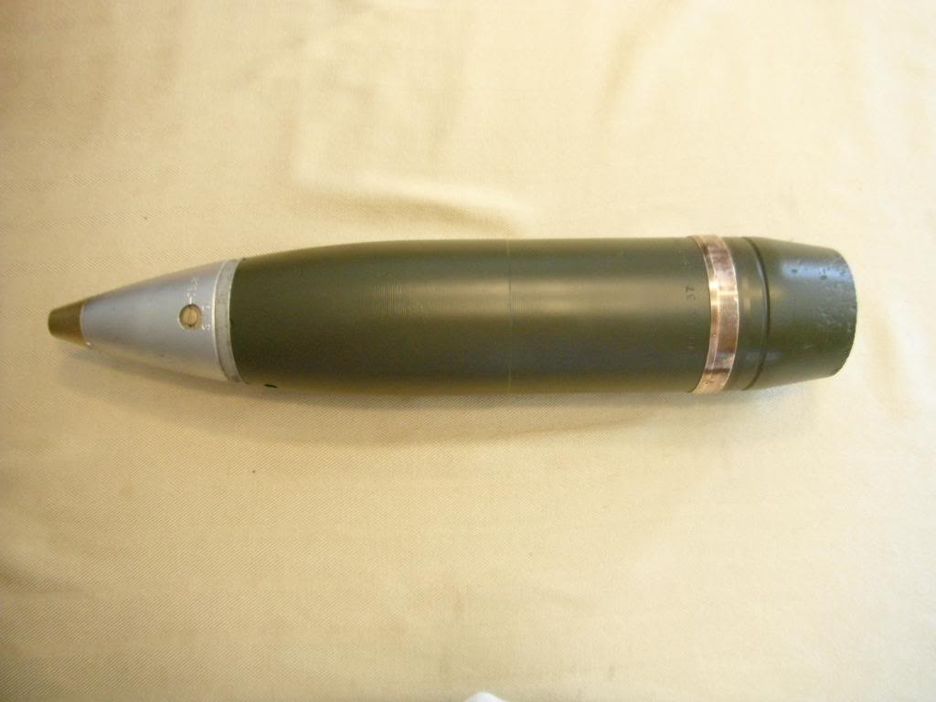
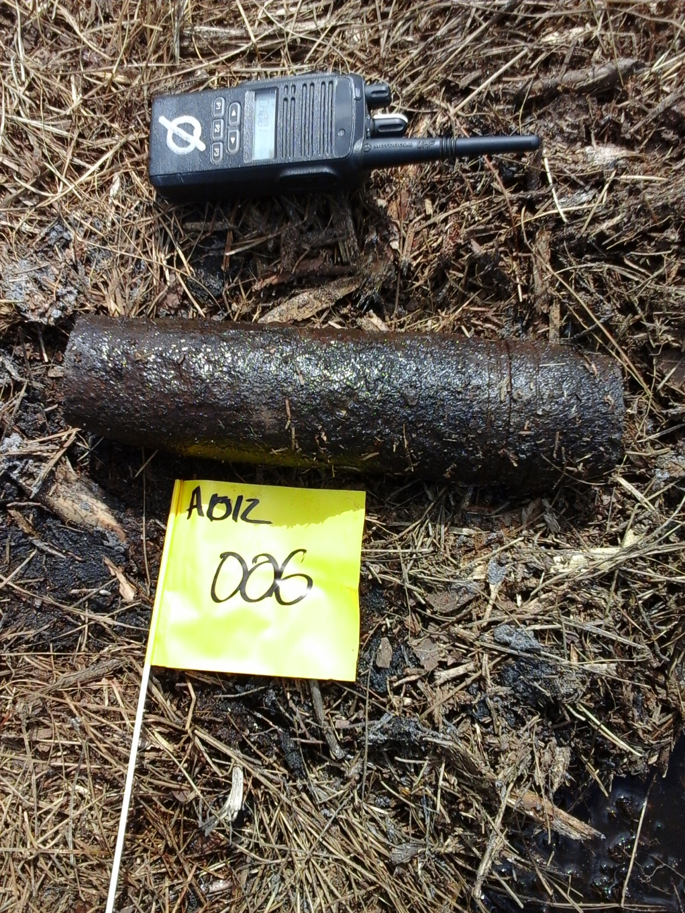
75mm Projectile
Fuze

Slide 28
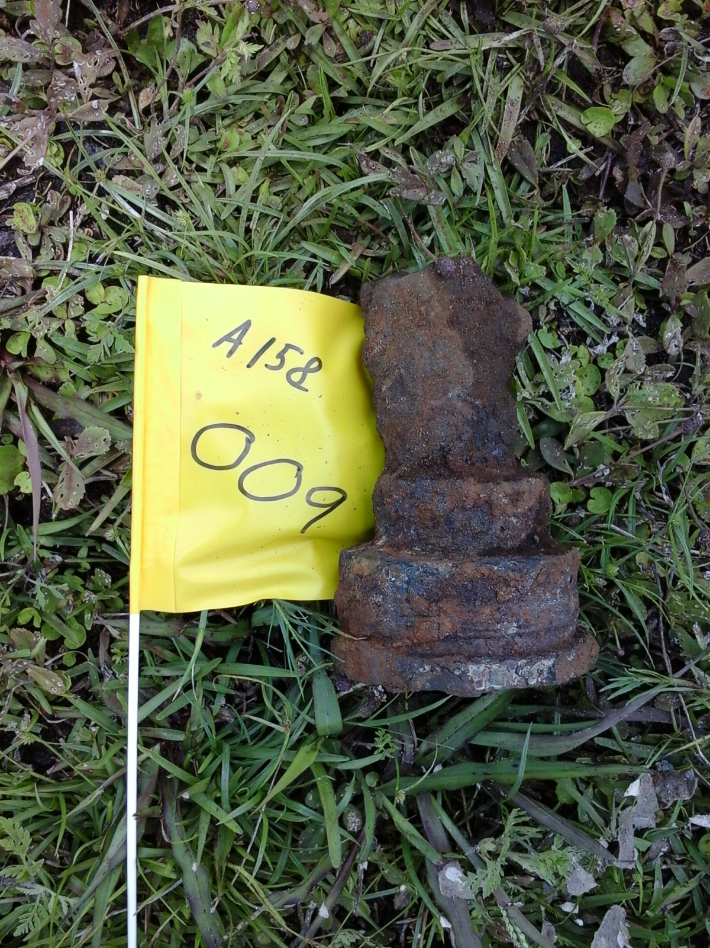
Aircraft Rockets
3.5inch warhead
5inch Rocket Fuze

Slide 29
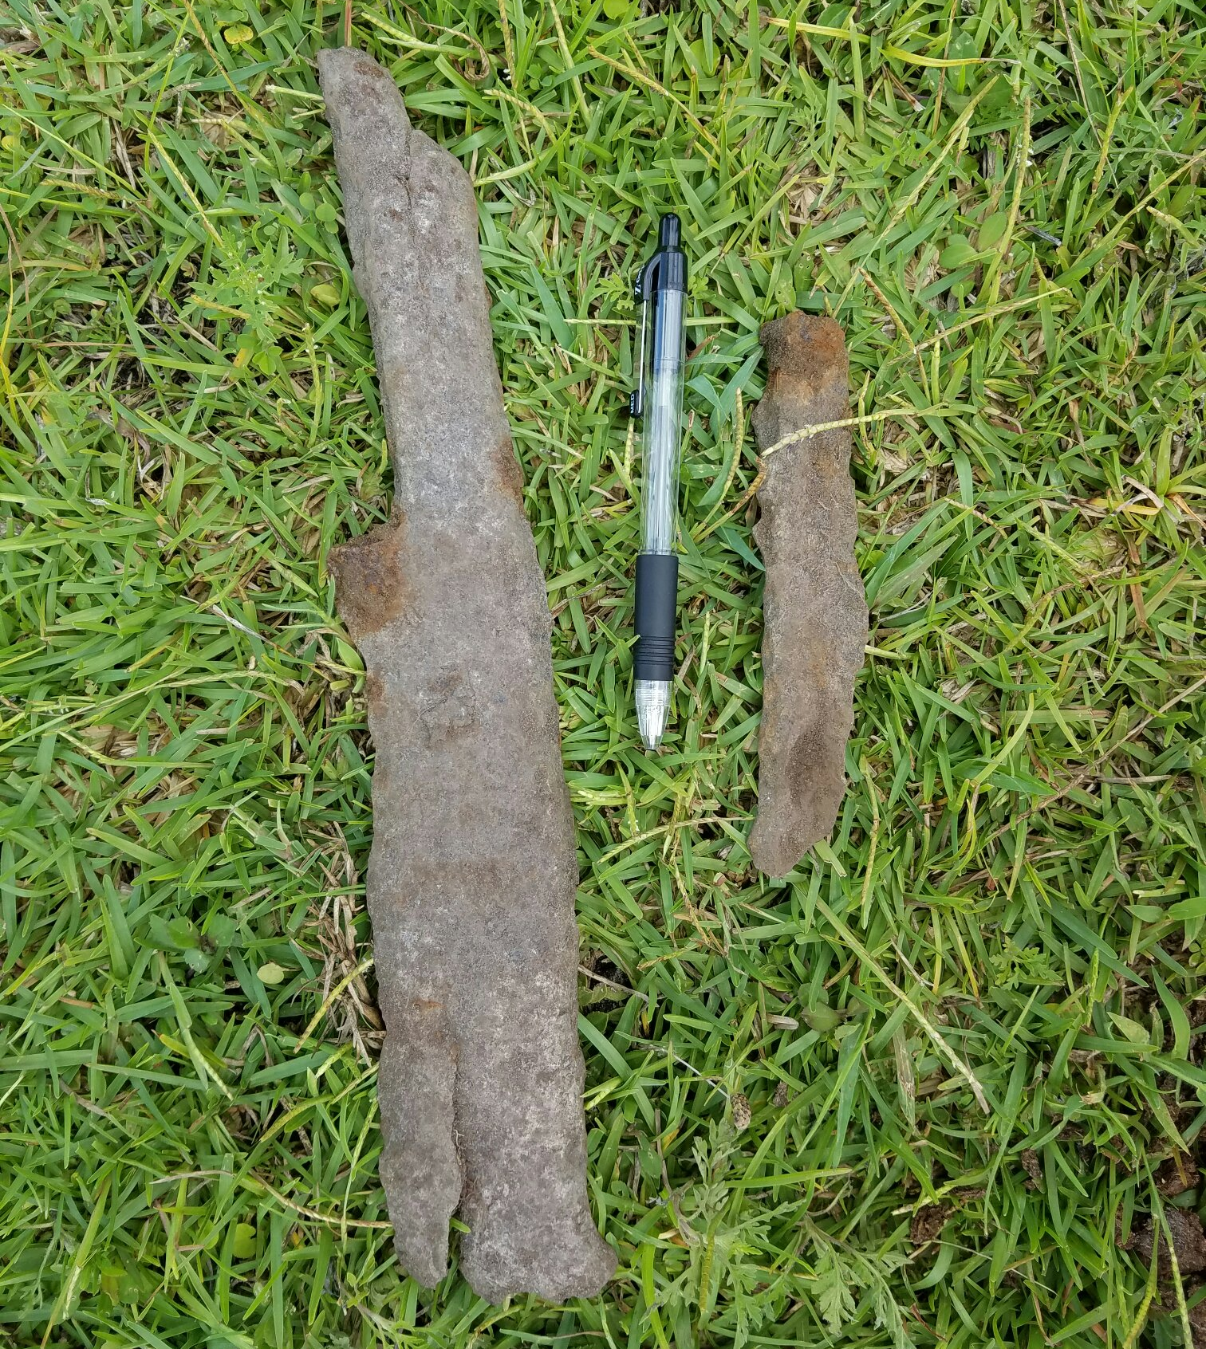
General Purpose Bomb Base Fuzes and Fragmentation
100 series Base Fuze
100 series Base Fuze
Fragmentation
250-LB General Purpose Bomb

Slide 30
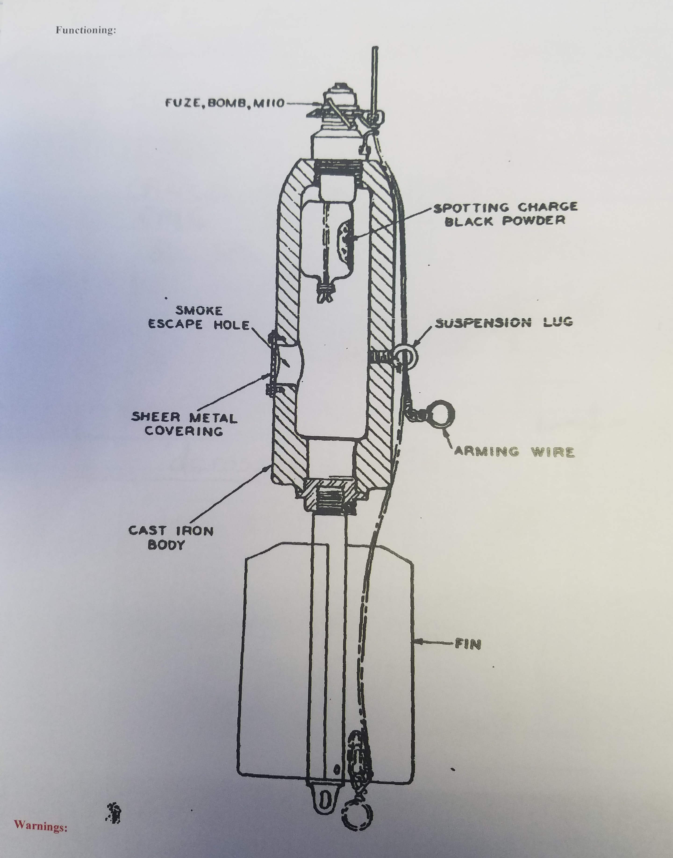
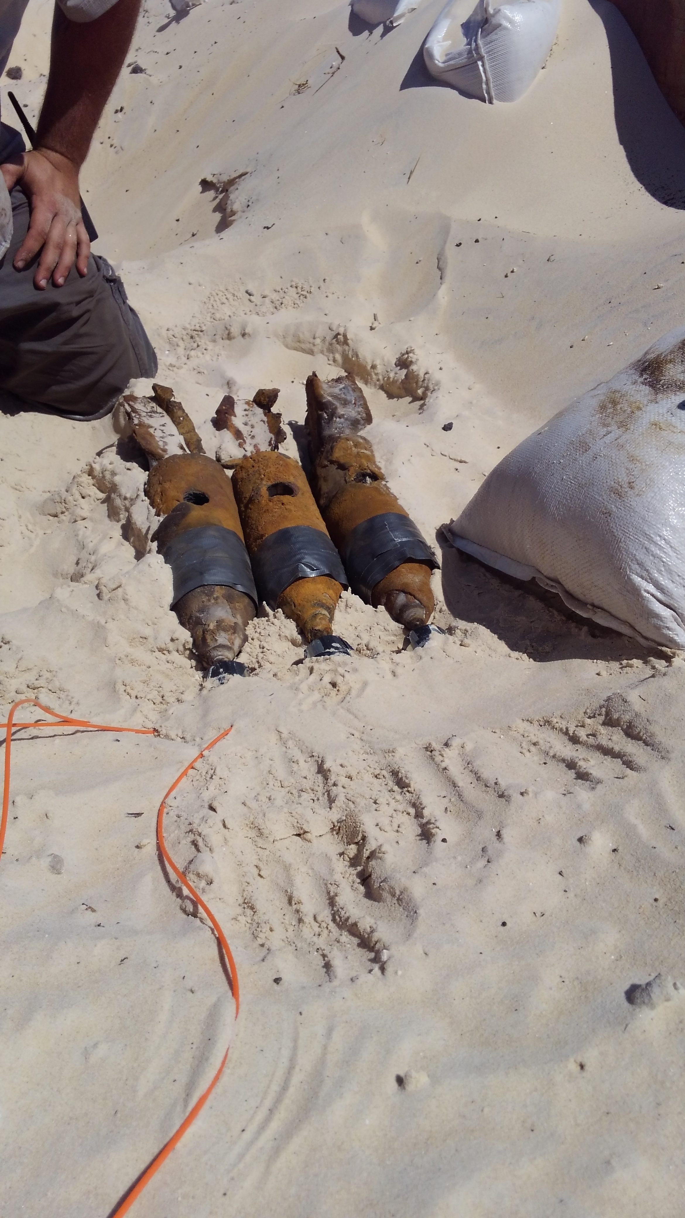

Slide 31
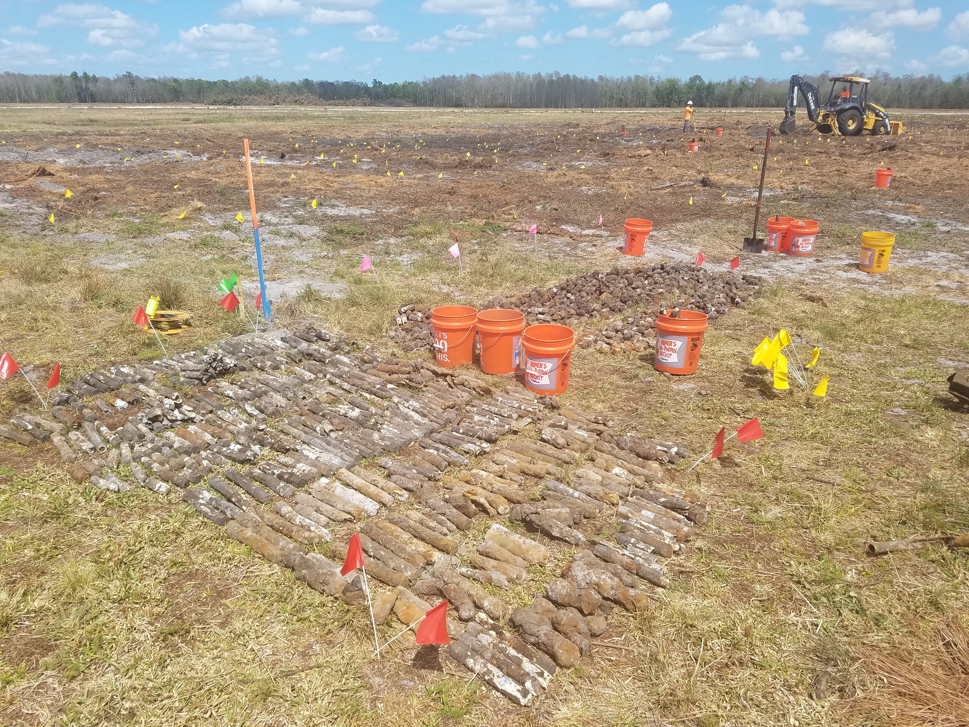
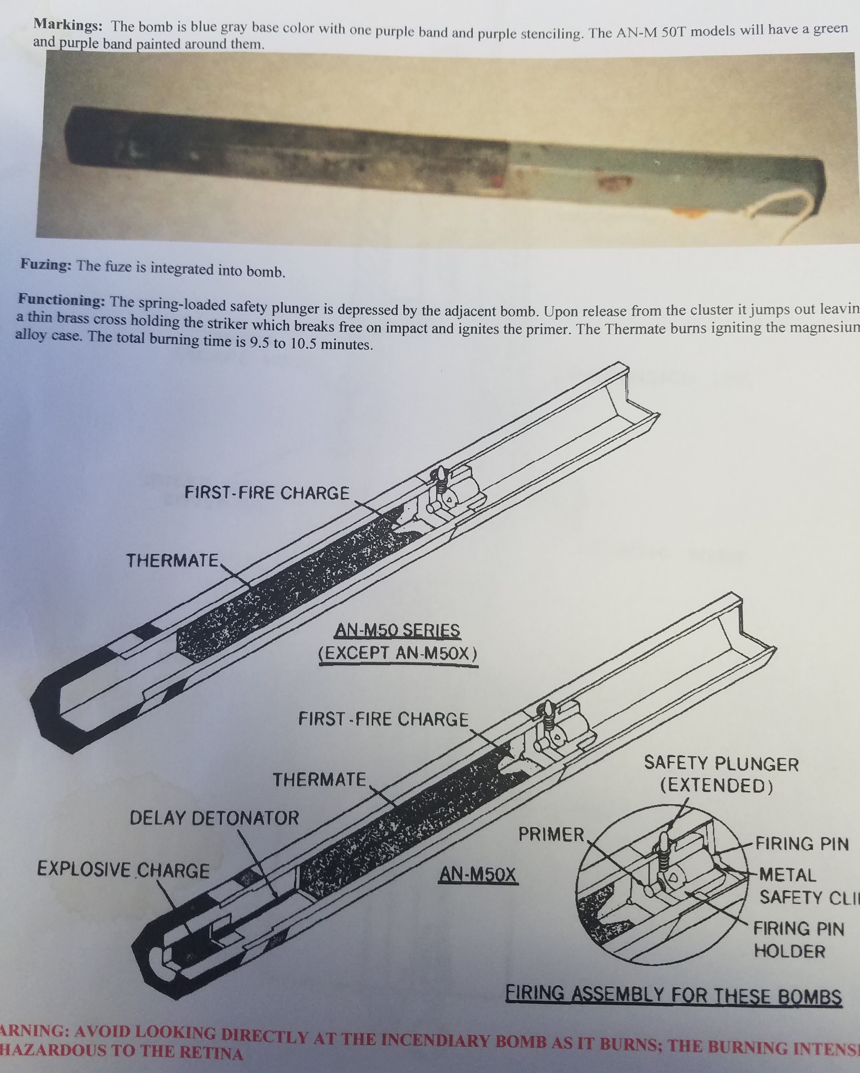

Slide 32
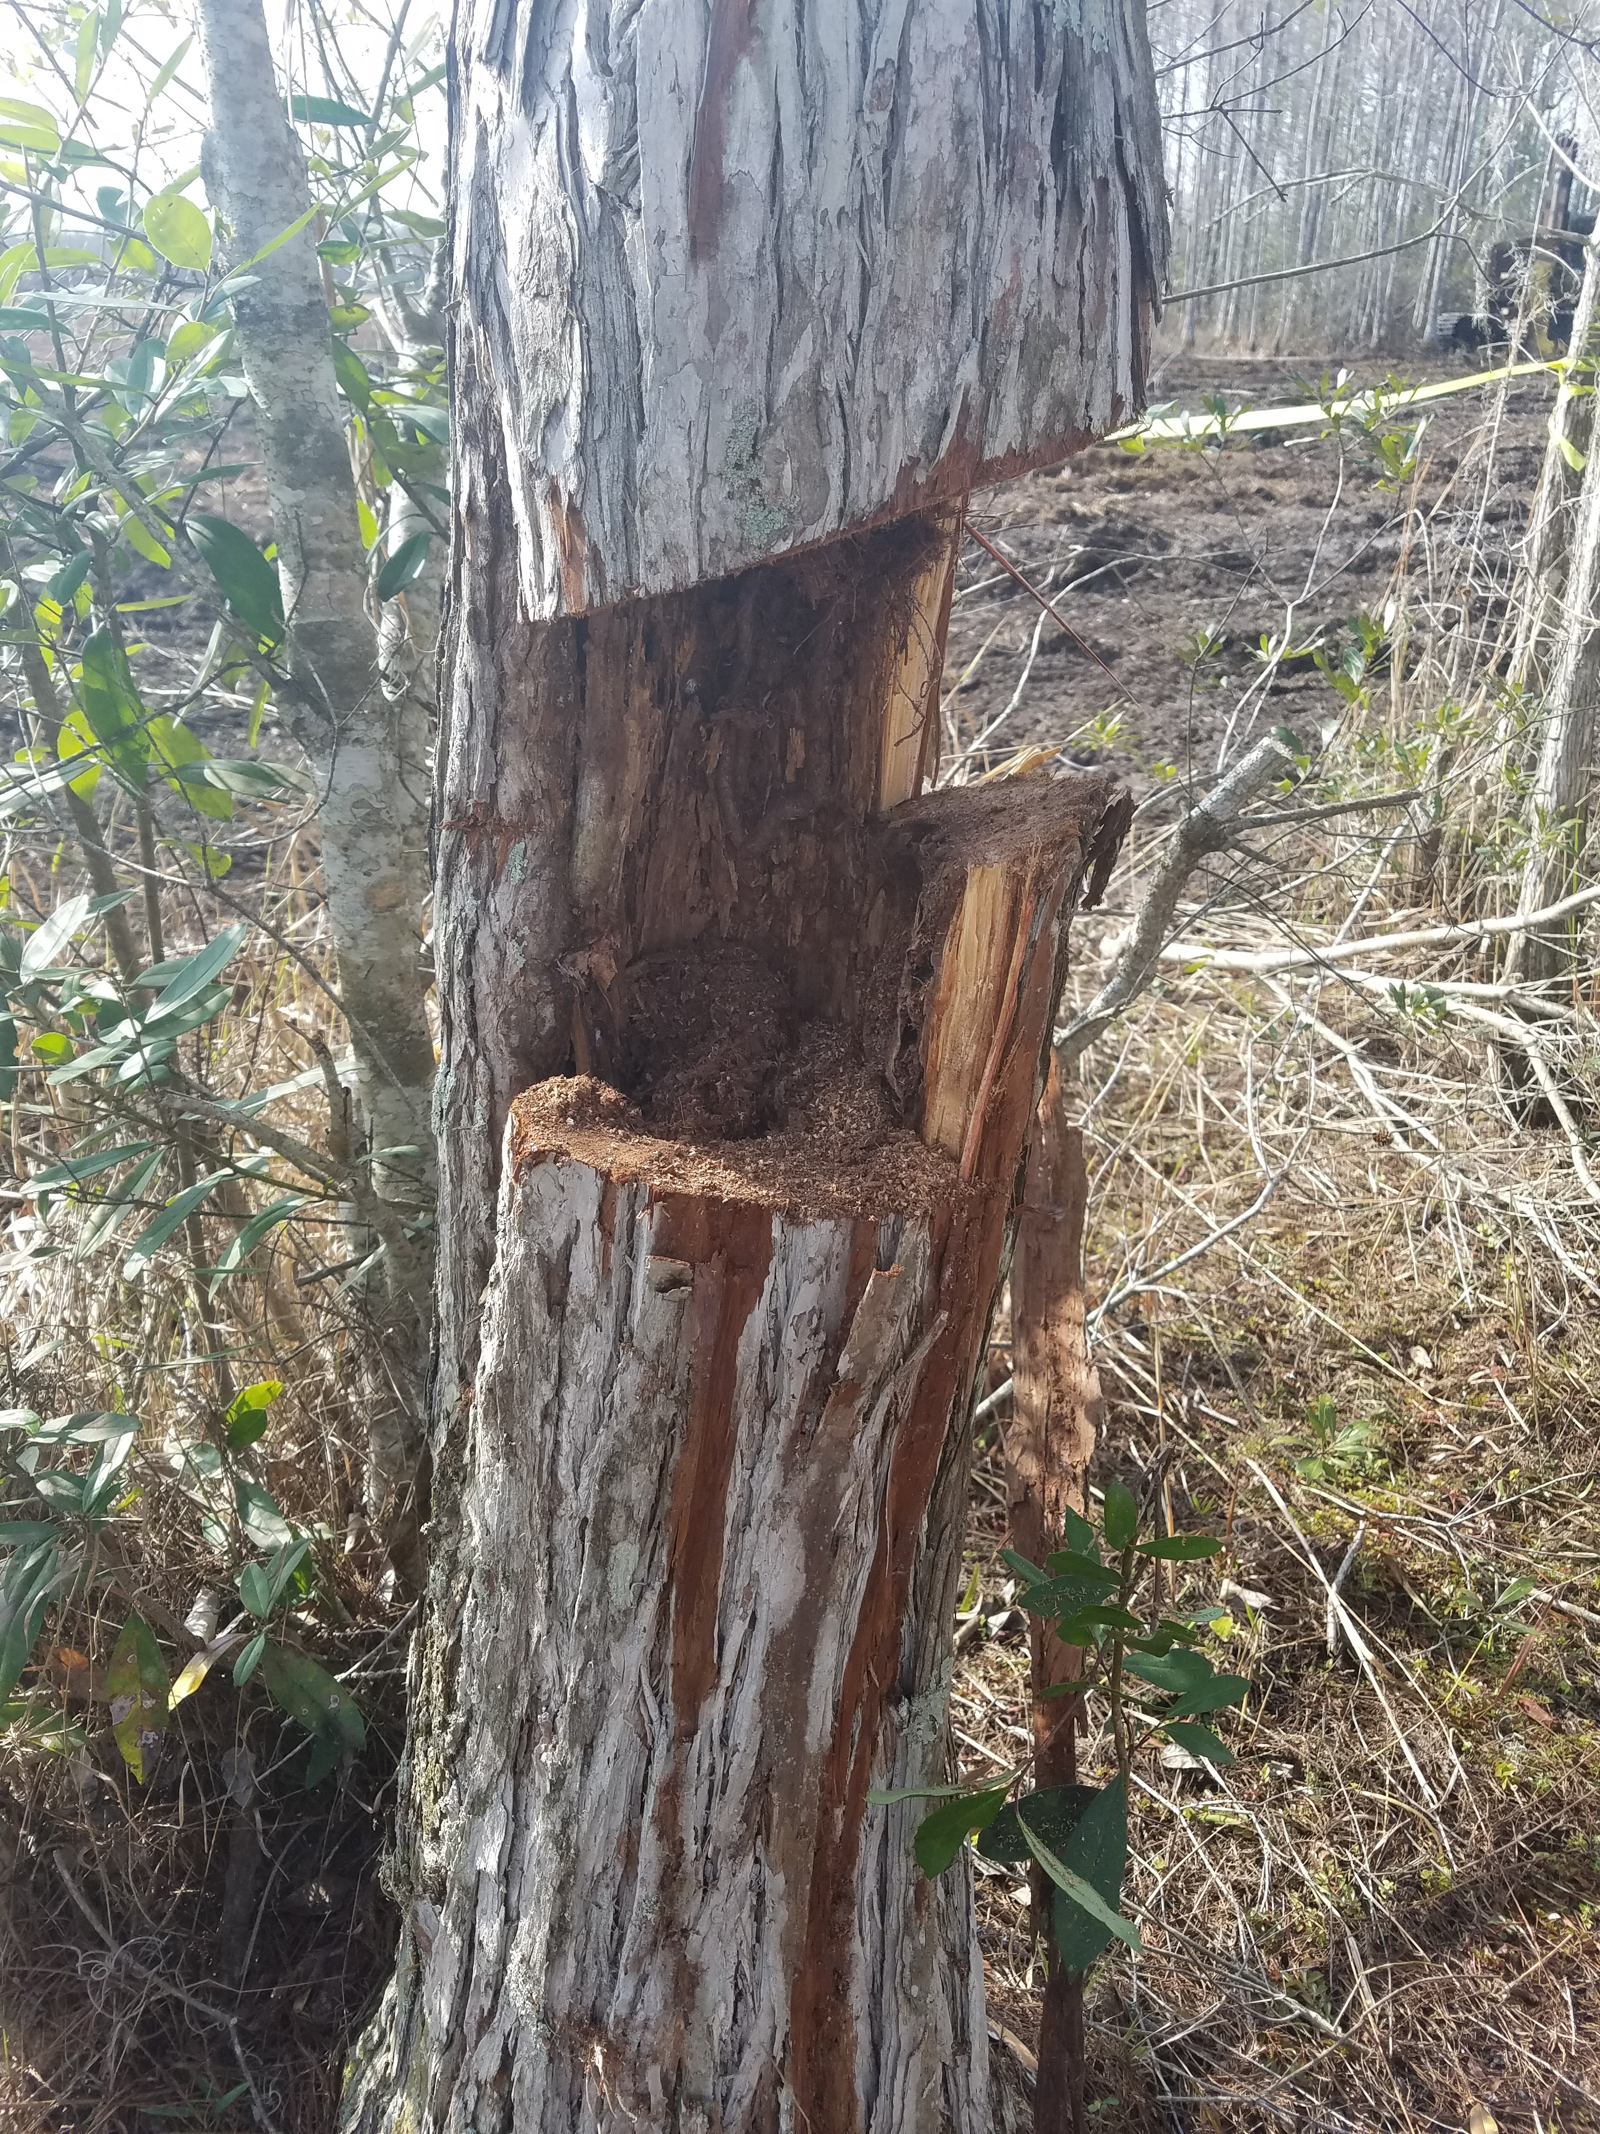
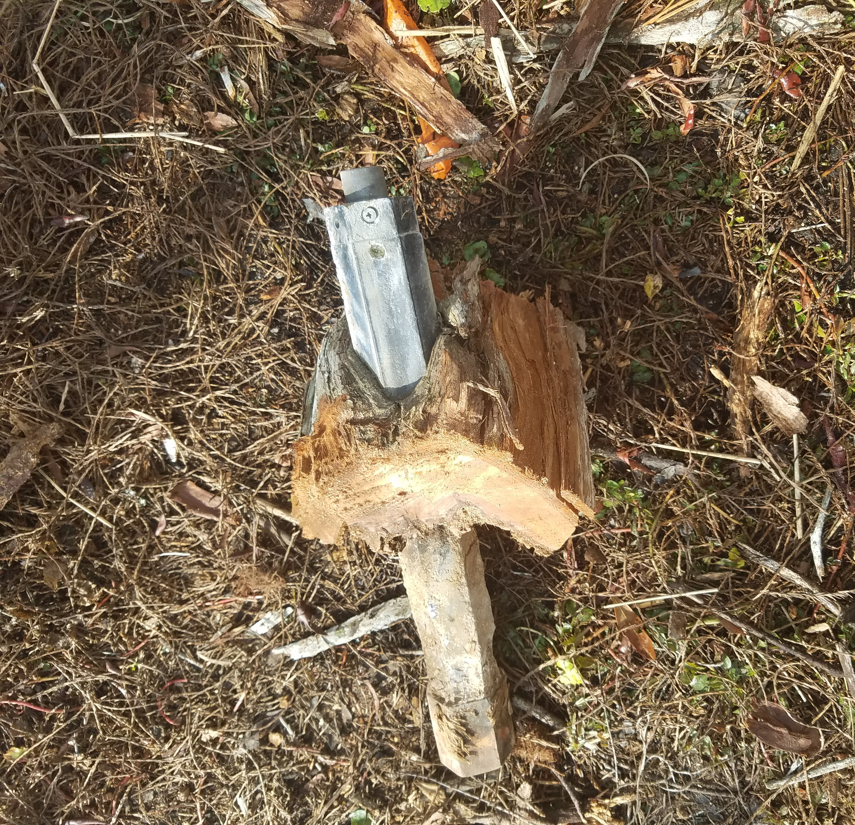

Slide 33
FOR PROJECT INFORMATION AND UPDATES VISIT WWW.VISTAPARK.INFO Thank you for your interest and participation

