Slide 1
Vista Park Remediation project update meeting

Slide 2
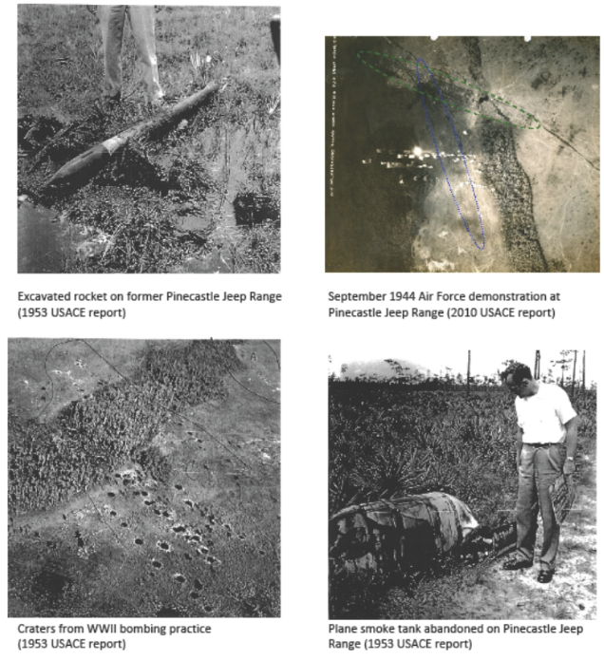
Historical images of munitions use on former pinecastle jeep range

Slide 3
Vista Park Site Marked With Munitions Remediation Sectors

Slide 4
VISTA PARK REMEDIATION: RESOLVING WWII-ERA ENVIRONMENTAL CONTAMINATION AND PUBLIC SAFETY RISKS

Slide 5
HOW WE GOT THERE
The contamination stems from military use of the property, part of the former Pinecastle Jeep Range, for a variety of munitions training and demonstration exercises during World War II.
In 2007, investigation and studies conducted by the U.S. Army Corps of Engineers (ACOE) identified hazards including bomb craters, munitions debris, and soils contaminated with explosive compounds.
The ACOE studied the site in 2008, but has not implemented any specific plan to remediate the full site. The ACOE has not committed to a date for remediation of any portion of Vista Park in the foreseeable future.
The Florida Department of Environmental Protection (FDEP) approved the Voluntary Cleanup Order (VCO) following the owner’s submittal of a detailed plan for the clearance process.

Slide 6
What you can expect
Neighbors will be fully informed on each primary phase of cleanup activity, so they know what to expect from the clearance process.
State government oversight of the UXO Remediation project. The FDEP, through its VCO, prescribes strict guidelines for the remediation and restoration process.
Neighbors will see equipment brought in to clear the land, as well as deliveries of scanning devices used to detect subsurface anomalies (potential MEC).
Future meetings, so the community can receive updates and provide input on the progress of the remediation efforts.

Slide 7
Preliminary Wetland Evaluations Used in Developing the FDEP Voluntary Cleanup Order
Researched historical databases including aerial photography; published wetland maps; USGS topographic surveys
Field delineated all wetlands and located by Global Positioning System
Conducted preliminary functional wetland assessments
Researched listed species databases for potential occurrence of Threatened and/or Endangered wildlife species or Species of Special Concern
Coordinated with Project Team on techniques for UXO (munitions) sampling in wetlands, and post remediation
Evaluated potential wetland restoration approaches
Coordinated wetlands evaluations and procedures with Florida Department of Environmental Protection (FDEP)

Slide 8
Wetland Requirements associated with the FDEP Voluntary Cleanup Order
FDEP site review completed site-wide prior to initiation of work
Baseline Uniform Mitigation Assessment Method Evaluation (UMAM) & FDEP review completed site-wide prior to initiation of work
UMAM analysis of proposed wetland impact area completed site-wide prior to initiation of work
100% gopher tortoise survey to be completed by sector and any gopher tortoises will be relocated following Florida Fish and Wildlife Conservation Commission permitting criteria
FDEP Notice of Commencement to be completed by sector
Water bird nesting colony survey to be completed by sector
Florida sandhill crane survey to be completed by sector
FDEP site review to be completed by sector
FDEP post-remediation review and mitigation debit analysis to be completed by sector
Upon issuance of the NFA determination, all necessary submittals will be made to obtain issuance of the Site Rehabilitation Completion Order

Slide 9
SITE WIDE PRE-REMEDIATION

Slide 10
SITE WIDE REMEDIATION PROCESS SECTOR BY SECTOR

Slide 11
Vista Park Site Marked With Munitions Remediation Sectors

Slide 12
SITE WIDE REMEDIATION PROCESS SECTOR BY SECTOR

Slide 13
SITE WIDE POST-REMEDIATION

Slide 14
Vista Park UXO Remediation Process

Slide 15
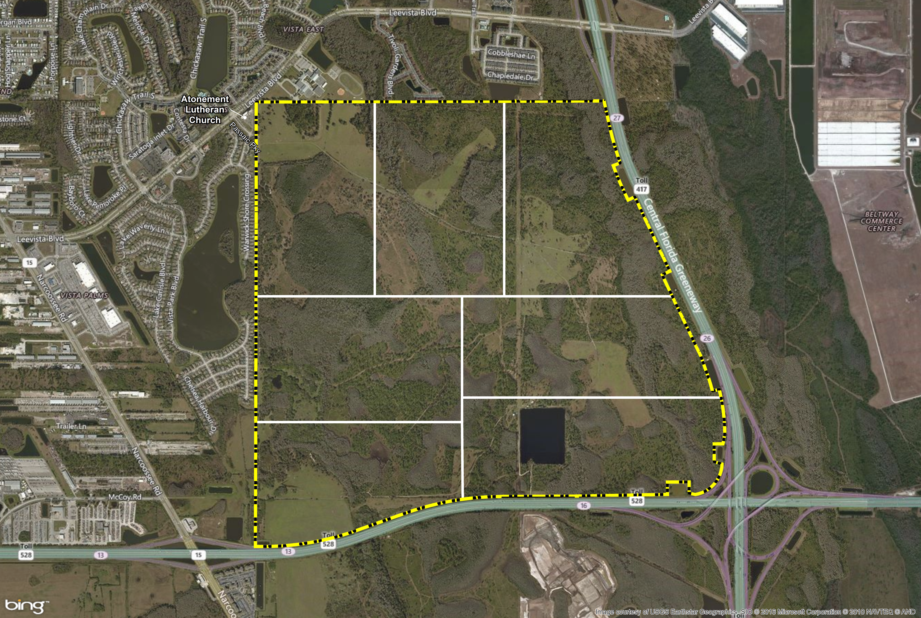
PROJECT LAYOUT
Specially trained technicians perform safety sweep of surface and shallow subsurface of all sectors.
Thick brush cleared with remote-controlled equipment.
Buffalo Restoration marks corners of 66m by 66m grids across the project site.

Slide 16
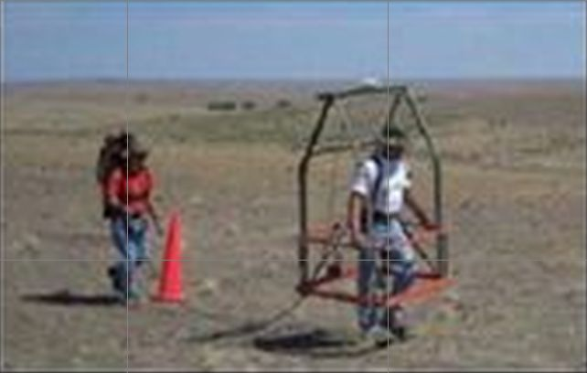
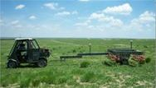
ADVANCED DETECTION EQUIPMENT
Buffalo Restoration uses geophysical mapping equipment to locate and map surface and sub-surface metal items.
Locations of metal anomalies (potential munitions or explosives of concern, or “MEC”) are identified for appropriate excavation, identification/classification, treatment/detonation as necessary, and disposal.
Quality control is assured by geophysically re-mapping randomly selected areas throughout the course of Buffalo Restoration work, to assure that equipment is accurately detecting subsurface anomalies.

Slide 17
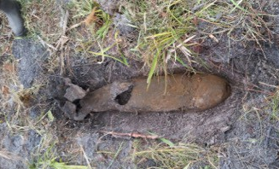
CHARACTERIZATION, TREATMENT/DETONATION AND DISPOSAL
Technicians identify anomaly items for removal.
Intrusive Team inspects/characterizes each anomaly
item.
Detonation of anomalies identified as MEC will be conducted in accordance with requirements of the FDEP-approved VCO and 62-730.320, F.A.C.
Planned detonation will be scheduled at noon on Thursdays, unless weather requires postponing until noon on Friday.
Anomalies classified as MEC which are not safe to move may be detonated where they are discovered (BIP). Such detonation events may, of necessity, be conducted at times other than the regularly scheduled times.
Notice of any necessary BIP treatment event will be posted to the Project website as soon as possible.
All detonation events will be strictly managed to minimize off-site noise or ground vibration.

Slide 18
PROJECT ENVIRONMENTAL SAMPLING PLAN COMPLIANCE
Project Environmental Sampling Plan (ESP) (approved by FDEP effective May 2, 2016) provides methodology for sampling collection and data analysis, to establish:
Background concentrations for FDEP-identified contaminants of concern (COC).
Evaluation criteria for all relevant media (groundwater, sediments, surface water, and soils) potentially contaminated by MEC or the detection/extraction process.
Decontamination “action levels” for all identified COCs.
Requirements for reporting to and coordination with FDEP.
Buffalo will comply with all ESP requirements, and compile all compliance documentation in periodic Area Specific Completion Reports.

Slide 19
COMPLETION REPORTING
Throughout the project as sectors are completed, Area Specific Completion Reports will be submitted to the FDEP for review and approval. Upon the completion of all sectors, a Final Completion Report will be submitted for final FDEP approval. Upon completion of all approved MEC remediation and Site Rehabilitation work, and acceptance of Owner’s proof of purchase for all required mitigation credits, FDEP will issue its No Further Action determination for the Vista Park Site.

Slide 20
SITE WIDE REMEDIATION PROCESS SECTOR BY SECTOR

Slide 21
SITE WIDE POST-REMEDIATION

Slide 22
FOR PROJECT INFORMATION AND UPDATES VISIT WWW.VISTAPARK.INFO Thank you for your interest and participation

